Slide 1
Newspaper Report

Slide 2
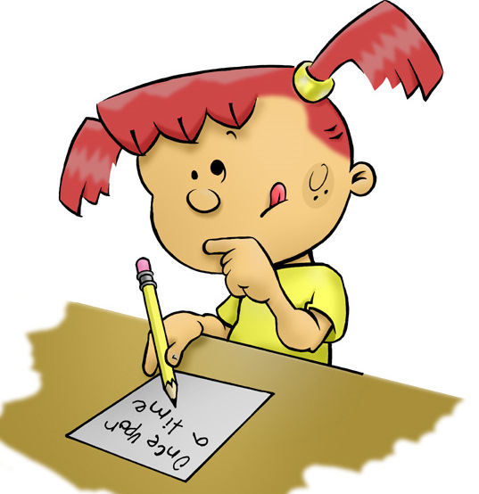
What is a newspaper and what is its purpose?
Notes:
In year 5, we have previously looked at newspaper reports. This was in the autumn term where children explored articles in depth before writing their own newspaper report based on WW1 (we used inspiration from our class read ‘Stay Where You Are and Then Leave’.
Since then, children have learnt a lot of new skills which would be beneficial to use in a newspaper article and there writing has improved a lot since autumn.
Children may be familiar with the expectations of a newspaper but would be useful for them to have a reminder ☺

Slide 3
Purpose of a newspaper
To inform the reader (in an entertaining way) of important current events or issues that are going on in the world.

Slide 4
Let’s have a look at one now…
A newspaper from the summer of 1914
How does this newspaper inform the reader (in an entertaining way) of important current events or issues that are going on in the world?

Slide 5
Features of a newspaper
Features are the ‘stuff,’ or the ‘things,’ or the ‘ingredients’ that go into a text to make it what it is.
For example, the features of a horror story would be a spooky setting, tense writing and an exciting event!
From reading this newspaper about the outbreak of World War One, what do you think the features of a newspaper might be?

Slide 6
Features of a newspaper
Headline
Byline
Opening – the 5Ws!
Time connectives and fronted adverbials
Relative clauses
Direct speech
Reported speech
Third person
Past tense
Closing

Slide 7
The opening – what’s the point?
Notes:
The following slides will break down the main sections in slightly more detail – get the children to think about the purpose of each.
The opening – short paragraph which often answers the 5 W’s (who, what, where, when and why). A newspaper doesn’t always have to answer all 5 but will give reader an overall idea of what the article is about/who it is about.

Slide 8
Driverless cars to be tested in London ahead of launch this Christmas
Driverless cars are to be tested on the streets of London this week as part of a plan to deploy the UK's first completely autonomous fleet on British roads by Christmas. A Government-backed committee will deploy cars to map the streets of Hounslow in West London to teach them to understand road signs and lane markings following successful tests in Oxford.
What?
When?
Where?
Who?
Why?
______________________________________________________________________________________________________________________________________________________________________________________________________________________________________
Notes:
An example for children to have a look at. They can identify which of the 5 W’s it answers. Is it effective? What 5 W’s will they definitely include in their article?

Slide 9
Why do newspapers use inverted commas (speech marks)?
Notes:
Children should instantly recognise that it is to show someone is speaking but we have moved beyond this. Why do they have to show people speaking? Why do they need speech in newspapers? There are no right/wrong answers but children should recognise newspapers want the views of others.

Slide 10
What is the essential checklist for direct speech?
“
ABC
writing the sentence
using closing punctuation ! ? ,
”
writing who said it and how it was said.
Notes:
Opening speech marks
Capital letter
The speech itself
Closing punctuation
Closing speech marks
A synonym for said and who said it

Slide 11
What is reported speech?
Reported speech is when we tell someone what someone else has said but we don’t report it word for word.
Notes:
This is another type of speech we have looked at. In newspaper reports, they can use either or both.

Slide 12
Reported speech checklist
a noun or pronoun for the third person.
a verb that means ‘said.’
the word ‘that.’
the past tense.
Notes:
E.g. Miss Nicholls reported that 5N were the best class she has taught.
Make sure that children do not think that this has anything to do with the subjunctive verb form because reported speech often needs the word ‘that.’ It doesn’t have anything in common with subjunctive.

Slide 13
Speech Word Bank
Synonyms of ‘said’ |  | Adverbs
announced claimed declared remarked replied stated suggested told fumed joked screamed shouted added commented recalled revealed answered described explained reckoned blurted questioned |  | Don’t forget that you can use adverbs that start with the word ‘with’ or ‘in’ followed by the word or root word from the list below. (Warning: doesn’t work with all of them)!
 |  | gleefully honestly nervously politely quickly rudely seriously bravely eagerly inquisitively kindly merrily angrily brightly defiantly happily irritably sharply anxiously boastfully cheerfully dramatically speedily unexpectedly
Notes:
A list of synonyms for said and useful adverbs that can support this.
Children cannot pick any random synonym, it must have a purpose/fit the context of the speech

Slide 14
Features of a newspaper
Headline
Byline
Opening – the 5Ws!
Time connectives and fronted adverbials
Relative clauses
Direct speech
Reported speech
Third person
Past tense
Closing

Slide 15
Your task today will be to write a newspaper article on a topic of your choice. Before you start writing, you need to produce a small plan to help jot down your initial ideas, so you have a structure when writing.
On the following slide will be suggested topics that you may wish to write about.
You may wish to include a photo and caption.
Suggested structure:
Opening paragraph (5 W’s)
Paragraph one
Paragraph two
Paragraph three
Closing paragraph
Your plan can be either notes or verbally to an adult or a sibling.
Notes:
The suggested structure is not one they have to follow – they may have more or less paragraphs but I would rather children focus on the quality of their writing as opposed to the quantity.

Slide 16
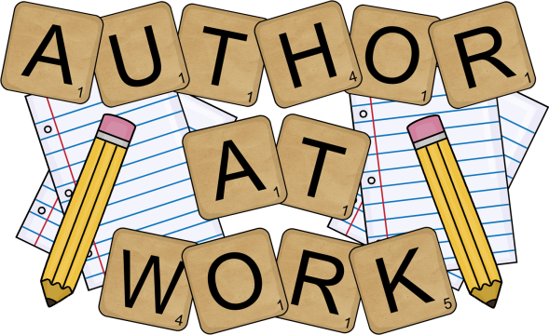
Possible topics for your newspaper article.
The government are only serving healthy food at lunch (including no pudding except fruit).
WW1 (you showed a great understanding of this).
A sports team having their first win in over 10 years.
The Wright Brothers create the first successful aircraft.
Notes:
This is not a limited list. Children to pick a topic they can write a strong newspaper article about.
Please encourage them to use both reported and direct speech as this is a skill they need to develop further.
Also, I would love to see any completed newspapers – I really do miss their work!

Slide 17
Things to consider
Opening paragraph – This can be straight to the point but must make the reader want to read on (you can not literally answer the 5W’s).
Main point paragraphs – New point – new paragraph. Remember to vary your use of direct and reported speech. You want to discuss the main events that have already happened (hence the past tense).
Closing paragraph – You want to update the reader on where the situation is currently at. Remember, if you are writing about something that has already happened, pretend to be in that moment (as you can see in the example).
Write your newspaper article in your green book. You may want to draw lines or stick lined paper in to make sure that your writing is neat.
Notes:
Remember to leave a space for your photo/caption if you decide to include one.
Children should be encouraged to use their year 5 skills where appropriate – complex sentences, prepositional phrases etc.

Slide 18
Does it make sense?
When you’re happy with it, read your story to someone in your house.
Did it persuade them?

