Slide 1
The focus for reading this week is prediction.
This is where we will think about what might happen next or what something might be about.
A reading clairvoyant uses their knowledge about what has already happened to help them predict what could happen in the future.
Read chapter one from the fiction text. Then, carefully answer the questions. Remember to check your answers by scanning back through the text. Your predictions should be backed up using evidence from the text.

Slide 2
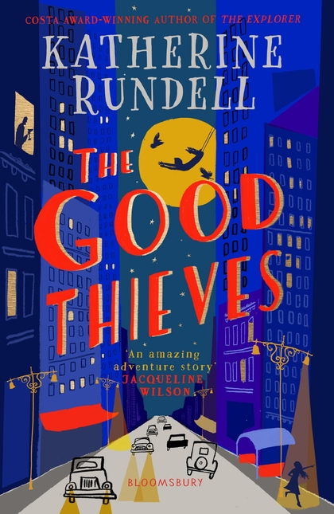
Have a look at the front cover →
Think about & answer the following questions:
What do you think the book will be about? Why?
What clues do the pictures have? Where might it be set?
How might the title link in with the plot/storyline?
‘Thieves’. How many people do you think this might refer to?
There are no right or wrong answers as these are just your thoughts based on what you can see ☺
Notes:
This is the front cover of the book they will be reading and answering questions from today.
Front covers are a great way to practice prediction when looking at a text for the first time.
These are just the children’s initial thoughts – a good way to get them thinking before. If reading with them, please question their thoughts (not as though they are wrong) so they can get used to explaining/elaborating on their answers.

Slide 3
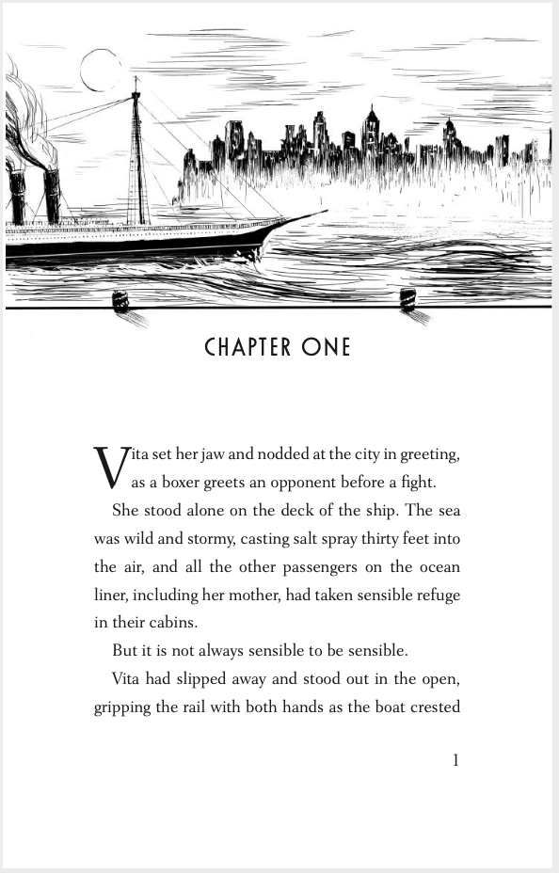
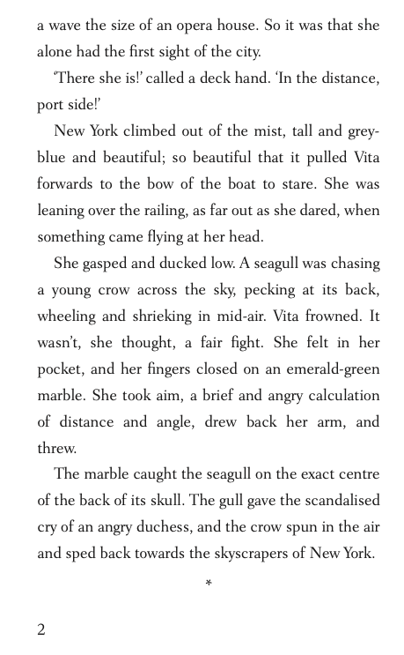
Notes:
Children have already had a go at practicing their prediction skills from the front cover. There will be less questions than normal due to the nature of the skill but the emphasis should be placed on children explaining/discussing their answer. For example, if there is a multiple-choice question, whether they pick the right or wrong answer, encourage them to share their reasons for picking that answer.
When writing their own predictions, children must use evidence from the text to justify their reasons.

Slide 4
1. Look at page 1. Based on the text you have read, do you think Vita or her mother will be sensible?

Slide 5
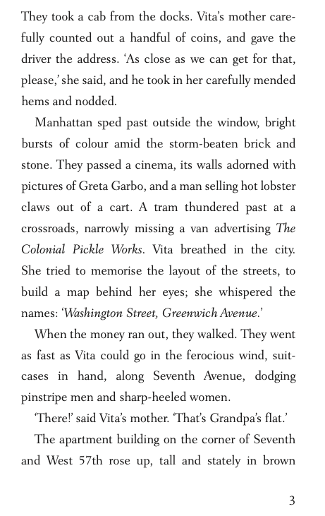
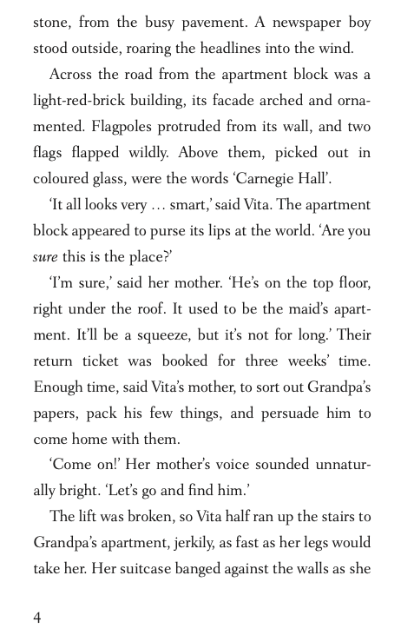

Slide 6
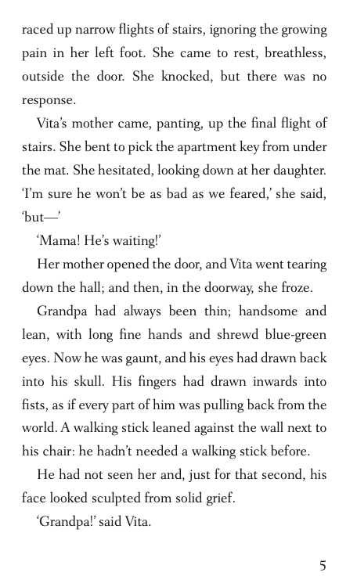
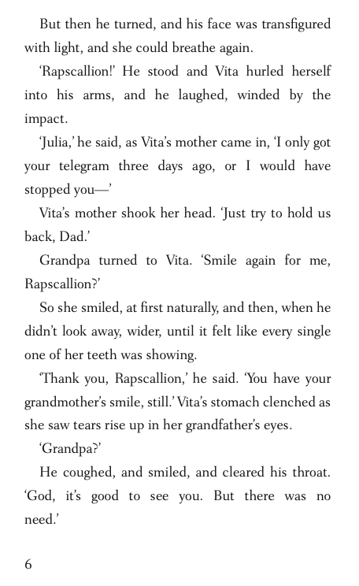

Slide 7
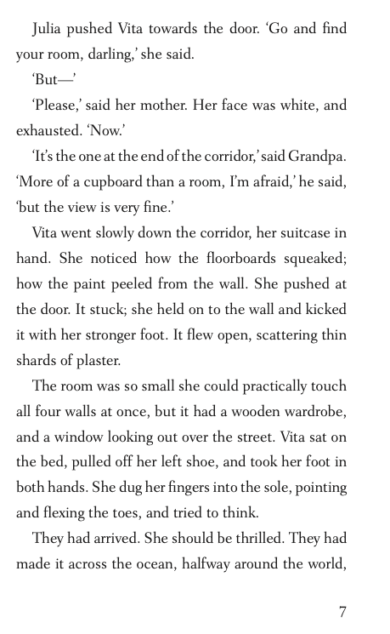

Slide 8
2. Look at the text you can see on page 7. Do you think Vita will go to her room? Tick one.
Yes because her Mother asked her.
Yes because her Grandpa has explained where her room is.
No because she wants to stay with Mother and Grandpa.
No because she has only just got there.

Slide 9
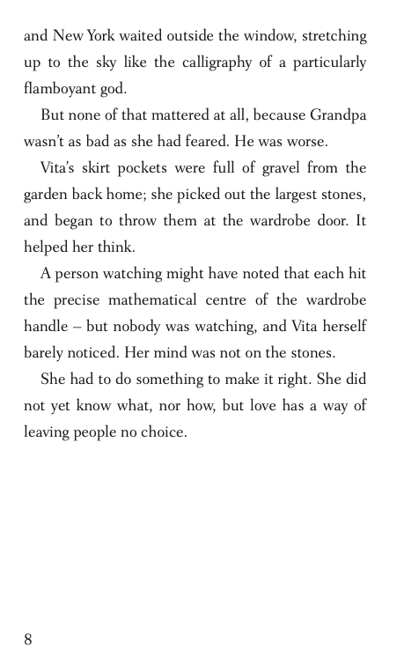

Slide 10
Based on what you have read, what do you think will happen next? Use evidence from the text to support your answer.

Slide 11
The Good Thieves
Look at page 1. Based on the text you have read, do you think Vita or her mother will be sensible?
I think they wont be sensible as it says ‘but it is not always sensible to be sensible’ which suggests they might do something risky.
Look at the text you can see on page 7. Do you think Vita will go to her room? Tick one.
Yes because her Grandpa has explained where her room is.
Try to discuss this answer with the children. It seems that from what we have read so far, both Vita and her mother have a lot of love and respect (and also worry) for Grandpa and Vita wouldn’t want to upset him.
Based on what you have read, what do you think will happen next? Use evidence from the text to support your answer.
There is no specific answer for this as children can have different predictions if what they have wrote is accurately backed up by evidence from the text. E.g. I think Vita will find a way to make money so that she can help her Grandpa get better and fix his house. I think this because it says Grandpa wasn’t as bad as she had feared. He was worse. It also says that she knew she had to do something to make it right but makes a reference to love which suggests she would be willing to take a risk for the love and care she has for her Grandpa.
Notes:
Children have already had a go at practicing their prediction skills from the front cover. There will be less questions than normal due to the nature of the skill but the emphasis should be placed on children explaining/discussing their answer. For example, if there is a multiple-choice question, whether they pick the right or wrong answer, encourage them to share their reasons for picking that answer.
Normally the children would have the text printed in front of them or be able to scan with their fingers directly. I would encourage the children to identify the key words in the question and understand what the question is asking them to do. These are all about what might happen next but are phrased in different ways.
When writing their own predictions, children must use evidence from the text to justify their reasons.

