Slide 1


Year 5/6 word list
soldier
A person who fights for their country or beliefs.

Slide 2
Year 5/6 word list
stomach
The internal organ in which the major part of the digestion of food occurs.

Slide 3
Year 5/6 word list
suggest
put forward for consideration; recommend

Slide 4
Can you think of any words that end in the suffix ‘tion’ or ‘ation’?

Slide 5
words ending in –tion and -ation
action nation motion potion option lotion section station mention portion fiction emotion question position function location reaction fraction donation | auction caution duration ambition operation attention situation condition direction selection tradition intention evolution pollution infection | exception variation opposition population association competition examination destination invitation occupation
Notes:
Children are familiar with using rubrics. By the end of the year, we would hope children could spell and define most words in the 1 and 2 star columns and have an awareness of those in the three star.

Slide 6

-tion rules
If the root word is –ate, then the new suffix will be –tion.
If the last letter before the ‘shun’ sound is NOT L, N or R, then it will be –tion.

Slide 7
-tion rules
If the root word is ________, then the new suffix will be –tion.
If the last letter before the ‘shun’ sound is NOT _____, _____ or _____, then it will be –tion.
Notes:
Children to repeat the rule – become familiar with it. Allow children to practice with the spellings from the previous slides.

Slide 8
–tion words understanding
Which is the closest synonym?
evolution
a) stop | b) cover
c) progress | d) travel
Notes:
Which is the closest synonym?
C

Slide 9
–tion words understanding
Which is the closest synonym?
intention
a) rhythm | b) plan
c) create | d) tight
Notes:
Which is the closest synonym?
B

Slide 10
–tion words understanding
Which is the closest synonym?
selection
a) choice | b) unknown
c) final | d) understand
Notes:
Which is the closest synonym?
A

Slide 11
words ending in –tion and -ation
auction
caution
duration
ambition
operation
attention
situation
condition
direction
selection
tradition
intention
evolution
pollution
infection
Notes:
Children to choose a word and like they’ve just done, give a family member 4 options of the closest synonym (one must be correct).

Slide 12
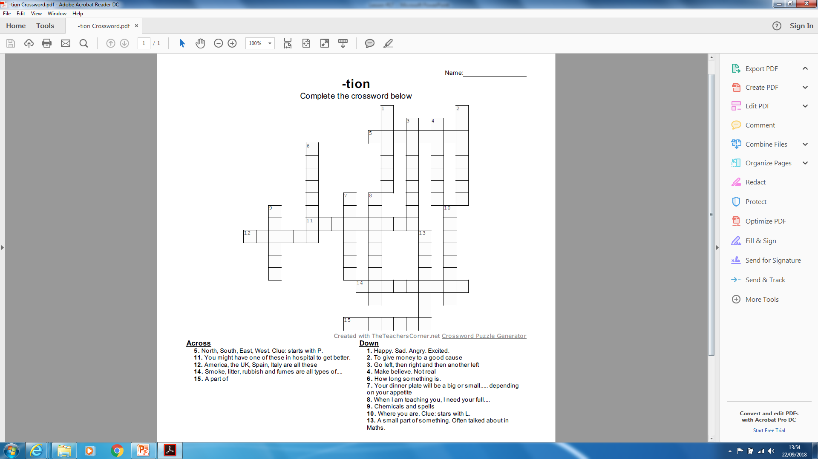
Try the –tion crossword

Slide 13

–tion and –ation
action nation motion potion option lotion section station mention portion fiction emotion question position function location reaction fraction donation | auction caution duration ambition operation attention situation condition direction selection tradition intention evolution pollution infection | exception variation opposition population association competition examination destination invitation occupation
Notes:
You could give children a mini spelling test to finish off.
Choose 5-10 words (mix of both suffixes)

