Slide 1







Kenning Poem

Slide 2
What is a kenning poem?

Slide 3
Poem writing, Brain hurting, Thought provoking
KENNINGS
A kenning is a way of describing something using clues rather than just saying what it is.
Each line is two words long.
Heat giver
Light maker

Slide 4
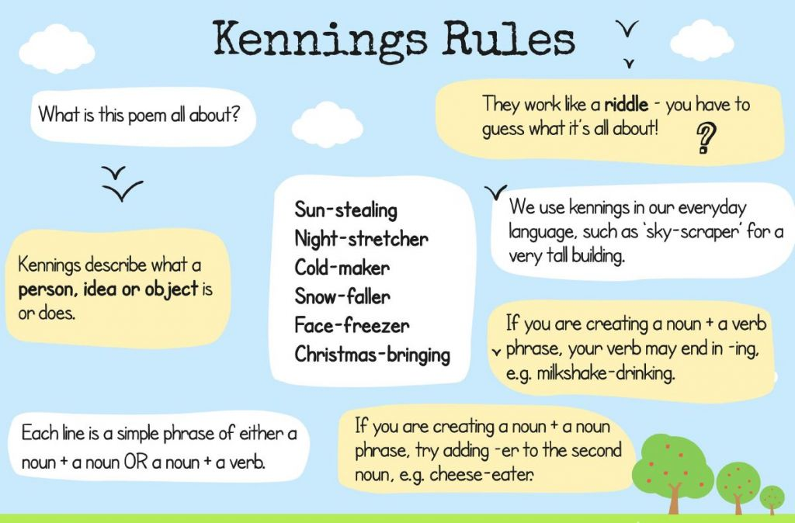

Slide 5

Story-reader
Problem-solver
Board-writer
Homework-setter
Playground-whistler
Register-taker
What could this be describing?
A teacher

Slide 6

What is a kenning?
Kennings are like riddles.
They describe something without ever saying what it is.
Read these phrases out loud. What could they be describing?
lip-licking
sauce-swirling
chin-dripping
cone-filling
flake-holding
tongue-freezing

Slide 7
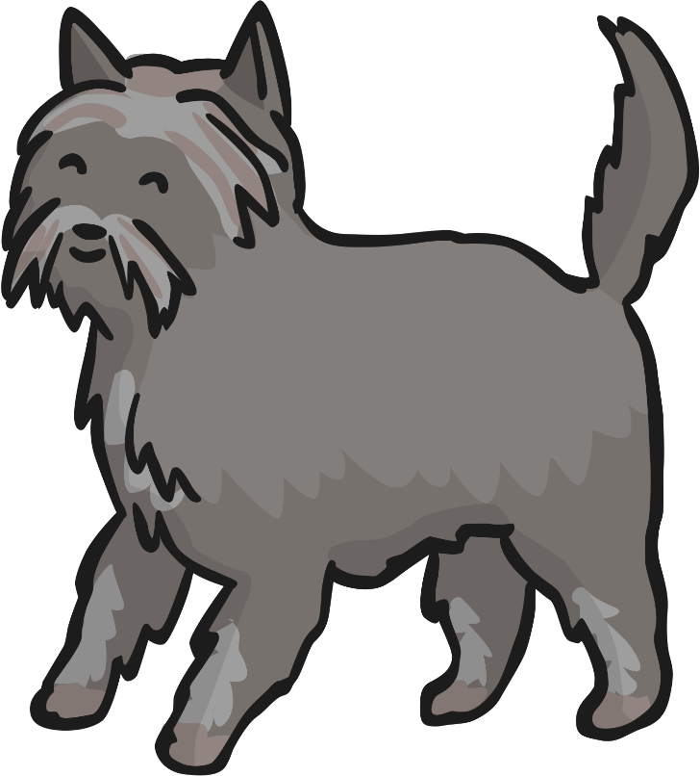
What is a kenning?
How about these?
tail-wagger
face-licker
ball-catcher
sofa-hogger
door-scratcher
cat-chaser

Slide 8


What is a kenning?
What did you notice about the phrases in each poem?
Each line of the poem is made of a two-word phrase.
The words are joined by a hyphen.
tail-wagger
lip-licking
face-licker
chin-dripping
Here the phrases are made up of a noun + a noun (by adding –er to the second noun).
Here the phrases are made up of a noun + a verb (the verb usually ends in -ing).

Slide 9

Let’s have a go!
How can we write a kenning?
First, we need to choose a theme. (It doesn’t have to be gory, like the Vikings!)
cat
Then, we brainstorm lots of words or phrases associated with that theme…
mice
nuzzle
scratch
drinks milk
stalk
sleeps a lot
fur
night
hunter
rubs ankles
purr
hates dogs

Slide 10
Let’s have a go!
How can we write a kenning?
To start creating your kenning, try and make a noun + noun phrase or a noun + verb phrase using your words.
nose
ear
mice
nuzzle
drinks milk
scratch
night
lick
stalk
sleeps a lot
fur
night
hunter
rubs ankles
purr
hates dogs

Slide 11

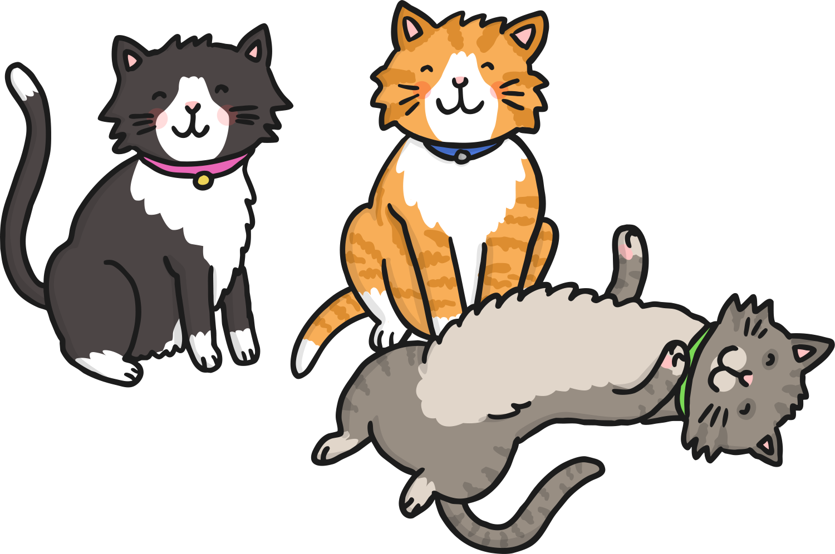
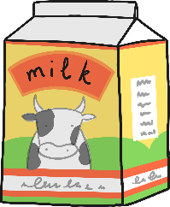
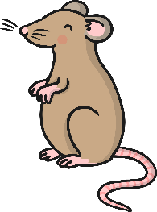
Let’s have a go!
How can we write a kenning?
Finally, put them together in your two-word phrases.
Don’t forget the hyphens!
mouse-hunter
milk-drinker
night-stalker
MEOW!
fur-licker
ankle-rubber
dog-hater
nose-nuzzler
ear-scratcher
loud-purrer

Slide 12
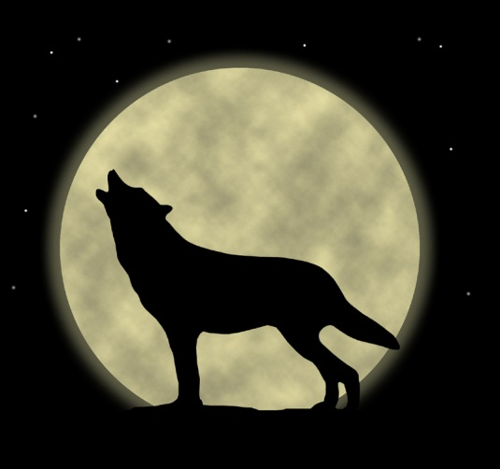
Think about what the subject does….
For example a wolf
Comes out at night
Eats meat
Hunts its prey
Lives in the woods
Howls at the moon
This becomes…………
Night-mover
Meat-eater
Prey-hunter
Wood-dweller
Moon-howler

Slide 13
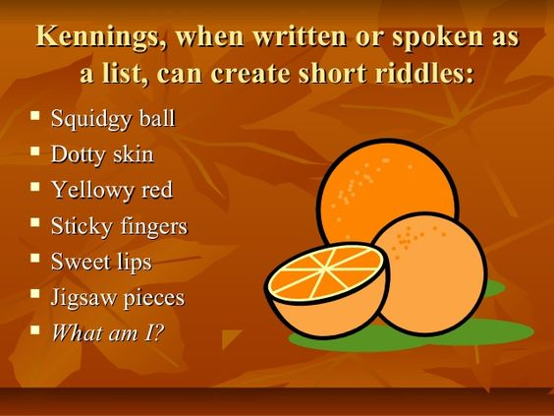
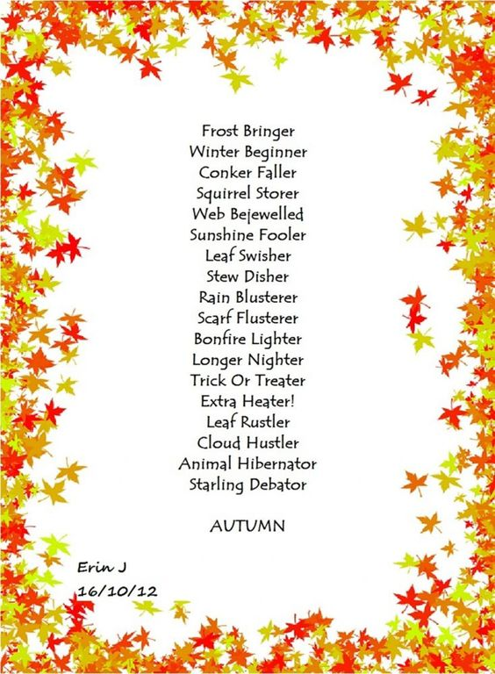
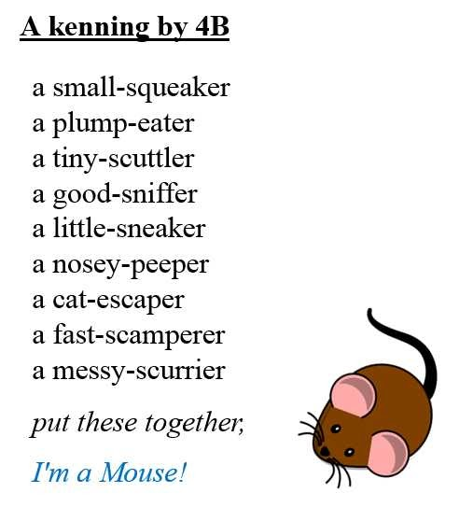

Slide 14
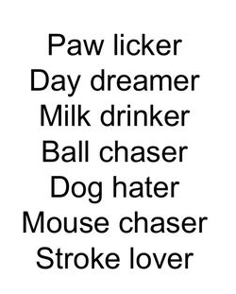
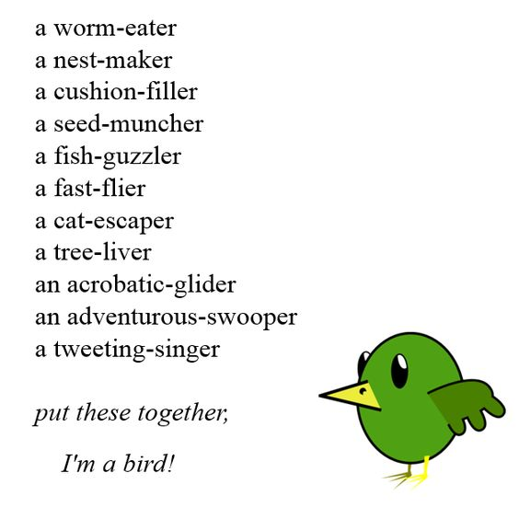
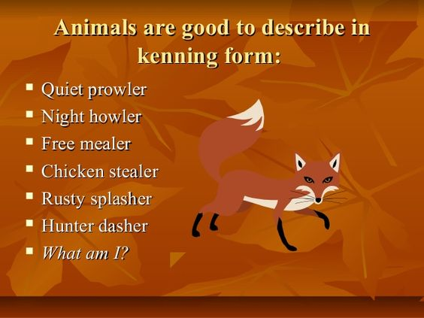

Slide 15
Your Task
Write a kenning about a topic of your own choice. I have included a few ideas below…
football
mums or dads
car
teachers
winter
pets
pizza

Slide 16

Does it make sense?
When you’re happy with it, read your poem to your family. Please share your poem with us through Twitter or email!

