Slide 1
Year 5 Measure
Perimeter
Week 5 Lesson 1 – measuring perimeter

Slide 2
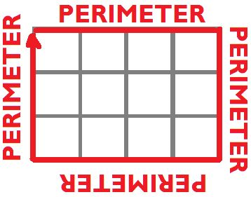
Perimeter – Key message
When we measure all the way around the outside of a straight-sided shape.

Slide 3
Sometimes, we are given squares when we are asked to measure perimeter (and this makes our job really easy)! Normally these square at are in your maths book at school are 1cm²
You can start off by counting the squares on the two different sized lengths that we have on this shape.

Slide 4
Sometimes, we are given squares when we are asked to measure perimeter (and this makes our job really easy)! Normally these square at are in your maths book at school are 1cm²
You can start off by counting the squares on the two different sized lengths that we have on this shape.
Because you know that the opposite side is the same size you can then multiply by two.
This is the same as 6 + 3 + 6 + 3.
(6 + 3) x 2 = 18cm
6cm
3cm

Slide 5
What is the perimeter of this rectangle?
Same rule again with this one.
Count the squares you have on the different sides you
Notes:
Count.
Then, (L + W) x 2 to check.

Slide 6
What is the perimeter of this rectangle?
Same rule again with this one.
Count the squares you have on the different sides.
(2 + 9) x 2 = 22cm
9cm
2cm
Notes:
Count.
Then, (L + W) x 2 to check.

Slide 7
We don’t NEED the squares, though!
5cm
7cm
Not to scale

Slide 8
We don’t NEED the squares, though!
(7 + 5) x 2 = 24 cm
5cm
7cm
Not to scale

Slide 9
What is the perimeter of this rectangle?
2cm
4cm
Not to scale

Slide 10
What is the perimeter of this rectangle?
(4 + 2) x 2 = 12cm
2cm
4cm
Not to scale

Slide 11
Remember to
Count the squares carefully.
use the formula P = (L + W) x 2

