Slide 1
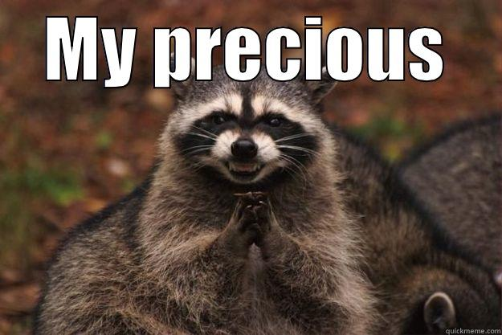
Home Learning: English
Monday: Spelling
-tious
-cious

Slide 2
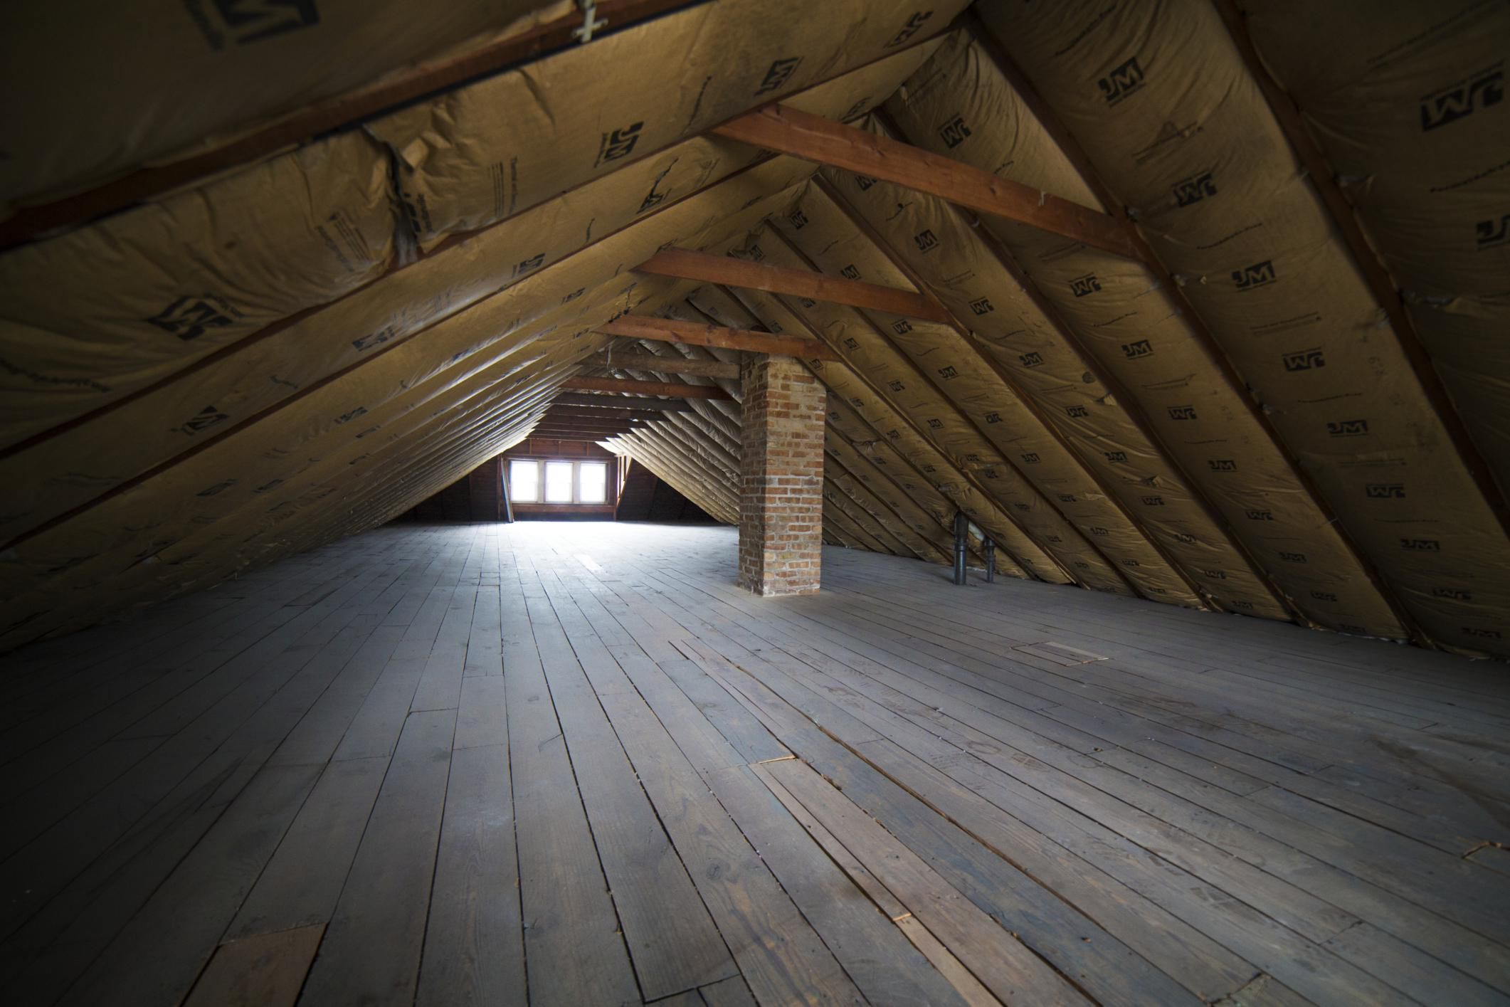
-tious
-cious
Both of these suffixes make the /shuhs/ sound.
For example, in this picture we can see a lot of space in the attic.
We could say that the attic is spacious.

Slide 3
-tious
-cious
By adding the suffix -cious to the root word, we have turned a noun into an adjective.
Space (noun)
Spacious (adjective)

Slide 4
RULE
If the root word ends in –ce, remove the
–ce and replace it with –cious.
Space Space Spacious
(Noun) (Adjective)

Slide 5

RULE
If the root word ends in –ce, remove the
–ce and replace it with –cious.
You could say that this emoji has a lot of malice (to cause harm to someone).
Malice Malice Malicious
(Noun) (Adjective)

Slide 6
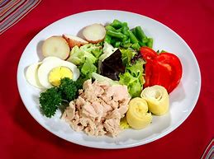
-tious
-cious
The suffix –tious acts in a similar way to –cious.
Nutrition
Nutritious

Slide 7
RULE
If the root word ends in –tion, remove the
–tion and replace it with –tious.
Nutrition Nutrition Nutritious
(Noun) (Adjective)

Slide 8

RULE
If the root word ends in –tion, remove the
–tion and replace it with –tious.
You could say that Bob needs a lot of ambition (a desire to achieve) if he wants to get to the top.
Ambition Ambition Ambitious
(Noun) (Adjective)

Slide 9
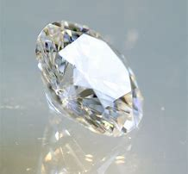

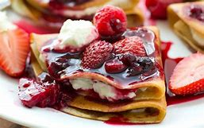
-cious
However, there are some exceptions.
Precious
Delicious
Ferocious
(Price)
(Delight)
(Fierce)
These words are adjectives that have not followed the rule. These words come from the following nouns…

Slide 10

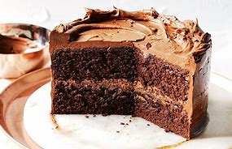
However, there are some exceptions.
-tious
Conscientious
Scrumptious
(Conscience- right or wrong/thinking)
(Sumptuous- expensive-looking)
These words are adjectives that have not followed the rule. These words come from the following nouns…

Slide 11
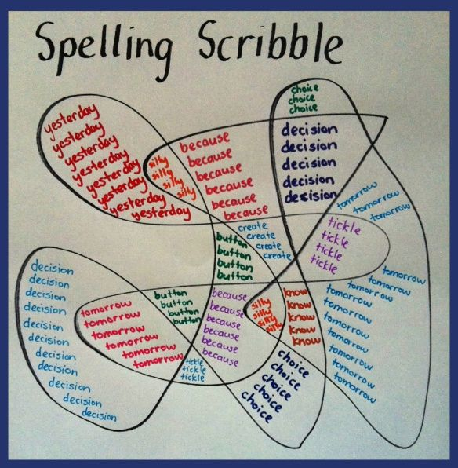
Scribble on your page. In the gaps, practise spelling the following words:
Ambitious
Cautious
Fictitious
Infectious
Pretentious
Anxious
Obnoxious
Vicious
Atrocious
Precious
Suspicious
Some of these words may be completely new to you.
Use the internet or a dictionary to find the meanings.
Extension- Find some more –tious and –cious words. Define them and put them in a sentence!

