Slide 1
Year 5
Revision
Decimals
Week 12 Lesson 4– adding and subtracting decimals to a whole number

Slide 2
1
0.7
 |  |  | ⁰1 | ¹0
 |  | - | 0 | 7
 |  |  | 0 | 3
When you have a whole number and you are subtracting a decimal, you need to make sure you include all the relevant place holders. In this question, we have added a place holder in the ones.
Start from the smallest value when subtracting from a whole number.

Slide 3
1
0.55
 |  |  | ⁰1 | ⁹0 | ¹0
 |  |  | 0 | 5 | 5
 |  |  | 0 | 4 | 5
The whole number at the top.
The decimal at the bottom.
Adding place holders where they’re needed.
Then subtract from right to left (smallest value).

Slide 4

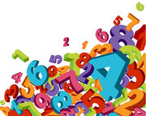
Remember to:
line your decimal up in the correct place value column.
carry when the number is >9.
exchange columns when a smaller number is being subtracted from a bigger one.
know that a whole number has no values as decimals.

