Slide 1
The focus for reading this week is summary.
This is where we will look at the text overall.
A reading reporter looks at the ‘bigger picture’ and the main ideas.
Read the two pages of the non-fiction text. Then, carefully answer the questions. Remember to check your answers by scanning back through the text.

Slide 2
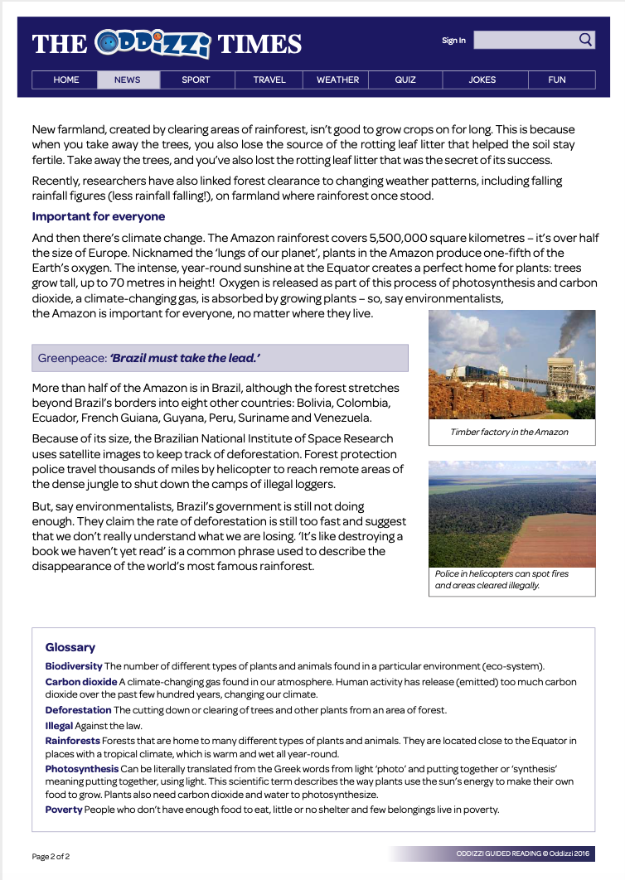
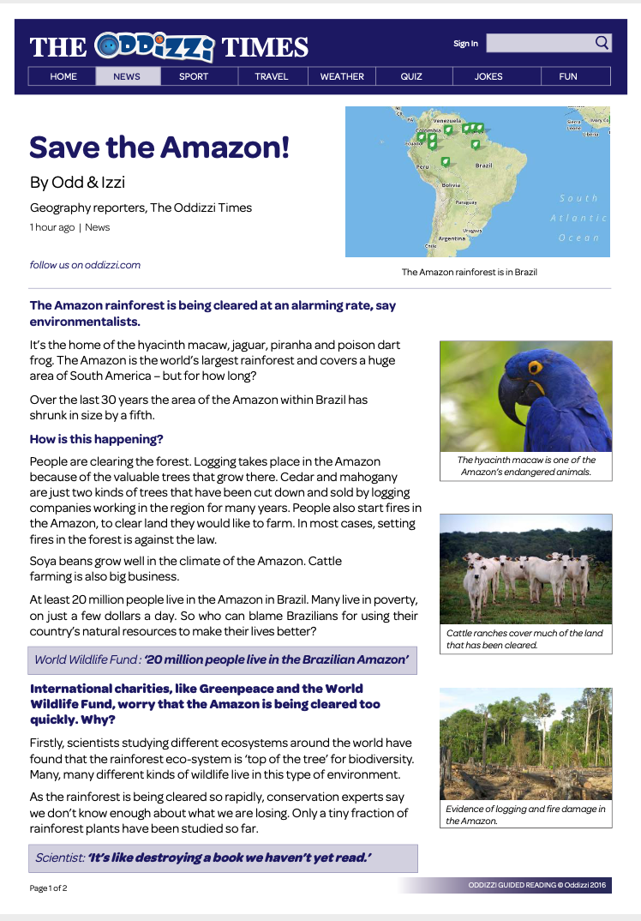
Notes:
Allow children chance to read it through as a whole text first.
You could read through it with them a second time but question them as they’re reading, picking out key features (some might be featured on the next page as a question but these are really good discussion points) such as headings, sub-headings, pictures, captions, quotes, glossary etc. Where is the article found? It’s an online article. How do you know? It has an interactive tool bar at the top, allows you to sign in and search and says it was updated/posted an hour ago.

Slide 3
Save the Amazon!
Why is a headline needed?
What is the purpose of a sub-heading?
Which section of the text is written to inform readers about the population in the Amazon? Write the name of the section.
Look at page two. Which sentence below best describes what this page is about? Circle one.
We could easily survive without the Amazon.
The Amazon is important to everyone and needs to be protected.
The Amazon is more than half the size of Europe.
The Amazon is important to Brazil and needs to be protected.
Number the following statements from 1-5 to show the order in which they appear in the text. The first one has been done for you.
Experts say we don’t know enough about what we are losing.
The Amazon has decreased in size by a fifth. – 1
Helicopters are used to reach remote areas of the jungle.
Forest clearance is linked to changing weather patterns.
People set fires in the Amazon to clear land.
What is a main idea of this text? Justify your answer.
Notes:
Normally the children would have the text printed in front of them or be able to scan with their fingers directly. I would encourage the children to identify the key words in the question and understand what the question is asking them to do. You can discuss this with them if they are unsure, particularly as a non-fiction text has a lot of features that can be unpicked and be used as a discussion point (what is the purpose). Then, go back to the text and look for where the answer can roughly be found.
E.g. For question 5, I would encourage them to scan the text for each of those statements (they might not be worded in that exact way so key words/synonyms are essential) and put a star or circle it. When they have found all 4/5, they can then go through and number them before writing the answer on their sheet.

