Slide 1
Year 5 Measure
Length
Lesson 2 – converting units of measurement
M to CM
CM to M

Slide 2
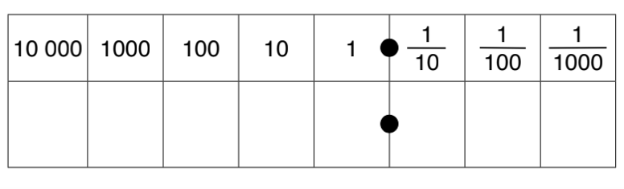
Similar to yesterday’s lesson, we will be using a method we have learnt before to apply to the context of measurement.
Multiplying means that we are getting bigger so the place value grid we would move to the left.
If we are multiplying/dividing by 100 we would move two place value.
32 x 100=
Have a look at the number sentence that you have.
If we are multiplying are we getting bigger or smaller?
How many times are we getting bigger or smaller?
The number sentence can answer both these questions.
Place value grid
2
4

Slide 3
32 x 100 = 3,200
We have moved twice to the left.
As you can see, I have added a 0 into the ones column and the tens. This acts as a place holder as we have no other number to put there and we cannot leave this value blank.
Place value grid
3
2
0
0

Slide 4
What about this time?
Are we multiplying or dividing?
What are we multiplying or dividing by (means the amount of place values we are moving)
1,131 ÷ 100
1
1
3
1

Slide 5
1,131 ÷ 100 = 11.31
As you can see, we are dividing this means now we are moving to the right because we are getting smaller.
We are dividing by 100 so we are moving two place values to the right.
1
1
3
1

Slide 6
We need to convert between these two measurements when comparing!
CM |  | M | ÷ 100
M |  | CM | X 100
100CM = 1M 1M = 100CM

Slide 7
34m into cm
CM | to | M | ÷ 100
M | to | CM | X 100
100CM = 1M 1M = 100CM
From the question, you can see that we need to convert from a m to a cm. On the table to the right, it will guide you to whether you are multiplying or dividing.
M to CM = x100
Place value grid
3
4

Slide 8
34m into cm
CM | to | M | ÷ 100
M | to | CM | X 100
100CM = 1M 1M = 100CM
M to CM = x100
34m x 100 = 3400cm
Because we are multiplying, we move to the left (getting larger). We are multiplying by 100 so we move twice to the left. As there was no number in the ones and tens column we must add our place holder.
Place value grid
3
4
0
0

Slide 9
192cm to m
CM | to | M | ÷ 100
M | to | CM | X 100
100CM = 1M 1M = 100CM
From the question, you can see that we need to convert from a cm to a m. On the table to the right, it will guide you to whether you are multiplying or dividing.
CM to M = ÷ 100
Place value grid
1
9
2

Slide 10
192cm to m
CM | to | M | ÷ 100
M | to | CM | X 100
100CM = 1M 1M = 100CM
CM to MM = ÷ 10
Because we are dividing, this means we are getting smaller. As we are dividing by 100, this means we are moving twice to the right.
No place holders needed as we have a number in the ones and tens column once converted.
192 ÷ 100 = 1.92
Place value grid
1
9
2

Slide 11
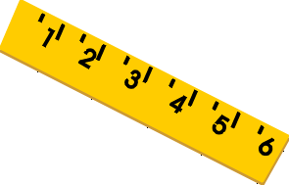
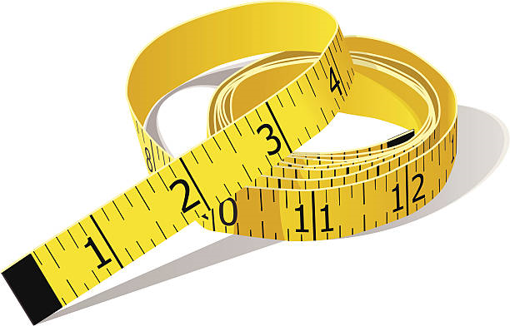
Today’s rule.
÷ by 100 when converting CM to M.
X by 100 when converting M to CM.

Slide 12
Notes:
Print back2back for the chn to use if needed.

Slide 13
Notes:
Print back2back for the chn to use if needed.

