Slide 1
Year 5 Measure
Perimeter
Week 5 Lesson 1 – measuring perimeter

Slide 2
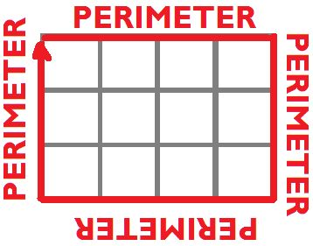
Perimeter – Key message
When we measure all the way around the outside of a straight-sided shape.

Slide 3

Here is a regular octagon tile that will be used on the wall of a bathroom. What is the perimeter of this octagon?
6cm

Slide 4
If we know that it is regular, we know that all sides are the same and all angles are the same.
6cm
6cm
6cm
6cm
6cm
6cm
6cm
6cm

Slide 5
6 + 6 + 6 + 6 + 6 + 6 + 6 + 6
or…
6 x 8
6cm
6cm
6cm
6cm
6cm
6cm
6cm
6cm

Slide 6
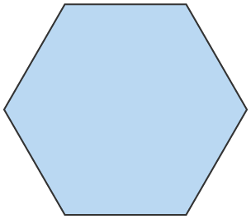
What is the perimeter of this regular hexagon?
7cm
Notes:
Model how finding the perimeter of a regular shape is easy because if we know one side, we just add all the sides together. In your modelling, make sure that you model the adding and the multiplying quicker method because not all shapes that we deal with will be regular. Then, multiplying won’t work.

Slide 7
What is the perimeter of this regular hexagon?
7 + 7 + 7 + 7 + 7 + 7 = 42cm
7 x 6 = 42cm
7cm
7cm
7cm
7cm
7cm
7cm
Notes:
Model how finding the perimeter of a regular shape is easy because if we know one side, we just add all the sides together. In your modelling, make sure that you model the adding and the multiplying quicker method because not all shapes that we deal with will be regular. Then, multiplying won’t work.

Slide 8
What is the perimeter of this regular pentagon?
11cm

Slide 9
What is the perimeter of this regular pentagon?
11 + 11 + 11 + 11 + 11 = 55cm
11 x 5 = 55cm
11cm
11cm
11cm
11cm
11cm

Slide 10
What happens if I know the perimeter already and would like to know the length of one side?
This is a regular octagon with a perimeter of 88cm.
??cm
Notes:
Model how to get the given perimeter and divide by the number of sides that there are. 88÷8 = each side is 11cm.

Slide 11
What happens if I know the perimeter already and would like to know the length of one side?
This is a regular octagon with a perimeter of 88cm.
When you all ready know the perimeter and the sides are equal length, you can divide the perimeter by the amount of sides.
88 divide by 8 = 11 cm per side
??cm
Notes:
Model how to get the given perimeter and divide by the number of sides that there are. 88÷8 = each side is 11cm.

Slide 12
This regular hexagon has a perimeter of 54cm.
??cm

Slide 13
This regular hexagon has a perimeter of 54cm.
54 cm divide by 6 = 9 cm per side
??cm

Slide 14
Important to remember .
accurately measure the sides with a ruler.
adding up all of the sides.
using division to find missing sides.

