Slide 1
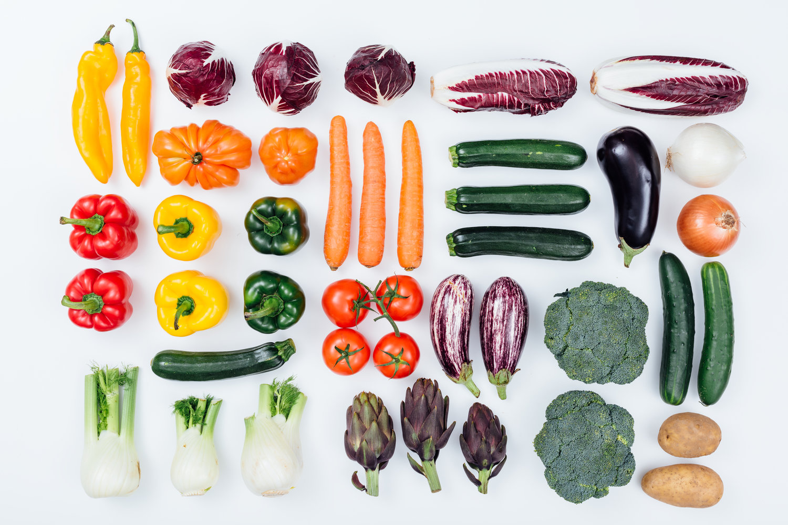

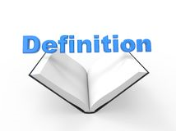
Year 5/6 word list
vegetable
A plant or part of a plant used as food.

Slide 2
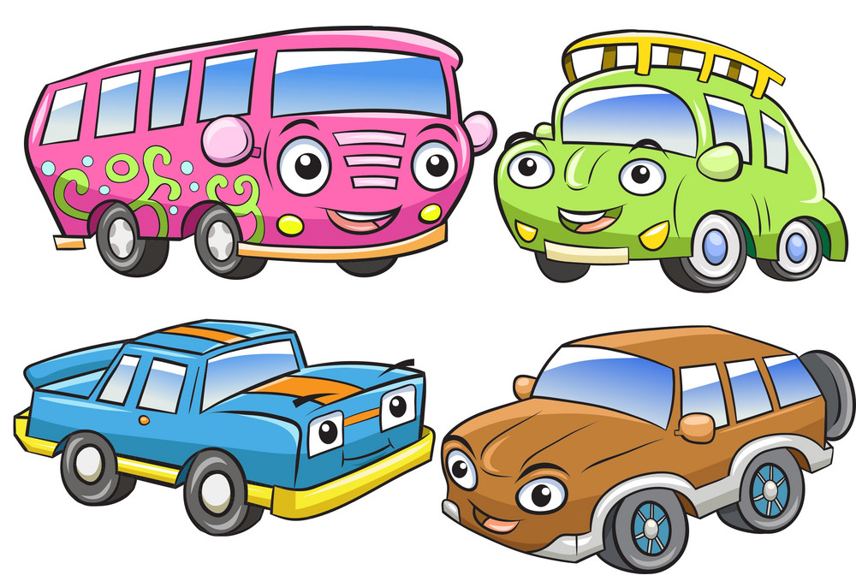
Year 5/6 word list
vehicle
Used for transporting people or goods.

Slide 3
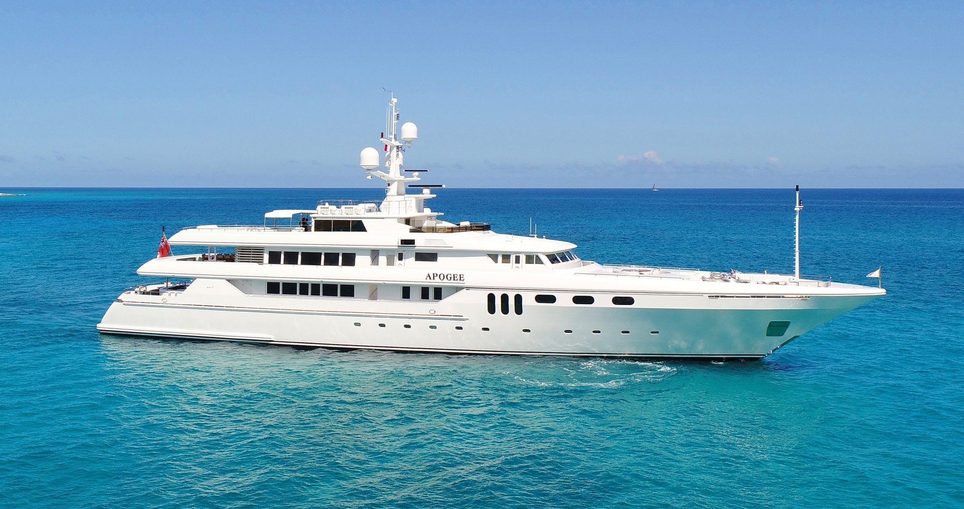
Year 5/6 word list
yacht
A medium-sized sailing boat equipped for cruising or racing.

Slide 4
Can you think of any words that have end with ‘ance’ or ‘ancy’?
Notes:
We have explored this spelling pattern earlier in the year (autumn) but children need to become more confident using this spelling pattern correctly in their writing.

Slide 5
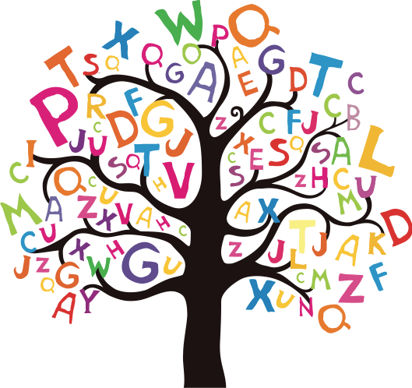
-ance and -ancy
significance
elegance
extravagance
hesitance / hesitancy
vibrancy
reluctance
vacancy
relevance/ irrelevance
performance
disturbance
importance
advance
guidance
finance
nuisance

Slide 6

Some of the –ance and –ancy words can be used as adverbs
with + reluctance
With reluctance, Zara went to school.
Zara went to school with reluctance.
Notes:
Note how the fronted adverbial can be moved around.

Slide 7

Some of the –ance and –ancy words can be used as adverbs
with + elegance
With elegance, the dancer performed.
The dancer performed with elegance.
Notes:
Chn have a go.

Slide 8
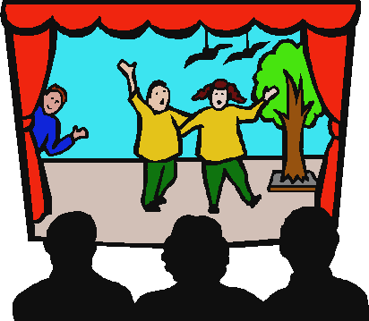
-ance and -ancy
Spot the error!
Be prepared to explain and correct it…
preformance
Notes:
Performance not preformance

Slide 9

-ance and -ancy
Spot the error!
Be prepared to explain and correct it…
giudance
Notes:
guidance

Slide 10
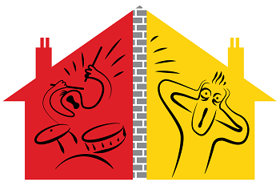
-ance and -ancy
Spot the error!
Be prepared to explain and correct it…
newsance
Notes:
nuisance

