Slide 1
Year 5 Measure
Perimeter
Week 5 Lesson 1 – measuring perimeter

Slide 2
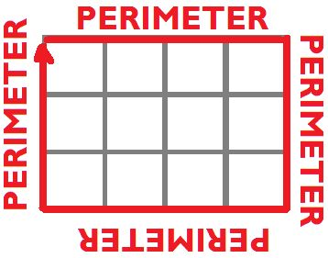
Perimeter – Key message
When we measure all the way around the outside of a straight-sided shape.

Slide 3
How do we find the perimeter of this composite shape?
Composite shape is a shape that can be divided/split into more than one polygon. Another name for a composite shape is a compound shape.

Slide 4
How do we find the perimeter of this composite shape?
We need to work around the shape measuring the length of each side.
Make sure that you get every side.
2 + 2 + 6 + 2 + 8 + 4 = 24cm
2cm
2cm
6cm
4cm
2cm
8cm

Slide 5
What is the perimeter of this composite shape?

Slide 6
What is the perimeter of this composite shape?
6cm
We need to work around the shape measuring the length of each side.
Make sure that you get every side.
6 + 3 + 3 + 4 + 3 + 7 = 26cm
3cm
7cm
3cm
4cm
3cm

Slide 7
Remember to .
Count the squares carefully.
use addition.
infer some missing sides.

