Slide 1






Writing – poetry
Notes:
In the autumn term, we spent a lesson looking at haiku poems and children created their own based on WW1/the novel we were reading.
I have set children the task today to write their own haiku poem(s) based on structures/the seven wonders of the world but they may wish to create another one of their own choice too ☺

Slide 2
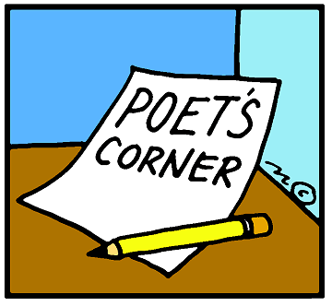
Haiku poems
Originate from Japan
Seventeen syllables in total
Three verses (lines) split into 5 syllables, 7 syllables and 5 syllables
Very, very rarely rhyme
Words chosen very carefully

Slide 3

Haiku poem – example
Winter
Winter is coming
Frost and ice hang off windows
Snowflakes start to fall

Slide 4

Haiku poem – example
World War One
Quickly, boys sign up
Can’t wait for the adventure
Propaganda tricks

Slide 5
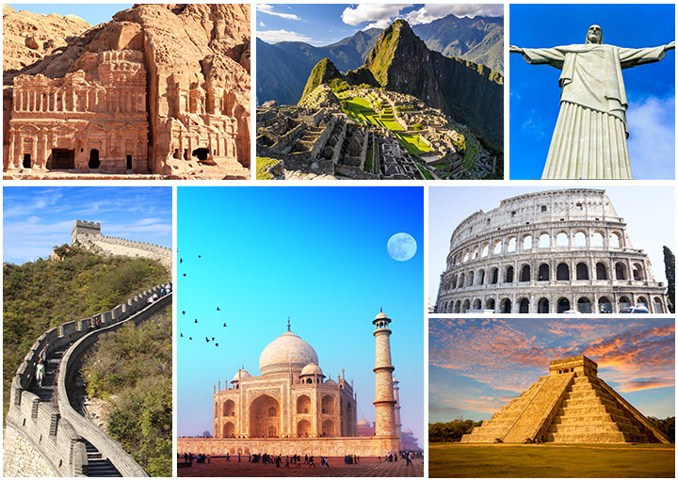
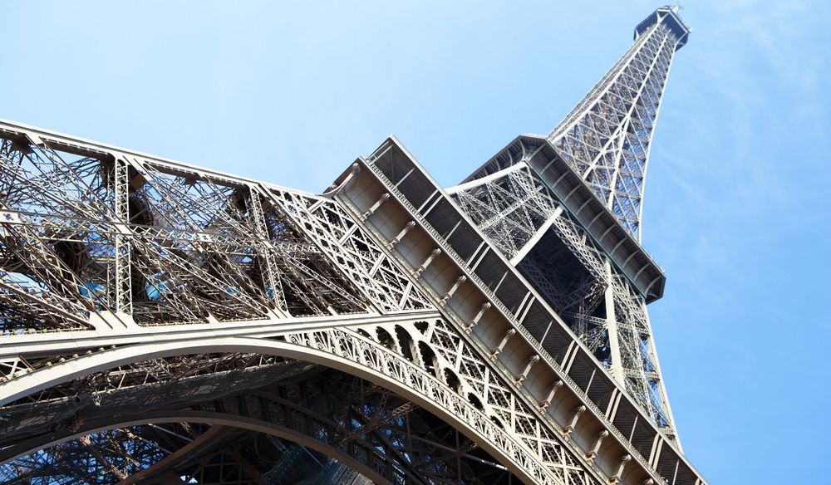
Your task today will be to write a haiku poem based on your non-core theme of structures. You may choose to base it around the New Seven Wonders of the World or a structure of your choice.
You could jot down initial words, ideas and phrases which you can then incorporate into your poem.
I have added a success criteria on the next page to help you remember the structure. Once complete, you may wish to read it aloud and gain feedback ☺
This can then be used to up-level your original haiku or you could create another of your own choice.
We would love to read your finished poems!

Slide 6

Success Criteria:
5 syllables
7 syllables
5 syllables
Based on structures
You may wish to illustrate your poem once you have finished.
You could also challenge yourself to use figurative language or a grammar technique of your choice!
Write your haiku poem in your green book. You may want to draw lines or stick lined paper in to make sure that your writing is neat.

Slide 7

Does it make sense?
When you’re happy with it, read your poem to your family. On the next slide, I have attached a peer-assessment sheet which could help you improve your poem further.

Slide 8
Does the title match the poem? Yes / No
Does the poem flow and make sense? Yes / No
Comments to improve: ________________________________________________________________________________________________________________________________________________________________________________________________________

