Slide 1
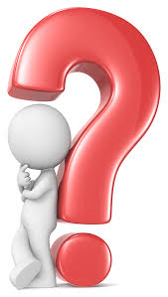
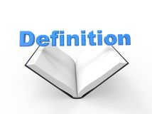
Year 5/6 word list
recognise
Identify someone or something from having seen them before.
Notes:
The first three slides are some of the year 5/6 statutory words they are due to learn.
They should focus on the spelling and also be able to define the word/identify synonyms too.

Slide 2
Year 5/6 word list
recommend
To approve someone or something. To advise.

Slide 3
Year 5/6 word list
relevant
Needed now. Useful now.

Slide 4
Last week, you looked at the spelling rule ‘ible’ and ‘able’ and learnt a range of words with this spelling pattern. This week, we are looking at a similar spelling pattern/words.
Can you think of any words that end in the suffix ‘ibly’ or ‘ably’?

Slide 5
–ibly and –ably
comfortably
undeniably
understandably
excitably
reliably
responsibly
legibly
irresistibly
possibly
horribly
terribly
incredibly
sensibly
visibly
Notes:
Show/explain/demonstrate how a lot of these are adverbs of manner.
Adverbs of manner describe how something happens.
It describes how and in what way a verb is carried out.

Slide 6
–ibly and –ably dictionary
Spelling | -ible or –able root word | Definition
comfortably | comfortable | To be relaxed, contented, happy or secure.
undeniably | undeniable | Cannot be denied or disputed. Almost factual.
understandably | understandable | Clearly or justifiably, for example… After the bad news, he was understandably upset.
excitably
reliably
responsibly
legibly
irresistibly
possibly
horribly
terribly
incredibly
sensibly
visibly
Notes:
Work from last week will help them with the –ible or –able root word section.
Children could compare their definitions of –ible or –able words with their -ibly or –ably words.
Are there any differences? Why are some similar?

Slide 7
Add the correct suffix!
comfort
ably

Slide 8
Add the correct suffix!
ibly
poss

Slide 9
Add the correct suffix!
understand
ably

Slide 10
Add the correct suffix!
ibly
sens

Slide 11
–ibly and –ably
comfortably
undeniably
understandably
excitably
reliably
responsibly
legibly
irresistibly
possibly
horribly
terribly
incredibly
sensibly
visibly
Dog
Driver
Alien
Student
Model
Weightlifter
Child
Author
Father
Criminal
Pilot
Monster
Volunteer
Teacher
Notes:
Pick a subject (one from list on the right or their own) and incorporate –ibly/-ably word into a good sentence.

Slide 12
The dishonest criminal lied terribly in court so the jury found him guilty!
Notes:
Use of noun phrase within sentence to describe the criminal.

Slide 13
–ibly and –ably
comfortably
undeniably
understandably
excitably
reliably
responsibly
legibly
irresistibly
possibly
horribly
terribly
incredibly
sensibly
visibly
Dog
Driver
Alien
Student
Model
Weightlifter
Child
Author
Father
Criminal
Pilot
Monster
Volunteer
Teacher
Notes:
Pick a subject (one from list on the right or their own) and incorporate –ibly/-ably word into a good sentence. Try to encourage children to up-level their adjectives where appropriate - don’t just write simple sentences (they could use complex sentences with subordination, begin with a fronted adverbial etc).

Slide 14
comfortably
undeniably
understandably
excitably
reliably
responsibly
legibly
irresistibly
possibly
horribly
terribly
incredibly
sensibly
visibly
Notes:
Children can have a go at the –ibly –ably wordsearch to consolidate their learning after they have identified definitions.

Slide 15
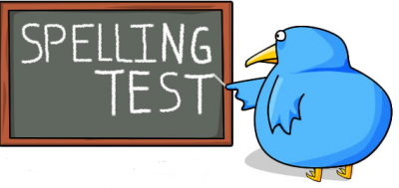
–ibly and –ably
comfortably
undeniably
understandably
excitably
reliably
responsibly
legibly
irresistibly
possibly
horribly
terribly
incredibly
sensibly
visibly
Notes:
You could give children a mini spelling test to finish off.
Choose 5-10 words (mix of both suffixes)

