Slide 1
Year 5 Measure
Area
Week 6 Lesson 1 – Area

Slide 2
What does it mean when asked to find an area of a shape?

Slide 3
Area is the section inside the shape. Because we have a square grid, we can easily work out the area of this shape by counting all the boxes that are inside it.
Another way you could to is find out the length and width of the shape.
Counting the boxes outside on the outside like last week will give you the length of one side.
length = 7cm
Width = 4 cm
7 x 4 = 28cm²
Length
Width

Slide 4
When finding area we always use the little two after the number. Do you remember what it means?
3²
4²
6²
5²

Slide 5
The little two (2²) stands for squared. This means that it is multiplied by itself.
4²
6²

Slide 6
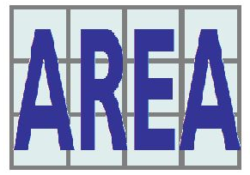
So Area is ….
When we measure all of the inside space in a shape.
Below is a formula to follow to find area.
A = L x W

Slide 7
What is the area of this rectangle?

Slide 8
Two ways:
Count the squares on the inside of the shape
Or
Finding the length and width (more effective method)
Length = 5 cm
Width = 3 cm
L x W = 3 x 5
area = 15cm²
Length
Width

Slide 9
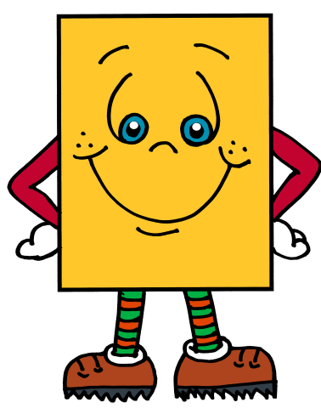
The squares wont always be there!
When the squares go, don’t frown! Just use the length and width measurements in the formula.
A = L x W

Slide 10
What is the area of this rectangle?
(Not to scale)
8cm
4cm
A = L x W AREA = 8 X 4

Slide 11
What is the missing side?!
OK, so the area is done for you, as is one side. So, how do you calculate the missing side?
10cm
Area = 50cm²
??cm
By using the information that we have, it is possible to find out the missing side. Rather than multiply to find the area, we are going to do the inverse to find the missing side.
So
50 divided by 10 = missing side (5 cm)
A = L x W

Slide 12
What is the missing side?! Use the same rule as last side.
??cm
Area = 54cm²
3cm
A = L x W

Slide 13
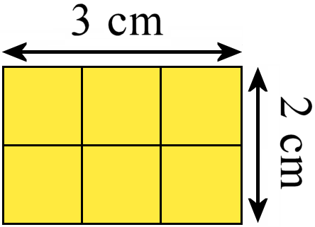
Important to remember.
counting squares if possible.
using the formula A = L x W
problem solving by using the inverse.

