Slide 1
Year 5 Measure
Weight
Week 3 Lesson 4 – converting units of measurement
G to KG
KG to G

Slide 2
From what we have done the last week or so, converting between grams and kilograms will be very similar. As you can see from the table, it is like M to KM. This is because 1KG = 1,000G.
G | to | KG | ÷ 1,000
KG | to | G | X 1,000
1,000G = 1KG 1kG = 1,000G

Slide 3
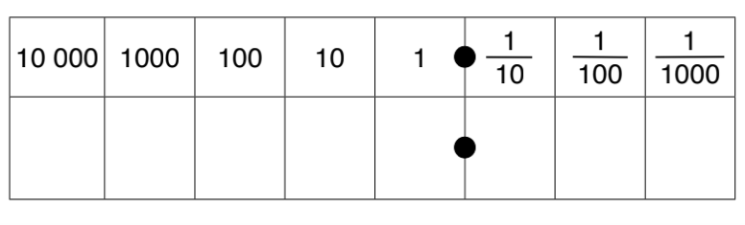
Similar to last week’s last two lessons, we will be using a method we have learnt before to apply to the context of measurement.
Multiplying means that we are getting bigger so the place value grid we would move to the left.
If we are multiplying/dividing by 1,000 we would move three place value.
85kg x 1,000=
Have a look at the number sentence that you have.
If we are multiplying are we getting bigger or smaller?
How many times are we getting bigger or smaller?
The number sentence can answer both these questions.
Place value grid
8
5

Slide 4
85 x 1,000 = 85,000g
We have moved three to the left.
As you can see, I have added a 0 into the ones column, the tens and the hundreds. This acts as a place holder as we have no other number to put there and we cannot leave this value blank.
Place value grid
8
5
0
0
0

Slide 5
What about this time?
Are we multiplying or dividing?
What are we multiplying or dividing by (means the amount of place values we are moving)
87,961 ÷ 1,000
8
7
9
6
1

Slide 6
87,961 ÷ 1,000 = 87.961KG
As you can see, we are dividing this means now we are moving to the right because we are getting smaller.
We are dividing by 1,000 so we are moving three place values to the right.
8
7
9
6
1

Slide 7
We need to convert between these two measurements when comparing!
G |  | KG | ÷ 1,000
KG |  | G | X 1,000
1,000G = 1KG 1kG = 1,000G

Slide 8
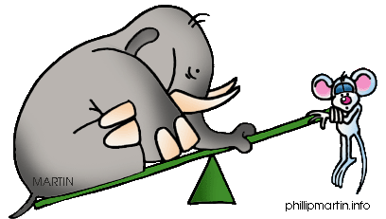
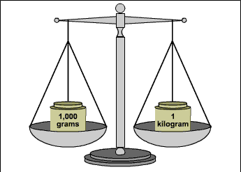
Today’s rule.
÷ by 1,000 when converting G to KG.
X by 1,000 when converting KG to G.

Slide 9
Notes:
Print back2back for the chn to use if needed.

Slide 10
Notes:
Print back2back for the chn to use if needed.

