Slide 1
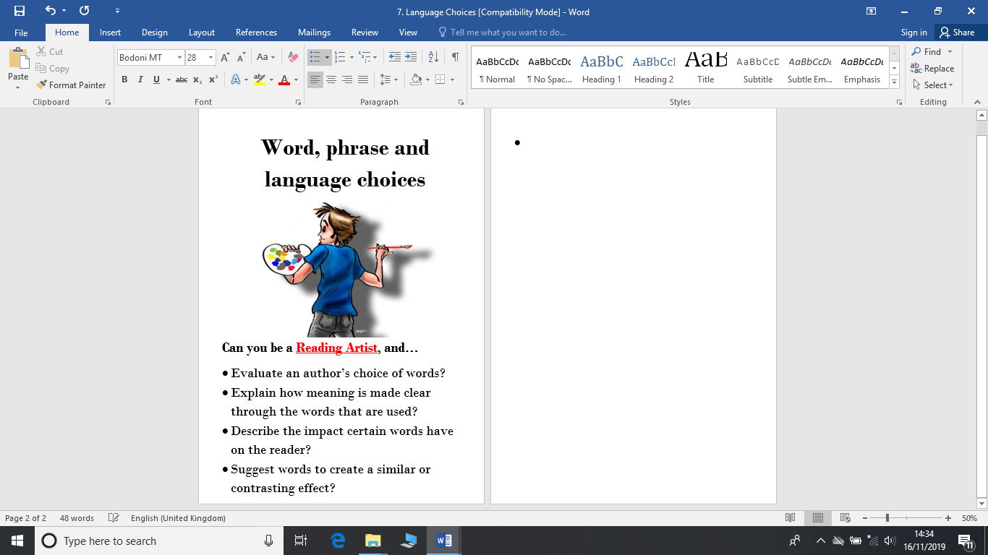
The focus for reading this week is language.
This is where we will explore the language that an author has used.
Reading Artists evaluate and explain the impact certain words have on the reader.
Read the pages from the text attached. Then, carefully answer the questions. Remember to check your answers fit the context and you have clearly explained your thoughts.

Slide 2
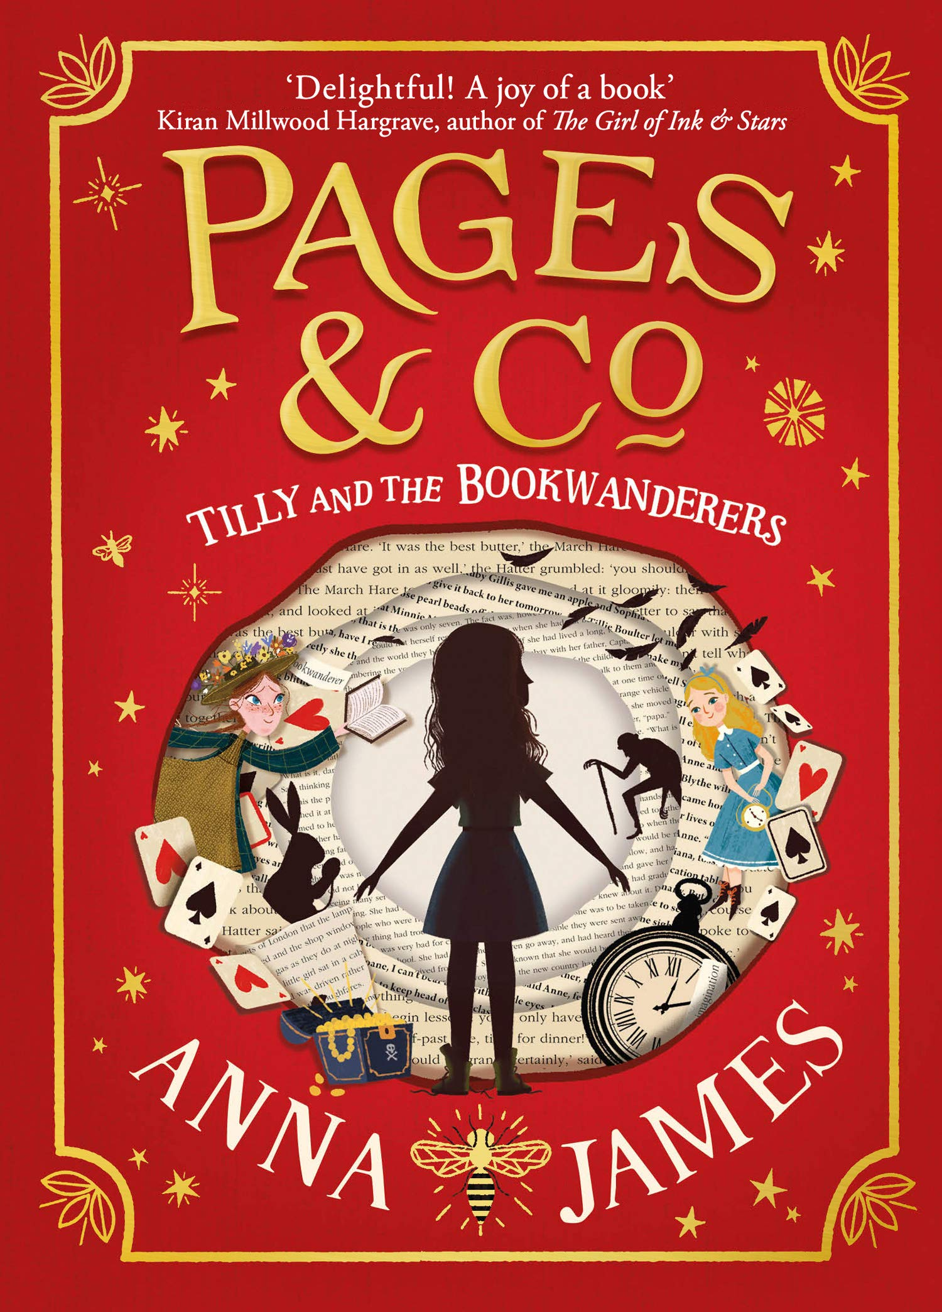
You will need to download today’s extract from:
https://www.worldbookday.com/resource/pages-and-co-extract/
Notes:
https://www.worldbookday.com/resource/pages-and-co-extract/

Slide 3
Pages & Co
‘…and simply relished the week’s holiday that stretched out in front of her…’. What do the words/phrases in red mean?
‘But the bubble of calm popped…’ What impact does this quote have on the reader?
‘Tilly flung her head theatrically on to her arms.’ Explain what this tells you about Tilly.
‘Tilly blushed and sheepishly started picking them up.’ What does the word ‘sheepishly’ tell you?
‘…Tilly said uncertainly.’ What does this tell you?
What phrase or group of words on page 12 suggest there was lots to see in the bookshop?
‘A spiral staircase danced up one wall.’ What image does this create for the reader?
‘…but as it was October a fire was roaring there.’ What does ‘roaring’ tell you about the fire?
Notes:
Normally the children would have the text printed in front of them or able to scan with their fingers directly. I would encourage the children to identify the key words/phrases in the question and understand what the question is asking them to do. Then, go back to the text and scan for those key words. For today’s task, they are unpicking and understanding the effect words have on a reader/what they mean.
You may be able to explain the answers yourselves, but the answers will be uploaded on Friday too.

