Slide 1
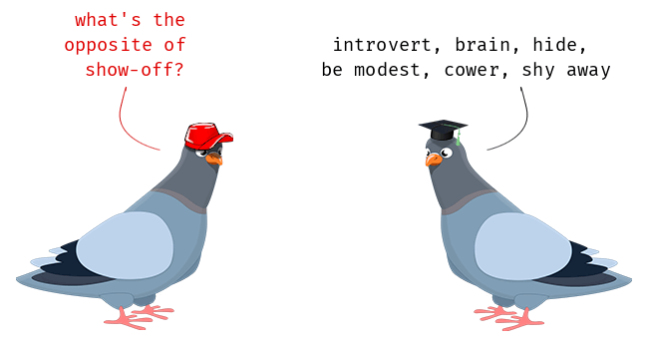
It’s the final week in year five!
To consolidate your learning from this year, you will be finding the errors in sentences before up-levelling an extract.
You have made fantastic progress this year in SPaG and now is your time to show off your skills!

Slide 2
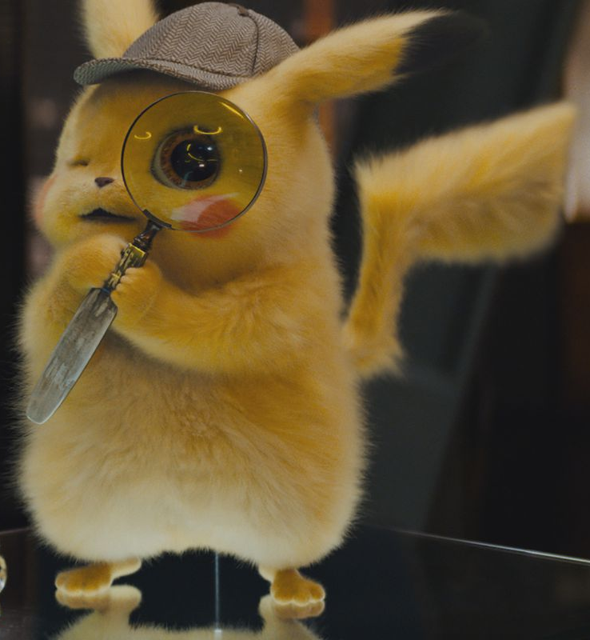
Spot the mistakes!
There not in they’re house because their over they’re, in the park.
The golden sand felt warm and soothing beneth my worn out and weary feet. Their where beads of condensation dripping from my cold refreshing glass off water.
Swaying in the wind, the trees dances to the rythm of the storm. The moon looked down on the danced trees and smiled in ameusment at the glittering stars.
A shimmering light reflected belo the surface. Bright blue specks were gleamed into my eyes.
I couldnt believe I past my test.

Slide 3
There not in they’re house because their over they’re, in the park.
They’re not in their house because they’re over there, in the park.
The golden sand felt warm and soothing beneth my worn out and weary feet. Their where beads of condensation dripping from my cold refreshing glass off water.
The golden sand felt warm and soothing beneath my worn out ad weary feet. There were beads of condensation dripping from my cold, refreshing glass of water.
Swaying in the wind, the trees dances to the rythm of the storm. The moon looked down on the danced trees and smiled in ameusment at the glittering stars.
Swaying in the wind, the trees danced to the rhythm of the storm. The moon looked down on the dancing trees and smiled in amusement at the glittering stars.
A shimmering light reflected belo the surface. Bright blue specks were gleamed into my eyes.
A shimmering light reflected below the surface. Bright blue specks gleamed into my eyes.
I couldnt believe I past my test.
I couldn’t believe I passed my test.

Slide 4
Spot the mistakes!
Miss Holden was so proud of aiden for achieving his best score yet.
“Please dont hurt me” wailed Makayla as she ran off screaming.
Mr Gaibee askd for biscuits pizza cheese and chocolate for the party.
As Hayden approached the forbidden territory he feared for his life
The new classroom, which was decorated beautifully was ready for the new arrivals in September.

Slide 5
Miss Holden was so proud of aiden for acheiving his best score yet.
Miss Holden was so proud of Aiden for achieving his best score yet.
“Please dont hurt me” wailed Makayla as she ran of screaming.
“Please don’t hurt me!” wailed Makayla as she ran off screaming.
Mr Gaibee askd for biscuits pizza cheese and chocolate for the party.
Mr Gaibee asked for biscuits, pizza, cheese and chocolate for the party.
As Hayden approached the forbidden territory he feared for his life
As Hayden approached the forbidden territory, he feared for his life.
The knew classroom, which was decorated beautifully was ready for the new arrivals in September.
The new classroom, which was decorated beautifully, was ready for the new arrivals in September.

Slide 6
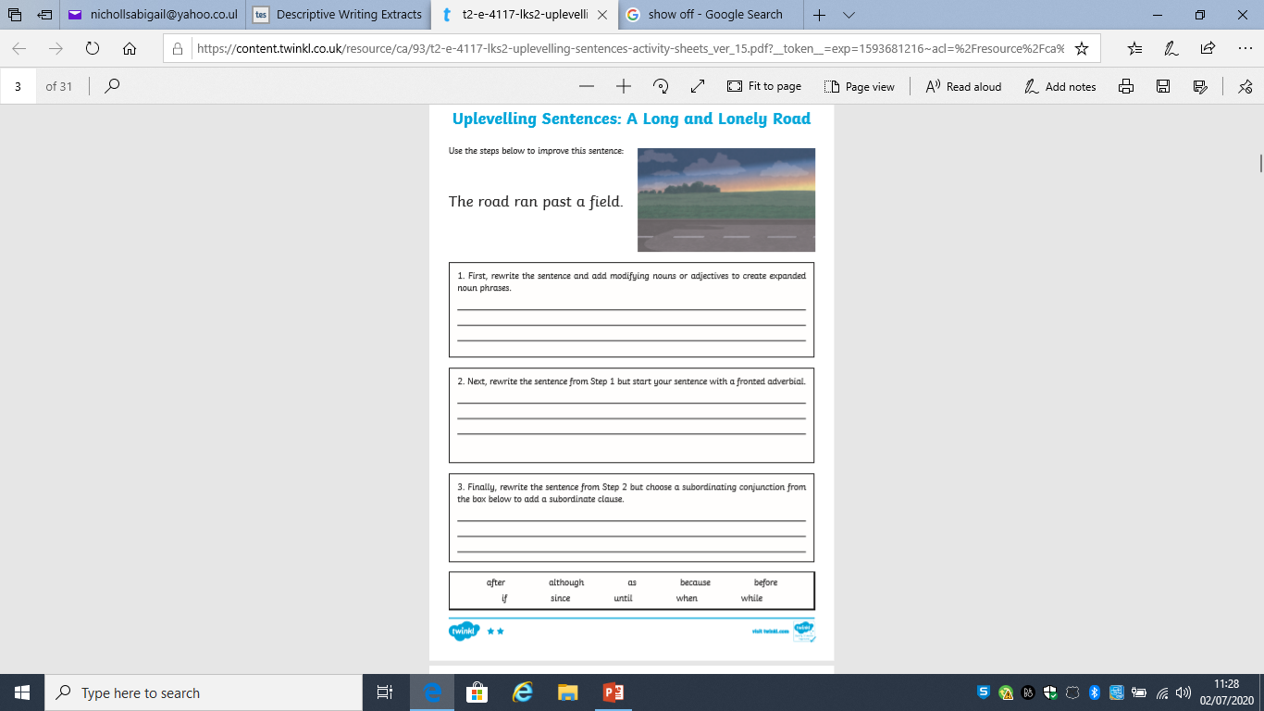

Slide 7
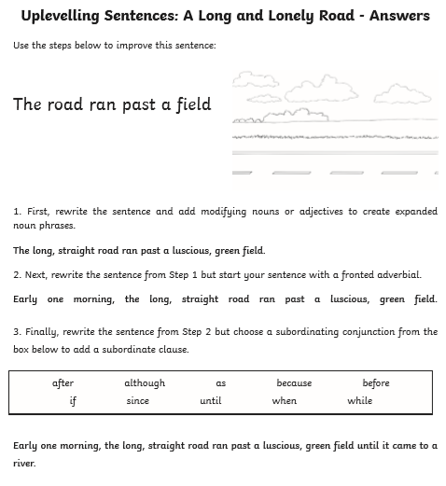

Slide 8
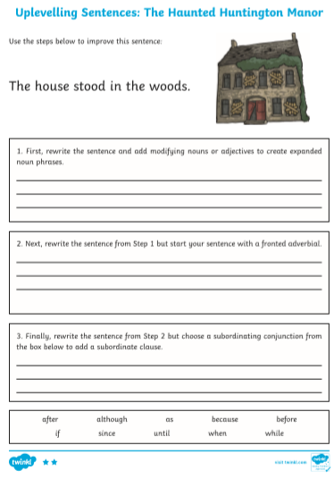

Slide 9
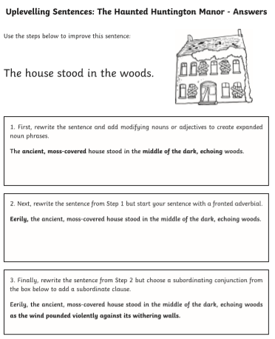

Slide 10
What’s good about this paragraph?
October arrived, spreading a damp chill over the grounds and into the castle. Raindrops the size of bullets thundered on the castle windows for days on end; the lake rose, the flower beds turned into muddy streams, and Hagrid's pumpkins swelled to the size of garden sheds. Oliver Wood's enthusiasm for regular training sessions, however, was not dampened, which was why Harry was to be found, late one stormy Saturday afternoon a few days before Halloween, returning to Gryffindor Tower, drenched to the skin and splattered with mud.
Positives
Fronted adverbials
Ambitious vocabulary
Figurative language
Semi-colon
Commas for lists
A range of sentence structures
What could be improved?
The final sentence could be changed into two smaller, more appropriate sentences.

Slide 11
Up level the following piece of writing.
On the right, I have included some suggestions you might want to consider.
Ways you can up level
Fronted adverbials
Ambitious vocabulary
Figurative language
Semi-colons
Commas for lists
A range of sentence structures
Complex sentences/
subordination
Connectives
Noun phrases
Powerful verbs
Include adverbs where appropriate
Synonyms for said
Show not tell
There was a boy called Peter. He went to the park. Then he saw a notice about the fair. Peter liked the fair. He went home and told his mother about it.
“It looks like fun” he said to his Mum.
“Would you like to go?” said his Mum.
“Yes” said Peter.
They went to the fair. It was fun. Lights were flashing.
Peter went to the ghost train, then on the waltzer, then the merry –go-round. Then Peter went on the coconut shy. He wanted to win a coconut but he didn’t win one.
Peter lost his wallet. He looked around but he couldn’t find it. Peter was sad. He didn’t have enough money to try to win another coconut. Then he saw his friend Joe talking to a policeman.
“Is everything ok?” said Peter.
“Yes, I just found this wallet on the floor” said Joe.
“That’s mine, you found it” said Peter.

