Slide 1
Year 5 Measure
Weight
Week 4 Lesson 1 – problem solving

Slide 2
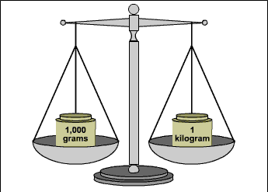
In today’s lesson
We are going to apply what we learnt on lesson 4 last week to answer problem solving questions with grams and Kilograms. To do this we need to:
converting between g and kg.
knowing what the question is asking me to do.
using column methods.

Slide 3
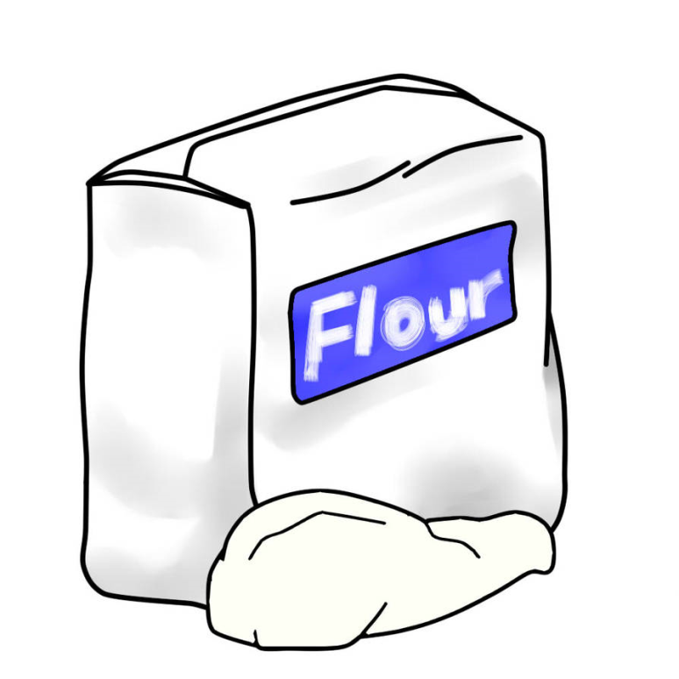
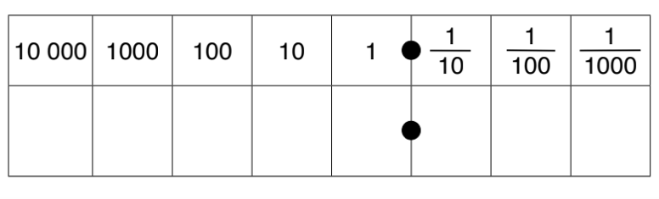
Mr. Hunt is baking – badly! He starts off with 1.28kg of flour and adds another 715g. In grams, how much flour does the wannabe baker have?
As said on the previous slide, our first step is to convert the weight so that they are the same measurement.
1.28kg into grams
1.28 x 1000 = 1280
G | to | KG | ÷ 1,000
KG | to | G | X 1,000
1,000G = 1KG 1kG = 1,000G
1
2
8
1
2
8
0

Slide 4
Mr. Hunt is baking – badly! He starts off with 1.28kg of flour and adds another 715g. In grams, how much flour does the wannabe baker have?
As you can see by the question, it is asking how much he has altogether. This means it is an addition question. The answer is 1995g
 | 1 | 2 | 8 | 0
+ |  | 7 | 1 | 5
 | 1 | 9 | 9 | 5
G | to | KG | ÷ 1,000
KG | to | G | X 1,000
1,000G = 1KG 1kG = 1,000G

Slide 5
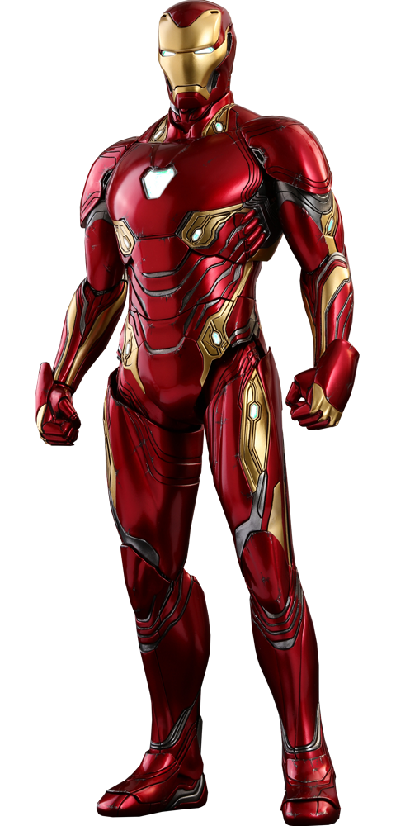
Captain Marvel is 65g of energy-boosting crystals. Iron Man has 16 times as much. How many KG of crystals does Iron Man have?
Sometimes it can be easier to do your working out first before you convert. From the question you can see Iron man has 16x more. If we were to do the converting first we would have a decimal. This would make it harder to then multiply. So be logical and careful when getting to your answer.
Remember the steps for long multiplication?
Ones x ones
Ones x tens
Place holder
Tens x ones
Tens x tens
Add together
 |  | 6 | 5
 | x | 1 | 6
 | 3 | 9 | 0
 | 6 | 5 | 0
1 | 0 | 4 | 0
³
¹

Slide 6
Captain Marvel is 65g of energy-boosting crystals. Iron Man has 16 times as much. How many KG of crystals does Iron Man have?
As said on the previous slide, we have 1040g. This needs to be converted into KG.
1040g into KG = ÷ 1,000
1040 ÷ 1,000 = 1.04KG
G | to | KG | ÷ 1,000
KG | to | G | X 1,000
1,000G = 1KG 1kG = 1,000G
1
0
4
0
1
0
4

Slide 7
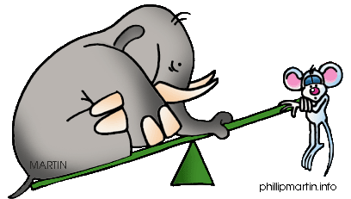
Important notes for today.
Really read the question carefully.
Are you converting or doing your equation (adding, subtracting, dividing or multiplying) first?
Make sure your answer is in the measurement asked.
G | to | KG | ÷ 1,000
KG | to | G | X 1,000
1,000G = 1KG 1kG = 1,000G

