Slide 1


Slide 2


Homophone
Father – your Dad.
farther – to go a bigger or greater distance. To go far.

Slide 3
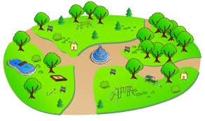
Father or farther?
Michael went to the park with his _______________.
Michael kicked the football _______________.
Notes:
Father
Farther

Slide 4
Homophone
guessed – to estimate or predict.
guest – a person who is invited to go to someone’s house or event.

Slide 5
Which homophone?
I guessed / guest correctly!
We can accommodate up to twenty people in our guessed / guest bedrooms.
You simply guest / guessed that answer!
Notes:
Guessed
Guest
Guessed

Slide 6

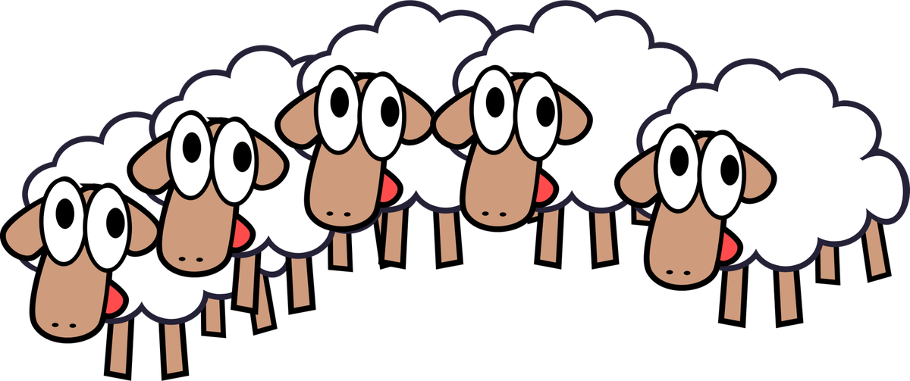
Homophones
heard
herd

Slide 7
Homophones
Suddenly, I ______________ a great creaking noise behind me. It was only the door!
The farmer ______________ his tractor start to chug-chug-chug! He hoped it wouldn’t break down!
The ___________ of cows munched happily on the grass.
Notes:
Heard
Heard
Herd

Slide 8
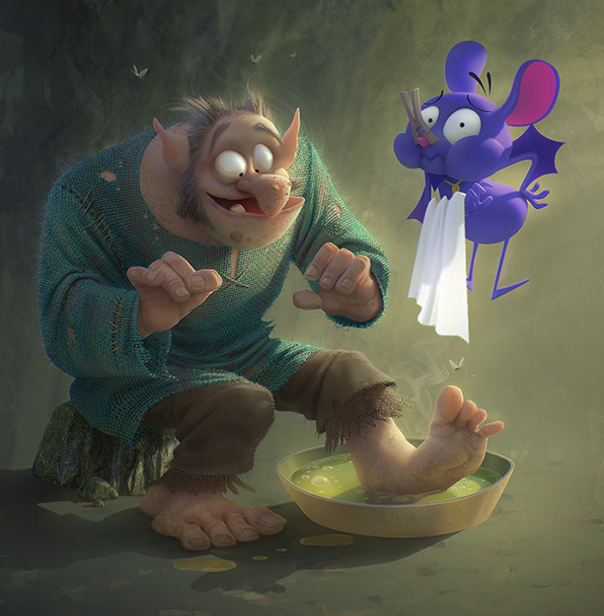
A complex sentence is a sentence with two clauses:
A main clause with a subject doing a verb which makes complete, perfect sense on its own.
Write a main clause about this picture. Main clauses are usually short (subject + verb + object).

Slide 9
A complex sentence is a sentence with two clauses:
A main clause with a subject doing a verb which makes complete, perfect sense on its own.
A subordinate clause with a subordinating conjunction. It may have a subject doing a verb but it does not make sense on its own. It relies on the main clause!

Slide 10

Grammar: Subordinating Conjunctions
Even though
If
When
Unless
As soon as
Before
Although
After
Until
While
As
So
Rather than
Because
Whenever
Let’s try and make full complex sentences now!

Slide 11
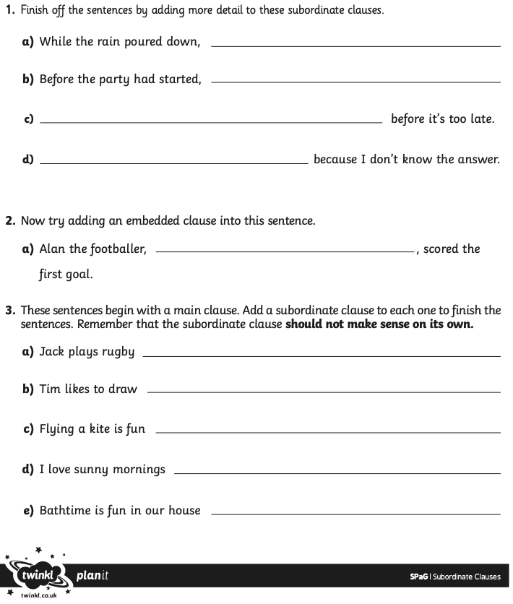
Your Task

Slide 12
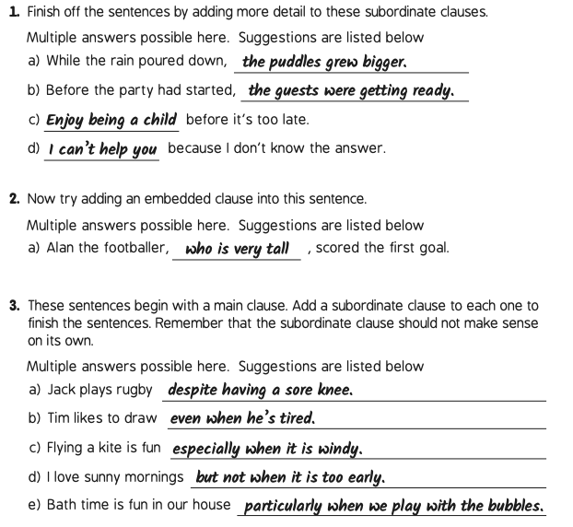
Answers

Slide 13

Notes:
On the following slides will be SATS questions based on what they have just learnt.

Slide 14
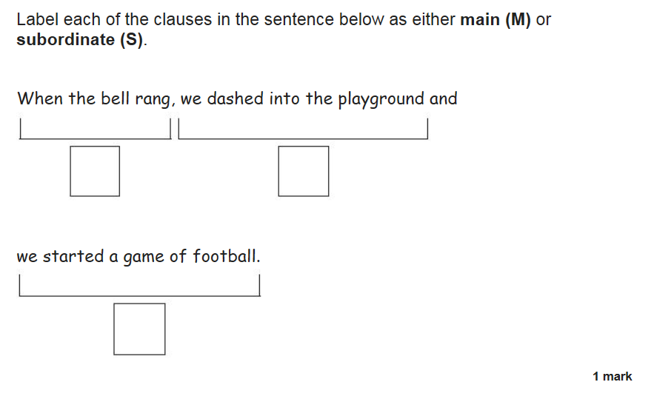
Notes:
S,M,M

Slide 15
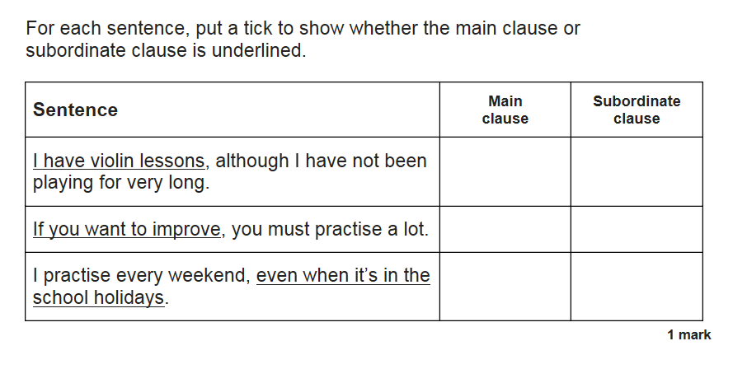
Notes:
M,S,S

Slide 16
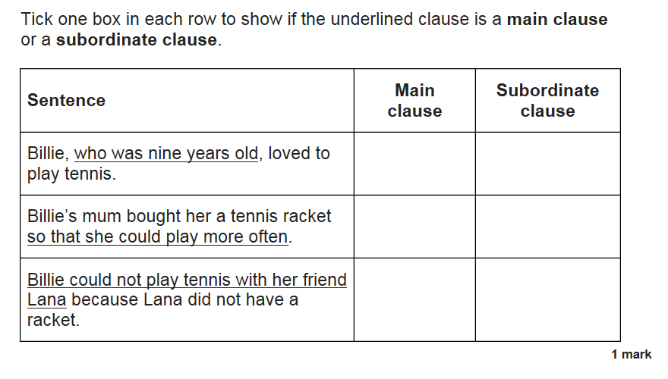
Notes:
S,S,M

Slide 17
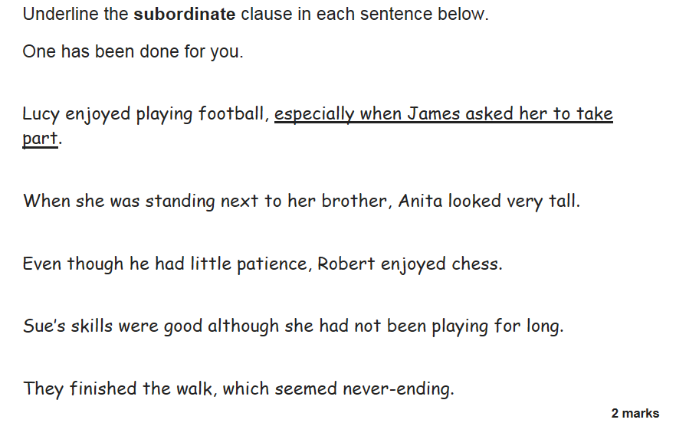
Notes:
(a) When she was standing next to her brother, Anita looked very tall.
(b) Even though he had little patience, Robert enjoyed chess.
(c) Sue’s skills were good although she had not been playing for long.
(d) They finished the walk, which seemed never-ending.

