Slide 1



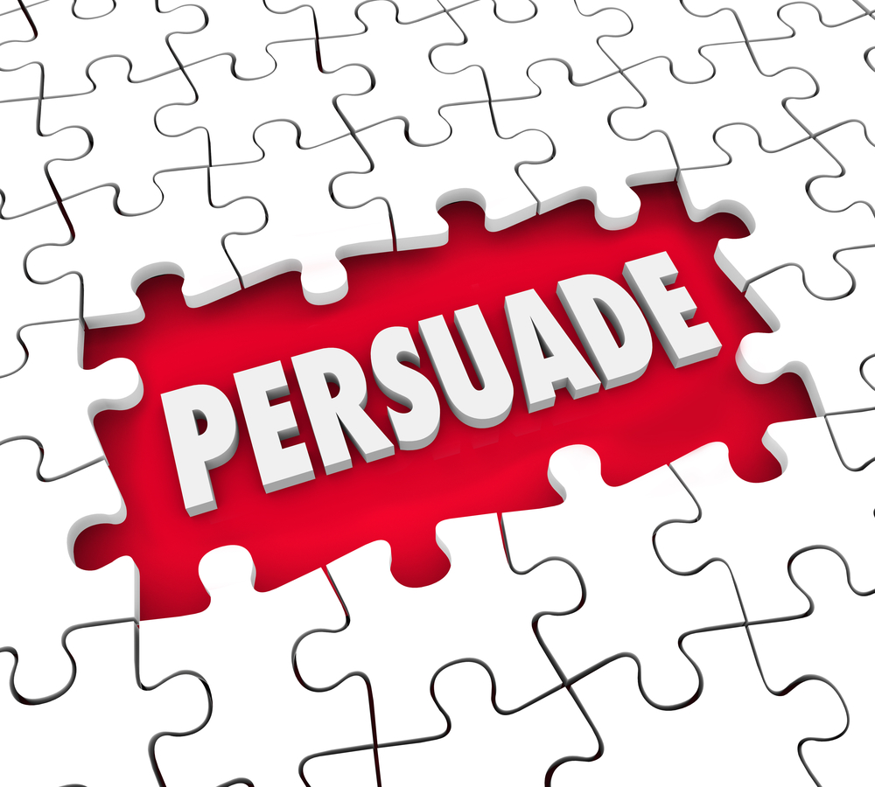



Persuasive Writing

Slide 2
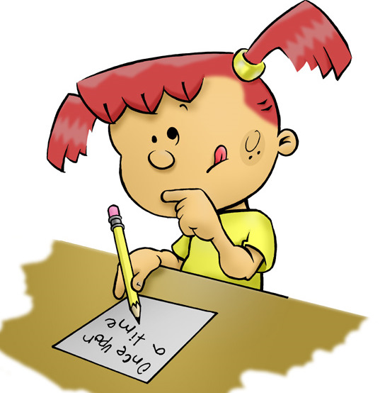
What does the word ‘persuasive’ mean and what is its purpose?

Slide 3
Purpose of a persuasive writing
To have an effect on the reader and begin to challenge or change their opinion based on a specific topic. Persuasive writing is very powerful when done correctly.

Slide 4
Let’s have a look at one now…
How does this persuasive text inform the reader in an effective way based on the writer’s opinion?
A piece of persuasive writing about John.
Notes:
Could discuss these ideas together. Encourage children to think about the language used, grammar techniques, the structure/lay out and any other features.
Children to unpick the different features. Paragraphs. Opening & closing paragraphs. Paragraph for each main point/idea. High-level vocabulary. Modal verbs. Rhetorical questions.

Slide 5
Features of a persuasive text
Features are the ‘stuff,’ or the ‘things,’ or the ‘ingredients’ that go into a text to make it what it is.
For example, the features of a horror story would be a spooky setting, tense writing and an exciting event!
From reading this persuasive text about John and his over use of apps, what do you think the features might be?

Slide 6
Features of a persuasive text
Opening paragraph
First person
Personal pronouns
Present tense
Rhetorical questions
Fronted adverbials
Colons
Repeated words
Powerful verbs
Subjunctive verb form
Strong adjectives
Closing paragraph

Slide 7

Your task today will be to write a persuasive piece of writing from a chosen topic. Before you start writing, you need to produce a small plan to help jot down your initial ideas, so you have a structure when writing.
On the following slide will be suggested topics that you may wish to write about.
Suggested structure:
Opening paragraph
Point one
Point two
Closing paragraph
Your plan can be either notes or verbally to an adult or a sibling.
Notes:
As you are only expected to discuss two points, make sure these are the strongest two – they must be really effective to persuade the reader.
You may choose to write more ☺

Slide 8

Possible topics for you to write your persuasive writing on.
Homework should be given everyday.
Weekends should be 3 days long.
Children should only be able to watch 30 minutes of TV a day.
Children should not be able to have a phone until they are 16.
Takeaways/fast food should be banned.
Cars should be banned to reduce global warming.
Notes:
Explain to children that they don’t have to agree with each topic but they should choose the one which they feel they could be most persuasive about.
Children aren’t limited to these ideas, they are just a starting point.
Children to think carefully who they would be writing in the view of.
E.g. Homework should be given everyday (government, teachers, headteacher).
Takeaways should be banned (health experts)

Slide 9
Features of a persuasive text
Opening paragraph
First person
Personal pronouns
Present tense
Rhetorical questions
Fronted adverbials
Colons
Repeated words
Powerful verbs
Subjunctive verb form
Strong adjectives
Closing paragraph
Notes:
A reminder of key features before writing – children might write these down/print them off so they can tick them off as they go along.

Slide 10

Things to consider
Opening paragraph – This could be in the form of a short story (‘This will all change if’ sentence) or ‘Worried about… you should be! You could use ‘They say x3. We say x1’.
Main point paragraphs – Use the word bank on the PPT to help you. Also, refer back to the features of a persuasive text to ensure you have a range of punctuation and grammar techniques.
Closing paragraph – You could emphasise that urgent action is required (depending on chosen topic). You might reiterate the points made in your main paragraphs. You could close with double opposite questioning to get the reader to think about the main reason for writing.
Write your persuasive writing in your green book. You may want to draw lines or stick lined paper in to make sure that your writing is neat.
Notes:
These are ideas for children to think about which are modelled on the following slide.

Slide 11
Opener #1: Short story with a ‘This will all change if’ sentence
Checklist (what is needed in this opener) | Example
Use a proper noun (person) Paint a happy picture in the reader’s head Make this ‘picture’ (story) list-like using ; if you know how (if not use full stops) Start your second paragraph with ‘This will all change if…’ End your second paragraph with what you’re going to argue | Tim is a carefree boy. He sometimes runs all the way to school without stopping even once! He doesn’t have to worry about cars racing by; he doesn’t have to worry about speeding lorries; he doesn’t have to worry about huge, heavy trucks. This is because Tim doesn’t have to worry about crossing a busy road on his way to school. This will all change if the proposed road, directly in front of our school, is built. In this essay I will explain exactly why Tim should remain carefree and exactly why the road should NOT be constructed.

Slide 12
Opener #2: Worried about…you should be!
Checklist (what is needed in this opener) | Example
This opener is all about making the reader fearful or worried Start with a question Worried about…? Then tell them You should be! Make your point quickly at the start, In this essay I’ll… | Worried about obesity in the UK? You should be! In this essay I’ll persuade you why being overweight is the biggest threat that the UK is currently facing.

Slide 13
Opener #3: They say x3. We say x1
Checklist (what is needed in this opener) | Example
Use ‘they’ and ‘we’ to encourage the reader to take your side The sentences are repetitive; this encourages reader to take your side and adds drama Use a powerful verb in the second paragraph- convince, persuade, prove, show, demonstrate | They say it’s ok to eat sweets. They say it’s ok not to exercise. They say it’s ok to watch television all day. We say that it’s not ok and in this essay we’ll convince them that it’s not ok.

Slide 14
Closing #1: Urgent action needed
Checklist (what is needed in this opener) | Example
This ending is all about calling your reader into action (doing something) You need to make your reader get up and act Use verbs like: wait, act, hurry, walk, run Use phrases like: time is running out; the clock is ticking | Time is running out. The clock is ticking. We haven’t got much longer. Can you really walk away and do nothing?

Slide 15
Closing #2: Bullet point reiteration
Checklist (what is needed in this opener) | Example
Use bullet points Keep it very short and snappy Reiterate (repeat) the main points from your essay | To conclude, the airport runway should not be build because: It would be very noisy Pollution would increase Animals’ homes would be destroyed

Slide 16
Closing #3: Double opposite questioning
Checklist (what is needed in this opener) | Example
Ask 2 questions Both questions should be the opposite of what you want your reader to do Next sentence must start with No, Then you tell your reader what your point is once again | Are we a school that wants junk food from McDonalds? Are we a school that wants junk food from KFC? No, in our school we want healthy food and in this essay I’ve proved why healthy food is so important for children.

Slide 17
Being persuasive word bank
beseech | extremely | highly | implore | startling
tremendous | certainly | definitely | magnificent | worthwhile
abolish | appalled | atrocious | awful | corrupt
disaster | harmful | harsh | inconsiderate | strongly
urge | remarkable | popular | doubt | superb
Notes:
Strong vocabulary choices children might consider using in their writing. Emphasise that all words are not expected to be used and they should be familiar with the meaning before using in their work – it must fit the context.

Slide 18

Does it make sense?
When you’re happy with it, read your story to someone in your house.
Did it persuade them?

