Slide 1
Year 5 Measure
Length
Week 3 Lesson 3 – problem solving part 2 (multiplication and division)

Slide 2
In today’s lesson
We are going to apply everything you have learnt over that last few lesson on measurement. These problem solving questions will put what you have learnt into real everyday scenario’s. You need to be aware what method you are using to get to the answer. Yesterday, we concentrated specifically on addition and subtraction. Today, we are going to look at multiplication and division.

Slide 3
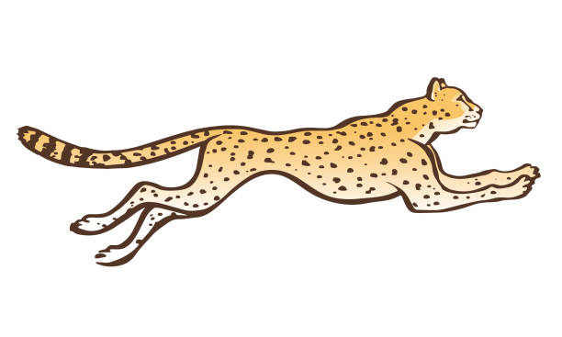
Charlie runs 480m. Chester runs four times further. How much does Chester run in km?
From the question, I can tell that we are looking at a multiplication question. This is because it says ‘times further’.
Chester runs x4 further
480m x 4 = 1840m
Yesterday, I showed you to convert the measurement first. Today I have converted the answer afterwards. Yesterday we need the unit of measurement the same to do any working. Today it can be done at the end.
 |  | 4 | 8 | 0
 | x |  |  | 4
 | 1 | 8 | 4 | 0
2
M | to | KM | ÷ 1,000
KM | to | M | X 1,000
1,000M = 1KM 1kM = 1,000CM

Slide 4
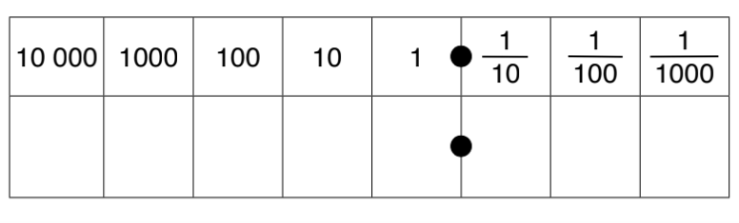
Charlie runs 480m. Chester runs four times further. How much does Chester run in km?
1840 m to km =
1840 ÷ 1,000 = 1.84km
 |  | 4 | 8 | 0
 | x |  |  | 4
 | 1 | 8 | 4 | 0
M | to | KM | ÷ 1,000
KM | to | M | X 1,000
1,000M = 1KM 1kM = 1,000CM
2
1
8
4
0
1
8
4

Slide 5
Mr. Hunt shares fish fingers and custard, that is 428m high, between him and his three friends. In km, how much do they each get?
This time the question is division. I know this because they are sharing between people.
Be careful with the question though. It says between him and his three friends (so we are dividing by 4).
428m ÷ 4 = 107m each
 |  | 1 | 0 | 7
 | 4 | 4 | 2 | 8
2
M | to | KM | ÷ 1,000
KM | to | M | X 1,000
1,000M = 1KM 1kM = 1,000CM

Slide 6
Mr. Hunt shares fish fingers and custard, that is 428m high, between him and his three friends. In km, how much do they each get?
428m ÷ 4 = 107m each
M to KM = ÷ 1,000
107 ÷ 1,000 = 0.107km
M | to | KM | ÷ 1,000
KM | to | M | X 1,000
1,000M = 1KM 1kM = 1,000CM
 |  | 1 | 0 | 7
 | 4 | 4 | 2 | 8
2
1
0
7
0
1
0
7

Slide 7
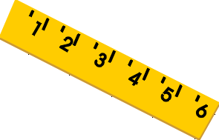
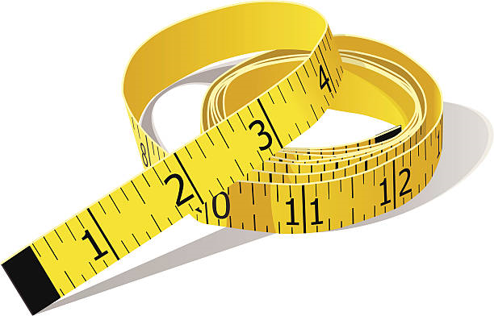
Important notes for today.
converting between mm, cm, m and km (on the next slide is the table used from each of the previous lessons to help you).
knowing when to multiply and divide(read the question carefully).
Using either short multiplication or bus stop method.

Slide 8
MM | to | CM | ÷ 10
CM | to | MM | X 10
This is because 1CM = 10MM AKA 10MM = 1CM!
CM | to | M | ÷ 100
M | to | CM | X 100
100CM = 1M 1M = 100CM
M | to | KM | ÷ 1,000
KM | to | M | X 1,000
1,000M = 1KM 1kM = 1,000CM

Slide 9
Notes:
Print back2back for the chn to use if needed.

Slide 10
Notes:
Print back2back for the chn to use if needed.

