Slide 1
Year 5 Measure
Area
Week 6 Lesson 3 – introduction to volume

Slide 2
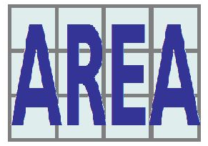
Remember - Area
When we measure all of the inside space in a shape.
A = L x W

Slide 3
Now we know how to work out the area of 2D shapes (like the one below) using L x W. However how would we do that with 3D shapes.
A = L x W

Slide 4
3D shapes
A three shape is basically a solid figure. An object that has three dimensions – length, width and height.
A 2D shape only has length and width.

Slide 5
3D shapes
However, in Year 5 it isn’t your job to work out the area of a compound shape.
Your job is to make an estimate of its area.
Today’s lesson – can go in one of two ways.
If you have blocks, Lego or cubes at home then you will only need to use the powerpoint and not the worksheet provided today.
If you do not have the above, use the learning from the powerpoints next few slides to help you on the worksheet like the normal lessons.

Slide 6
Estimating area can be tricky depending on the shape that you have. If you’re able to see every block like you can in the picture, then all you have to do is count them.
Red = 5cm³
Orange = 6cm³
Yellow = 6cm³
Blue = 4cm³
Green = 6cm³
We use cm³ because it is 3 dimensional shapes so we are multiplying by itself 3 times.

Slide 7
However, on some of these shapes you cannot see every cube. This means you need to make a logical guess from this angle. Below there are quite a few shapes here that have hidden sides.
The first shape I guess there is 8cm^{3.}
I have guessed this because on the side I can see. I can count 4 squares (area circled). Because the width is 2, I multiplied that by 4.

Slide 8
For this shape I followed a similar method. I can see 4 cubes on the side. Width is 2 cubes so I multiplied them together.

Slide 9
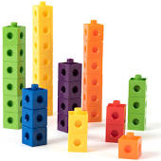
Important notice
Think logically when your try to make your estimation.
Always consider are there any hidden cubes.

Slide 10
If you have blocks, lego or cubes now continue on with the tasks on the slide.
If you haven’t, you can now refer to the worksheet.

Slide 11
Task 1
Take 10 cubes
Build the cubes to make a shape.
How many different shapes can you make
However, what is the same about these shapes?
Notes:
.

Slide 12
They all have the same volume!
10cm³

Slide 13
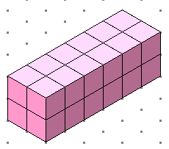
Task 2
How many more cubes are needed so that this shape has a volume of 27cm³?
Notes:
Encourage children to build it too

Slide 14
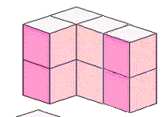
Task 3
How many less cubes are needed so that this shape has a volume of 7cm³?
Notes:
Encourage children to build it too

Slide 15
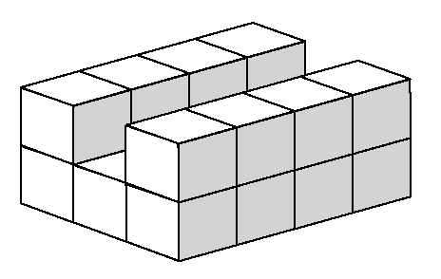
Task 4
Build a shape that has the same volume as this one here.
Notes:
Encourage children to build it before and to work from.

Slide 16
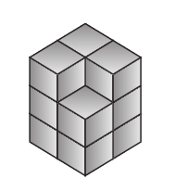
Task 5
Build a shape that has the same volume as this one here.

