Slide 1
Year 5 Measure
Weight
Week 4 Lesson 2 – problem solving using scales

Slide 2


In today’s lesson
To achieve today's lesson we are going to:
reading scales by studying the intervals.
converting between g and kg.
knowing what the question is asking me to do.
using column methods.

Slide 3
Remember…
G |  | KG | ÷ 1,000
KG |  | G | X 1,000
1,000G = 1KG 1kG = 1,000G

Slide 4
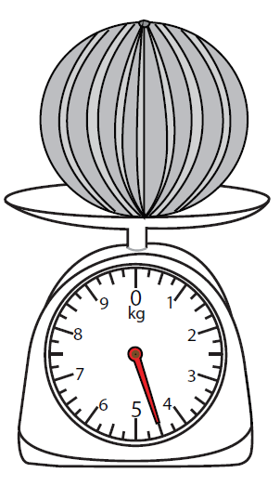
A melon weighs:
In today’s lesson, you need to be able to read a weighing scales. If you have one at home, it would be a great way to help you.
As you can see by the picture, the scale measures how heavy the object is in kilograms.
Reading the scale carefully you can see the dial is halfway between 4 and 5. This means that the weight of the melon is 4.5kg.
Depending on the scale, you may have a different amount of smaller lines between each kg. Each line on this scale goes up 0.25kg. You may notice there is a slightly larger line in-between to smaller lines. This means its halfway through (0.5kg).
Reading scales can be quite tricky until you get the hang of it so be careful.

Slide 5
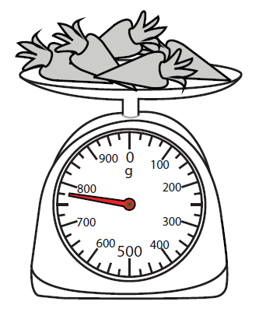
Carrots weigh:
By reading the scales, you will notice that the dial is in between 700 and 800 grams.
I know that it is measured in grams because there is a G below the 0 on the scales. To work out exactly how much the carrots weight we need to look at how many lines are between 700 and 800. There are 3 lines but 4 movements of the dial.
So 100 (difference between 700 and 800) divided by 4 will give you the amount increased between each dial. The answer is 25g.
As the dial is pointing to the third one between the two numbers the answer is 775g.
If we were to have a go at the question below, we need to convert so both are using the same measurement type.
775g into kg = 0.775kg
0.775kg subtract 0.45kg = 0.325kg
0.45kg are removed. How much do the scales read now?

Slide 6
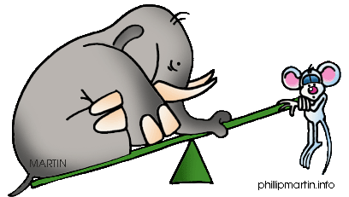
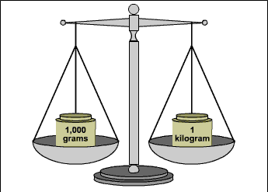
Important notes for today.
reading scales by studying the intervals.
converting between g and kg.
knowing what the question is asking me to do.
using column methods.
G | to | KG | ÷ 1,000
KG | to | G | X 1,000
1,000G = 1KG 1kG = 1,000G

