Slide 1
Year 5 Measure
Length
Lesson 1 – converting units of measurement
MM to CM
Cm to MM

Slide 2
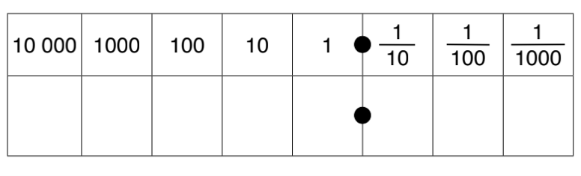
Before Christmas, we looked at multiplying and dividing by 10, 100 and 1,000. We have looked at this method on many occasions since then during Fast Five and maths reasoning. This method is helpful when converting between measurements.
Multiplying means that we are getting bigger so the place value grid we would move to the left.
If we are multiplying/dividing by 10 we would move one place value.
24 x 10
Have a look at the number sentence that you have.
If we are multiplying are we getting bigger or smaller?
How many times are we getting bigger or smaller?
The number sentence can answer both these questions.
Place value grid
2
4

Slide 3
24 x 10 = 240
We have moved once to the left.
As you can see, I have added a 0 into the ones column. This acts as a place holder as we have no other number to put there and we cannot leave this value blank
Place value grid
2
4
0

Slide 4
407 x 10
Are we multiplying or dividing?
What are we multiplying or dividing by (means the amount of place value we are moving)
Place value grid
4
0
7

Slide 5
407 x 10 = 4,070
As you can see we are multiplying this means we will be getting bigger. Due to this, we will be moving the numbers to the left.
Because we are multiplying by 10, this means we will move one place value to the left.
Place value grid
4
0
7
From moving each of the numbers over, you can see that there is a no number in the ones column before the decimal. A place holder must be put here for it to be correct.

Slide 6
What about this time?
Are we multiplying or dividing?
What are we multiplying or dividing by (means the amount of place value we are moving)
309 ÷ 10
3
0
9

Slide 7
309 ÷ 10 = 30.9
As you can see, we are dividing this means now we are moving to the right because we are getting smaller.
We are dividing by 10 so we are moving one place value to the right.
3
0
9

Slide 8
In today’s lesson, we need to convert between these two measurements when comparing!
MM |  | CM | ÷ 10
CM |  | MM | X 10
This is because 1CM = 10MM AKA 10MM = 1CM!

Slide 9
12cm into mm
MM | to | CM | ÷ 10
CM | to | MM | X 10
This is because 1CM = 10MM AKA 10MM = 1CM!
From the question, you can see that we need to convert from a cm to a millimetre. On the table to the right, it will guide you to whether you are multiplying or dividing.
CM to MM = x10
Place value grid
1
2

Slide 10
12cm into mm
CM to MM = x10
12 cm x 10 = 120mm
Because we are multiplying, we move to the left (getting larger). We are multiplying by 10 so we move once to the left. As there was no number in the ones column we must add our place holder.
MM | to | CM | ÷ 10
CM | to | MM | X 10
This is because 1CM = 10MM AKA 10MM = 1CM!
Place value grid
1
2
0

Slide 11
18mm to cm
MM | to | CM | ÷ 10
CM | to | MM | X 10
This is because 1CM = 10MM AKA 10MM = 1CM!
From the question, you can see that we need to convert from a mm to a cm. On the table to the right, it will guide you to whether you are multiplying or dividing.
MM to CM = ÷ 10
Place value grid
1
8

Slide 12
18mm to cm
MM | to | CM | ÷ 10
CM | to | MM | X 10
This is because 1CM = 10MM AKA 10MM = 1CM!
MM to CM = ÷ 10
Because we are dividing, this means we are getting smaller. As we are dividing by 10, this means we are moving once to the right.
No place holders needed as we have a number in the ones column once converted.
18 ÷ 10 = 1.8
Place value grid
1
8

Slide 13
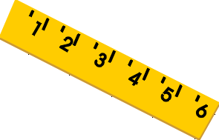
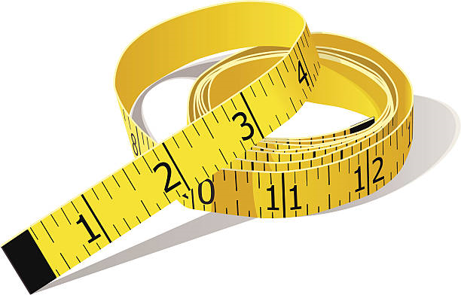
Today’s rule.
÷ by 10 when converting MM to CM.
X by 10 when converting CM to MM.

Slide 14
Notes:
Print back2back for the chn to use if needed.

Slide 15
Notes:
Print back2back for the chn to use if needed.

