Slide 1


Slide 2
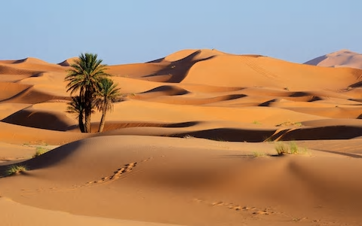
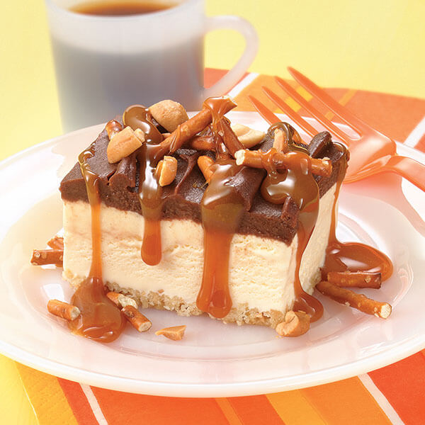
Homophones
Desert
Dessert

Slide 3

Homophones
Miss. Nicholls asked for the ____________ menu after eating a big burger!
Notes:
dessert

Slide 4
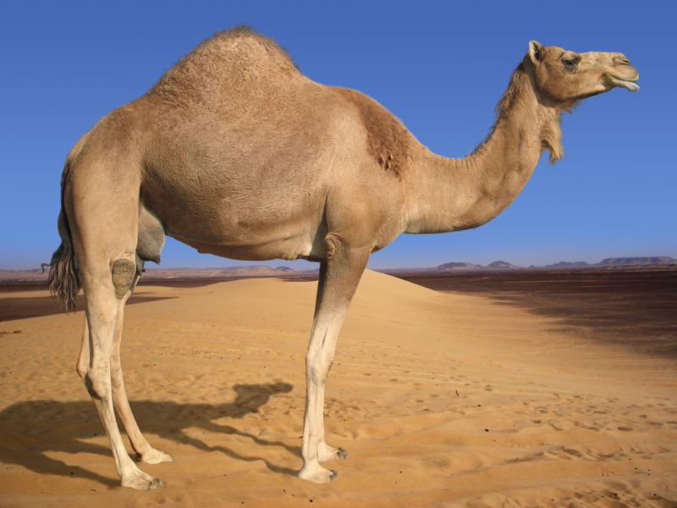
Homophones
Camels have big feet so that they don’t sink into the sand of the _________________.
Notes:
desert

Slide 5



Homophones
Principal
Principle

Slide 6

Homophones
“Go and see the _________________!” the angry teacher ordered.
Notes:
principal

Slide 7

Homophones
Stealing is against my _________________.
Notes:
principles

Slide 8
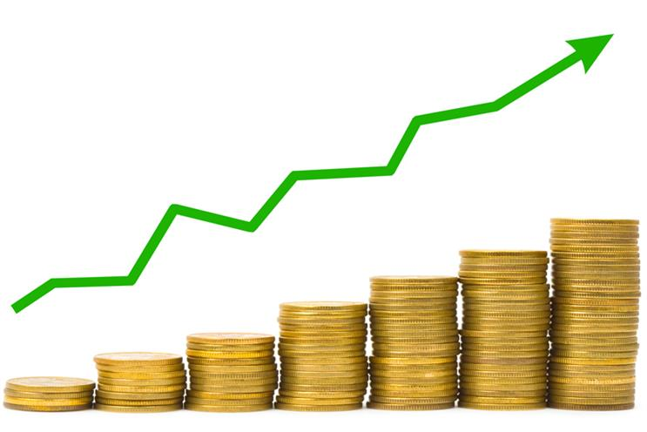

Homophones
Profit
Prophet

Slide 9
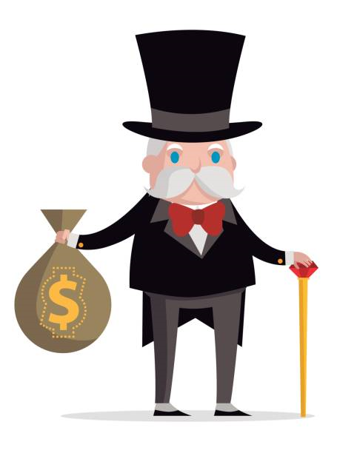
Homophones
The greedy banker was pleased with the amount of ________________ his bank had recently made.
Notes:
profit

Slide 10

Homophones
After deducting tax, Lord Sugar still had £2,000 _______________.
Notes:
profit

Slide 11
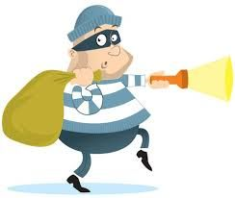
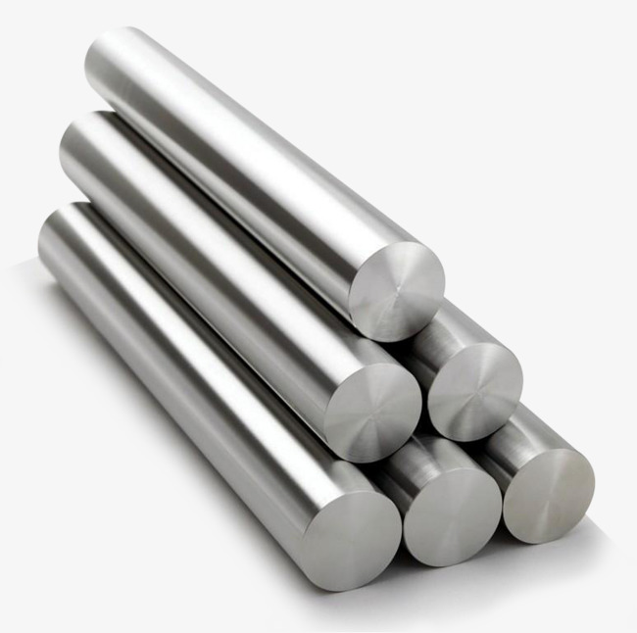
Homophones
Steal
Steel

Slide 12
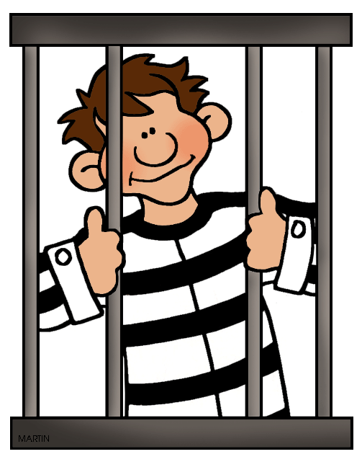
Homophones
If you _________ something, you risk getting caught and going to prison.
Notes:
steal

Slide 13

Homophones
The architect used __________ to build the base of the building.
Notes:
steel

Slide 14

Modal verbs
Modal verbs are a type of action / doing word.
Modal verbs tell us how definite or certain something is.
So, modal verbs come into two categories.
  certain
  uncertain

Slide 15
Modal Verbs
Certain / Definite | Uncertain / Not definite (possible)
can will must shall | may could might should ought to would need to

Slide 16

Let’s have a look at how modal verbs affect a sentence
I ___________ do my homework.
I ___________ do my homework.
will
might
Notes:
Will shows it is certain/definite
Might shows possibility/uncertainty – they may or may not do their homework

Slide 17
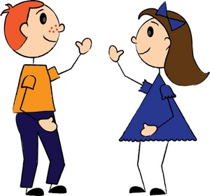
Which one of these modal verbs shows the most likely event? Why?
I ought to visit my friend.
I need to visit my friend.
I shall visit my friend.
I could visit my friend.
Notes:
Note how answer is C not B – need to does not necessarily mean you will do it!

Slide 18
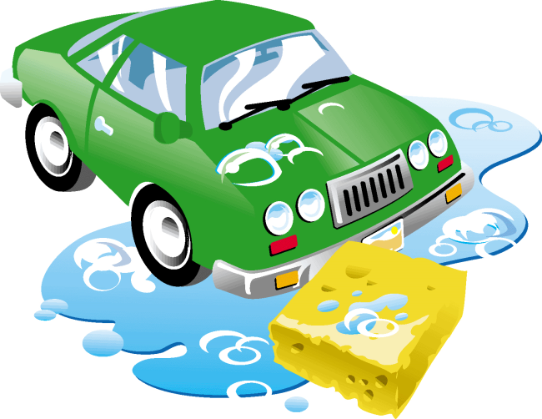
Which one of these modal verbs shows the least likely event? Why?
I might clean my car.
I must clean my car.
I will clean my car.
I shall clean my car.
Notes:
A

Slide 19

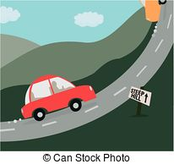
Expanded noun phrase
adjective, + adjective + noun =
expanded noun phrase

Slide 20
Expanded noun phrase
adjective, + adjective + noun =
the long, bumpy road
Remember your comma between your adjectives!

Slide 21
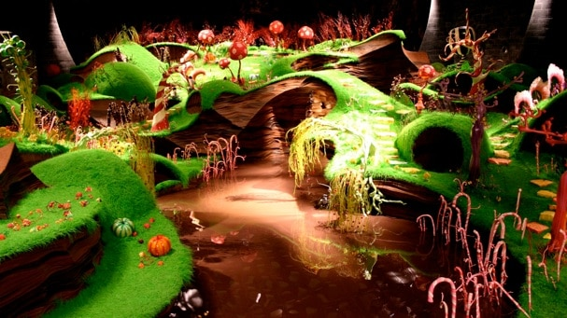
Your Task
Write a short descriptive paragraph using the photo below for inspiration. You must include three different expanded noun phrases throughout.
You should aim to include our other year 5 features such as subordination/complex sentences, fronted adverbials and relative clauses.
Try to vary your placement of expanded noun phrases so they are effective and remember to include your comma accurately.

Slide 22

Notes:
On the following slides will be SATS questions based on what they have just learnt.

Slide 23
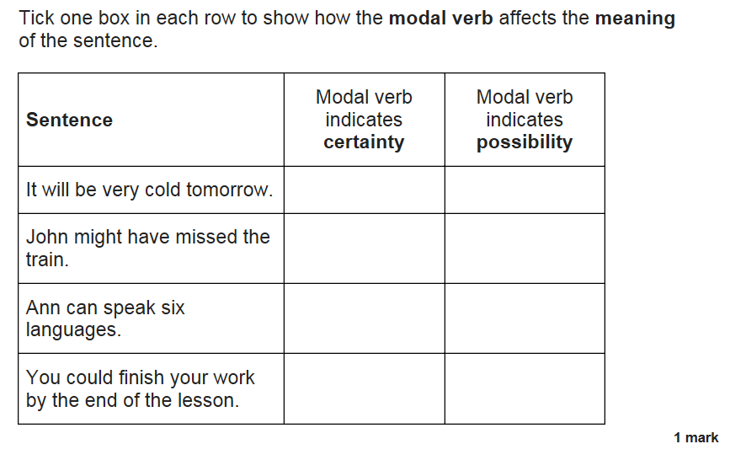
SATs question
Notes:
Certainty
Possibility
Certainty
possibility

Slide 24
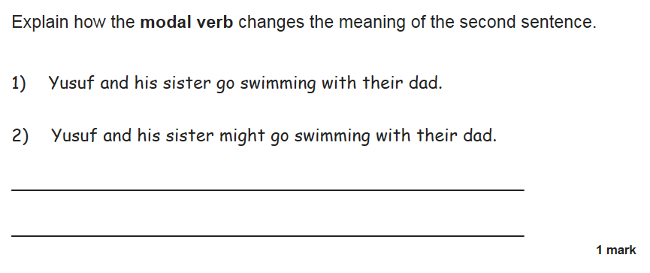
SATs question
Notes:
In the second sentence they are not definitely going swimming.
• The second sentence means maybe they are going to go swimming.
• In the second sentence, they might go but in the first, they will definitely go.

