Slide 1
Year 5
Roman Numerals
Week 7 Lesson 2 – Roman numerals

Slide 2
What do you remember from yesterday’s session?
Write down as many numbers you remember as possible.

Slide 3
What do you remember from yesterday session? Are you able to fill in the blanks?
I
 | 5
X | 10
L
 | 100
D
 | 1000

Slide 4
Roman Numerals
I | 1
V | 5
X | 10
L | 50
C | 100
D | 500
M | 1000

Slide 5
Important Rules – Reminder!
1. If the numbers go from largest to smallest, then it is a straight add.
2. If the numbers in parts go smaller to larger, then it is a subtraction.
3. You cannot have more than three consecutive numbers.
4 and 9 are the tricky numbers that we need to watch out for!

Slide 6
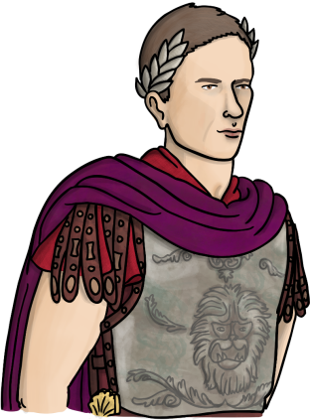
Today we are going to continue with Roman Numerals but begin to look at adding Year 5 style math's problems to it.

Slide 7
Roman Numerals
I | 1
V | 5
X | 10
L | 50
C | 100
D | 500
M | 1000
1,861
To work out this number as a roman numeral we need to use the chart.
We don’t have any fours or nines so this makes it a little easier.
The one in the thousands column is going to represent M.
The 8 in the hundreds column is going to be represented as DCCC. This means 500 + 3 lots of 100 (which equals 800).
The 6 in the tens column will represented as LX because it is 50 + 10.
Finally the 1 is I.
When we put them altogether, it will be MDCCCLXI

Slide 8
Roman Numerals
I | 1
V | 5
X | 10
L | 50
C | 100
D | 500
M | 1000
2,319
The two (Thousands) is going to be represented as MM (2 x 1,000).
The three (hundreds) is going to be represented as CCC (100 + 100 + 100).
The one (tens) is going to be represented as X.
The nine is going to be represented as IX
Remember because if it is 4 or 9 it means 1 less than the higher value column in this case ten.
Answer - MMCCCXIX

Slide 9
Now that we have had a little look at two trickier numbers, Work out this addition question then convert into roman numerals.
I | 1
V | 5
X | 10
L | 50
C | 100
D | 500
M | 1000
1,107 + 1,893 =

Slide 10
1,107 + 1,893 =
Answer – 3,000
In roman numerals = MMM
I | 1
V | 5
X | 10
L | 50
C | 100
D | 500
M | 1000

Slide 11
Your turn
Can you make these numbers?
3,891 – 1,634 =
I | 1
V | 5
X | 10
L | 50
C | 100
D | 500
M | 1000

Slide 12
3,891 – 1,634 =
Answer = 2,257
In roman numerals =
2 = MM
2 = CC
5 = L
7 = VII
Altogether = MMCCLVII
I | 1
V | 5
X | 10
L | 50
C | 100
D | 500
M | 1000

Slide 13
Your turn
Now try finding the number from the numerals
I | 1
V | 5
X | 10
L | 50
C | 100
D | 500
M | 1000
45 x 38 =

Slide 14
45 x 38 =
Answer = 1710
In roman numerals
1 = M
7 = DCC
1= X
0 = doesn’t need to be represented
MDCCX
I | 1
V | 5
X | 10
L | 50
C | 100
D | 500
M | 1000

Slide 15
Important Rules – Reminder!
1. If the numbers go from largest to smallest, then it is a straight add.
2. If the numbers in parts go smaller to larger, then it is a subtraction.
3. You cannot have more than three consecutive numbers.
4 and 9 are the tricky numbers that we need to watch out for!

