Slide 1
Year 5/6 word list
restaurant
Yum!

Slide 2
Year 5/6 word list
rhyme
Endings of words that sound similar.

Slide 3
Year 5/6 word list
rhythm
A strong, regular repeated pattern or sound.

Slide 4
Can you think of any words that have ‘ei’ after c?

Slide 5
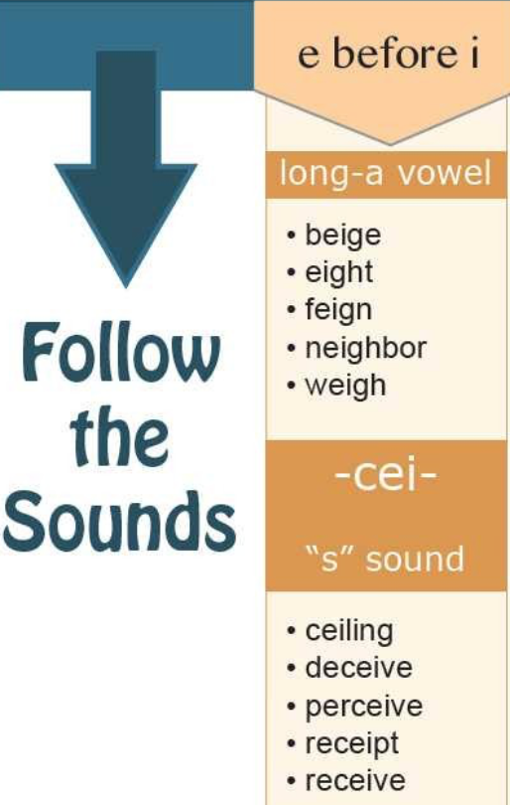
You might have heard of the common rhyme,
I before E except after C
But there is another line which is often missed out…
or when sounding like AY as in neighbour and weigh
I before E except after C
or when sounding like AY as in neighbour and weigh
However, as with most rules, there are a few exceptions. Here are some common exceptions to the above rule:
either, neither, caffeine, codeine, counterfeit, foreign, forfeit, height, leisure, protein, their, weird, seize, seizure.

Slide 6
–ei (after c)
receive
weight
height
reign
foreign
receipt
protein
forfeit
deceive
caffeine
ceiling
inconceivable
neighbour
weird
vein

Slide 7
–ei (after c)
Receive_______________________________________________________________________________________________
Weight _______________________________________________________________________________________________
Height _______________________________________________________________________________________________
Reign ________________________________________________________________________________________________
Foreign _______________________________________________________________________________________________
Receipt _______________________________________________________________________________________________
Protein _______________________________________________________________________________________________
Forfeit ________________________________________________________________________________________________
Deceive _______________________________________________________________________________________________
Caffeine ______________________________________________________________________________________________
Ceiling ________________________________________________________________________________________________
Inconceivable __________________________________________________________________________________________
Neighbour ____________________________________________________________________________________________
Weird ________________________________________________________________________________________________
Vein __________________________________________________________________________________________________
Notes:
Good opportunity for children to use dictionary to identify definitions of unfamiliar words

Slide 8
–ei (after c)
receive
weight
height
reign
foreign
receipt
protein
forfeit
deceive
caffeine
ceiling
inconceivable
neighbour
weird
vein
Make a pair!
Choose two words that are –ei and put them in the same sentence. The sentence must make grammatical sense and try to make it of a Year 5 standard too. Don’t be basic and boring!

Slide 9
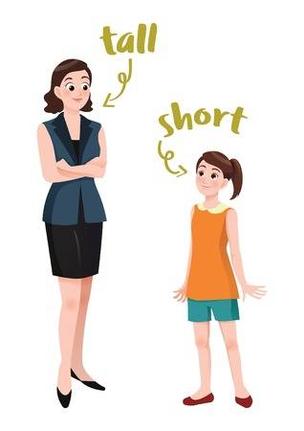
Make a pair – example
I have a neighbour who is an extremely tall height; she is at least 20cm taller than I am!
Notes:
Unpick this sentence with the children: the ei words (neighbour & height), the adverb (extremely), the semi-colon (two main clauses that have a link) and how I’ve used pronoun ‘she’ not neighbour again. Note how this is a good sentence and you/I expect the same from the children.

Slide 10
Anagrams
gehith
height
Notes:
Children to unscramble the letters to spell one of their new words.

Slide 11
Anagrams
eritonp
protein
Notes:
Children to unscramble the letters to spell one of their new words.

Slide 12
Anagrams
gicelni
ceiling
Notes:
Children to unscramble the letters to spell one of their new words.

Slide 13
Anagrams
eeecriv
receive
Notes:
Children to unscramble the letters to spell one of their new words.

Slide 14
–ei (after c) wordsearch
receive
weight
height
reign
foreign
receipt
protein
forfeit
deceive
caffeine
ceiling
inconceivable
neighbour
weird
vein
Notes:
Children have the choice of completing a word search or crossword to consolidate their knowledge of the new spelling pattern

