Slide 1
We have covered all of the spelling patterns for Year 5 and have also recapped some that we explored earlier in the year.
For our final two weeks, you can spend the time practicing the year 5/6 statutory words.
We have broken this down into two sections so that you can practice half during your lesson today and the other half next week.
On the next slide, I have attached the spellings I would like you to focus on and practice. You may do a spelling test to find out which ones you struggle with or may want to practice them all.
We have included a range of strategies and ideas over the next few slides which may be useful to try.

Slide 2
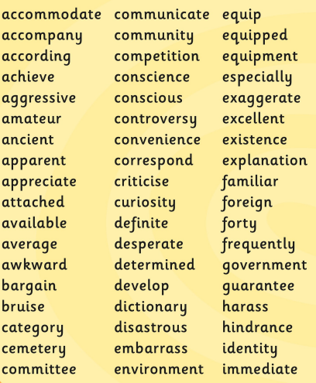

Slide 3



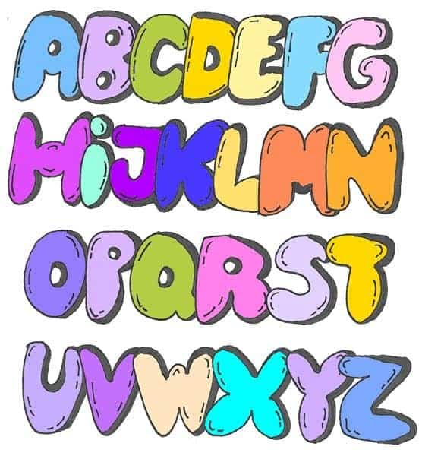


Bubble words:
Write your spellings in bubble letters.
You can colour these in afterwards.
Spelling flowers:
Draw a big flower.
Write each of your spelling words on one of the petals.
Write your spelling words using dots. Connect the dots you’ve drawn by tracing over them with a coloured pencil.
This Photo by Unknown Author is licensed under CC BY-SA

Slide 4



Fancy letters:
Write out your spellings in fancy handwriting and take your time.
Silly sentences!
Write silly sentences that include your spellings in. How many of your spellings can you fit into one sentence?
Rainbow write:
First write your spelling words in pencil then trace over the words five times using a different colour each time.

Slide 5
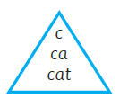

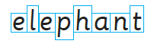
Building blocks:
Draw letter boxes for each of your spelling words. Box the shape of short, tall and tail letters and then write the words in the boxes.
Tell a story:
Write a short story using your spelling words and underline them when you use them!
Spelling pyramids:
Use your words to make spelling pyramids by adding one letter each time.

