Slide 1
Year 5 Measure
Perimeter
Week 5 Lesson 1 – measuring perimeter

Slide 2
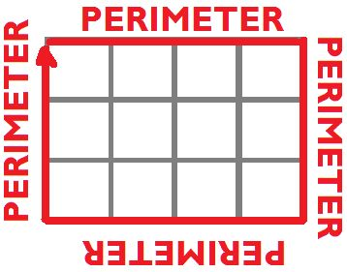
Perimeter – Key message
When we measure all the way around the outside of a straight-sided shape.

Slide 3
Can I calculate the perimeter of this composite shape?
Not to scale
Unfortunately, we can’t work out the perimeter just yet as we have two missing sides. But are we able to work out what these sides are based on what we already know?
4cm
3cm
6cm
7cm

Slide 4
Can I calculate the perimeter of this composite shape?
From the information we have on this shape, we can work out its perimeter if we find the missing sides. As you can see by the blue arrows, we have two sides missing. Lets concentrate on the larger line (A). Using the orange arrows we can work out what this side is because they’re opposite to the side we want to work out. Just because they aren't one side, doesn’t mean we cannot work it out. Both oranges added together would be the same as A.
4 + 6 = 10cm
A = 10cm
4cm
3cm
6cm
7cm
B
A

Slide 5
Can I calculate the perimeter of this composite shape?
Now we have found A, we need to find out what B is. Again, using the two sides that are opposite. The two sides that are opposite and are vertical are shown by the orange arrows. As you can see, the arrow on the left measuring 7cm is the largest. This is the total length of the shape. B is smaller.
B = 7cm – 3cm
B = 4 cm
4cm
3cm
6cm
7cm
B
A = 10cm

Slide 6
check all the sides of the shape.
carefully study what I do know already.
use add and subtract to calculate what I do not know.
What about finding these two question marks. The yellow box can help you.
Not to scale
A ?
3cm
6cm
9cm
B ?
3cm

Slide 7
check all the sides of the shape.
carefully study what I do know already.
use add and subtract to calculate what I do not know.
Your answer should be what I have below.
A = 3 + 9
B = 6 – 3
Not to scale
A = 12cm
3cm
6cm
9cm
B=3cm
3cm

Slide 8
check all the sides of the shape.
carefully study what I do know already.
use add and subtract to calculate what I do not know.
A ?
Not to scale
What about this one?
7cm
5cm
B ?
8cm
11cm

Slide 9
check all the sides of the shape.
carefully study what I do know already.
use add and subtract to calculate what I do not know.
A = 6
Not to scale
A = 11 – 5
B = 8 + 7
7cm
5cm
B = 15cm
8cm
11cm

Slide 10
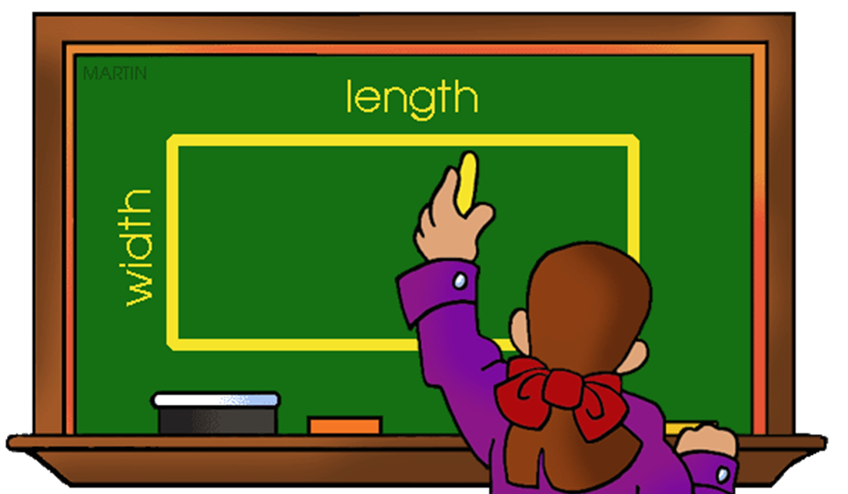
Remember
check all the sides of the shape.
carefully study what I do know already.
use add and subtract to calculate what I do not know.

