Slide 1
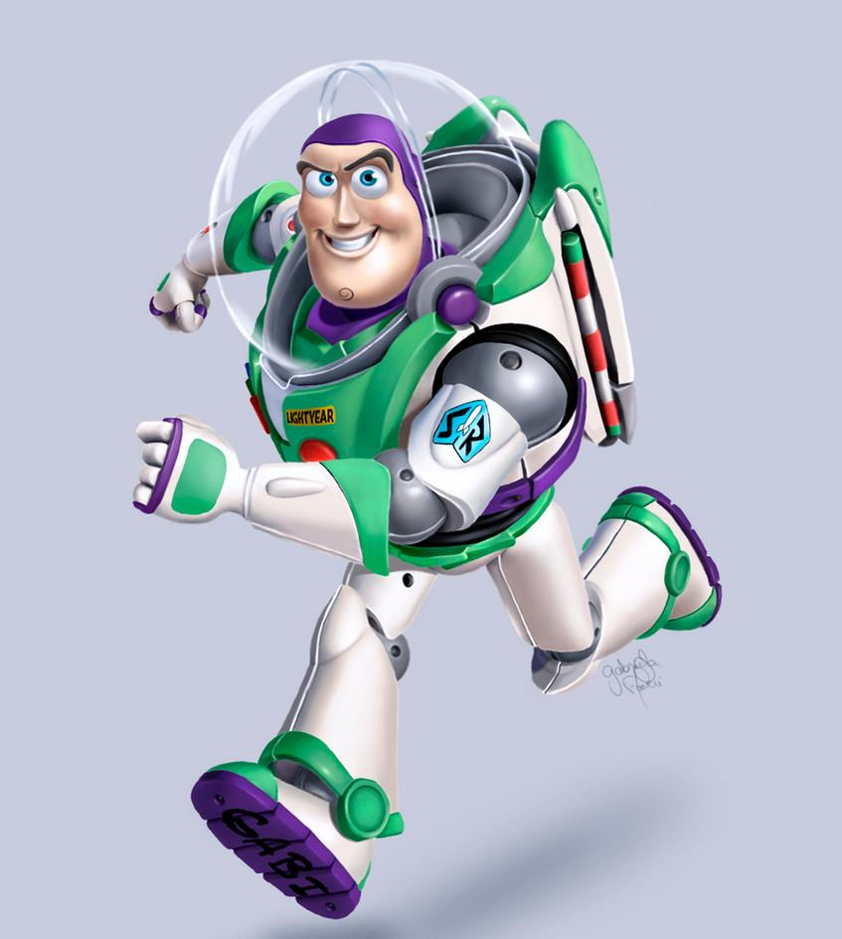
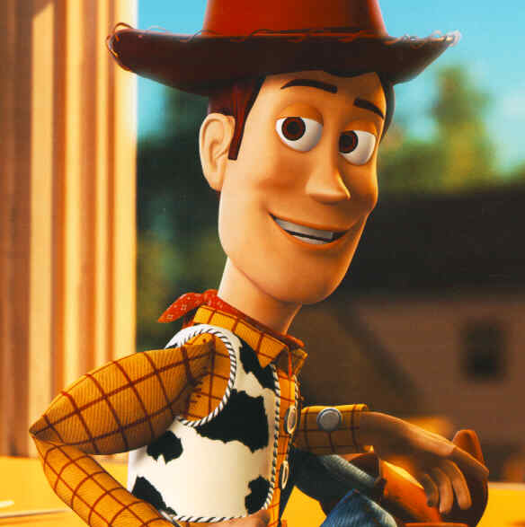
Home Learning: English
Reading

Slide 2
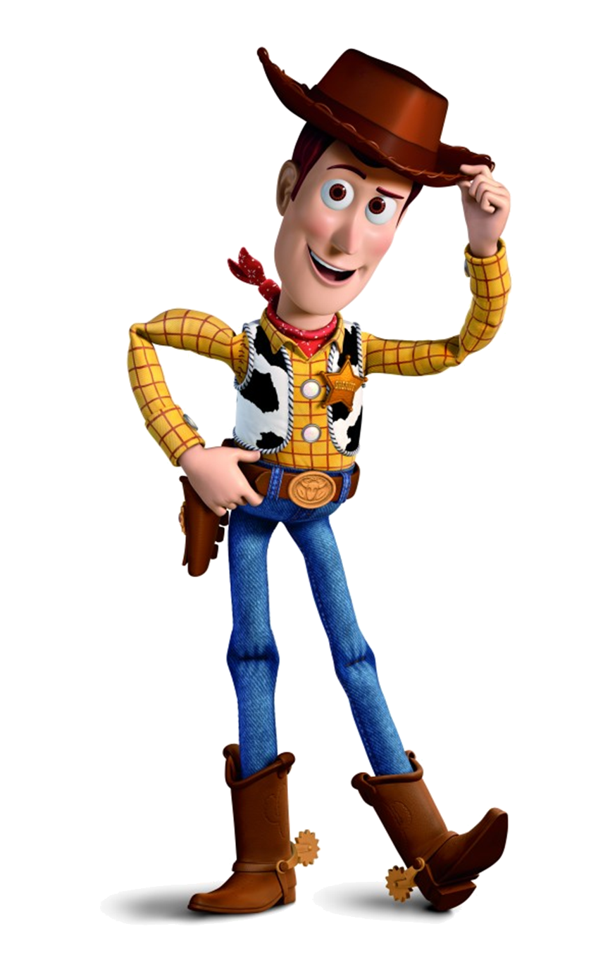
Background Information
"You've Got a Friend in Me" is the Academy Award Nominated song heard in the Toy
Story films. It is written and performed by Randy Newman.
It is featured in every Toy Story film.

Slide 3
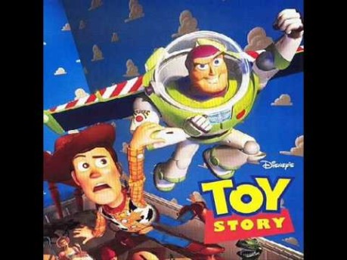
https://www.youtube.com/watch?v=XHFy3YWpRx8

Slide 4
Toy Story
You’ve got a friend in me -
Toy Story
You've got a friend in me
You've got a friend in me
When the road looks rough
ahead
And you're miles and miles
From your nice warm bed
You just remember what your
old pal said
Boy, you've got a friend in me
Yeah, you've got a friend in me
You've got a friend in me
You've got a friend in me
You've got troubles and I've got
them too
There isn't anything I wouldn't
do for you
We stick together and can see
it through
'Cause you've got a friend in
me
You've got a friend in me
Some other folks might be
A little bit smarter than I am
Big and stronger too, maybe
But none of them will ever love
you
The way I do
It's me and you, boy
And as the years go by
Our friendship will never die
You're gonna see it's our
destiny...
You've got a friend in me

Slide 5
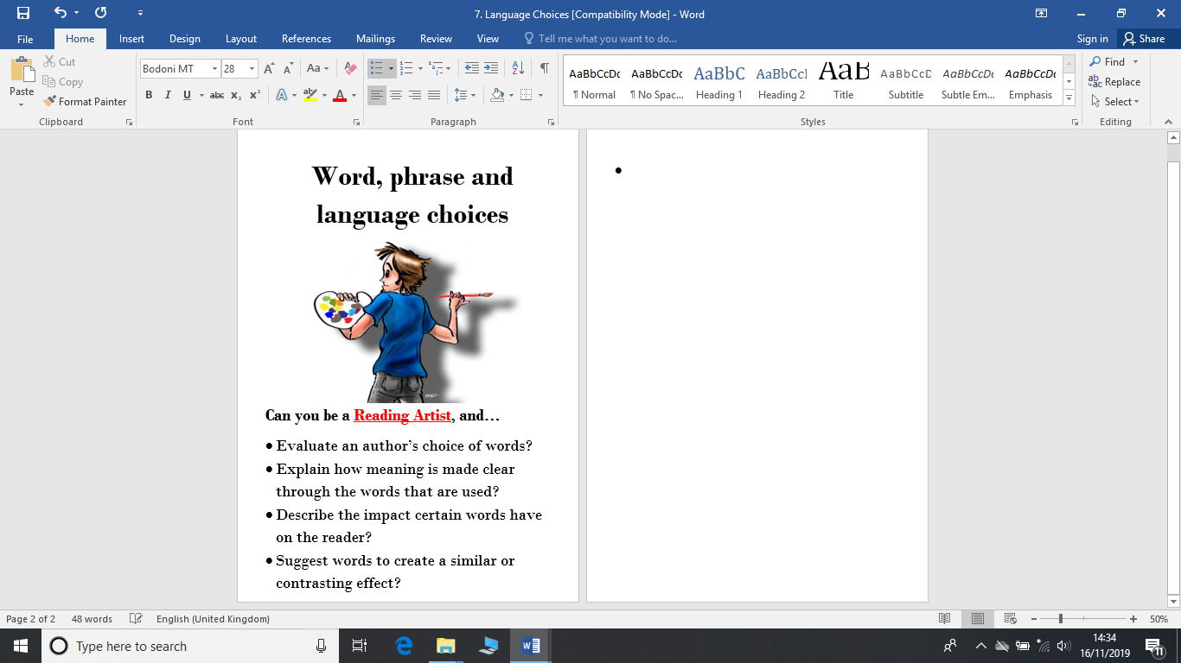
Today we will be looking at how the singer/author uses language to convey a meaning. We will try to explain the meaning of key words and look for other words to create a similar effect.

Slide 6
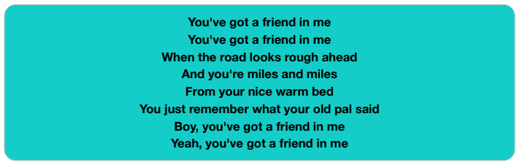
What do you think the “road” symbolises? Is it an actual road?
What other word in this verse means the same as friend?
How do you know these people have been friends for a long time?

Slide 7
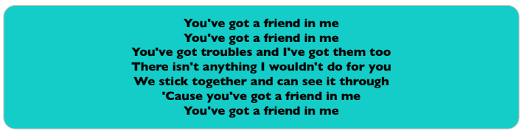
4) What do you think the singer means by “troubles”?
5) What does the singer mean by “stick together”?
6) What does the singer mean by “it” in the fifth line?
7) Consider the phrase “strength in numbers”. How does this phrase link here?

Slide 8
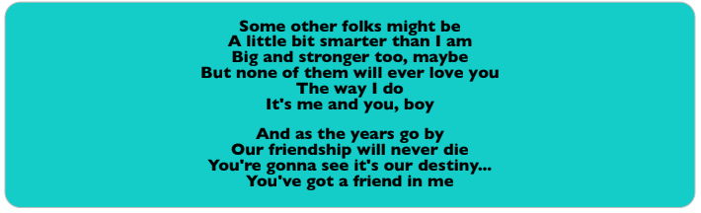
8) What are folks?
9) Write an informal word that the singer uses in this verse.
10) Which word matches the word “destiny” the most? Tick one.
Fate
Hope
Enemy
Success

Slide 9
ANSWERS
What do you think the “road” symbolises? Is it an actual road?
No, I don’t think it is an actual road. It symbolises the path you take in life- how you grow up and what choices you make.
2) What other word in this verse means the same as friend?
Pal
3) How do you know these people have been friends for a long time?
The verse talks about remembering what your “old pal said” which shows they are old friends or have been friends for a long time.

Slide 10
ANSWERS
4) What do you think the singer means by “troubles”?
Difficulties or problems you have in life.
5) What does the singer mean by “stick together”?
I think he means that by sticking together people can face problems together. They will not be lonely and can help each other.
6) What does the singer mean by “it” in the fifth line?
The “it” could be any problem or situations that is upsetting or worrying them.
7) Consider the phrase “strength in numbers”. How does this phrase link here?
You are always stronger in a group than on your own. You will have someone you trust to back you up.

Slide 11
ANSWERS
8) What are folks?
An old-fashioned word for people.
9) Write an informal word that the singer uses in this verse.
Gonna
10) Which word matches the word “destiny” the most? Tick one.
Fate
Hope
Enemy
Success

