Slide 1
Year 5 Measure
Area
Week 6 Lesson 2 – Area of a compound shape

Slide 2
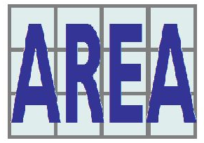
Remember - Area
When we measure all of the inside space in a shape.
A = L x W

Slide 3
What is the area of this composite shape?
As you have the squares, you can count the inside of them with a composite shape as well.
This would give you your area similarly to yesterday.

Slide 4
Just like yesterday, when we have no squares, it’s no probs!
4cm
3cm
6cm
7cm
4cm
10cm
Not to scale

Slide 5
Just like yesterday, when we have no squares, it’s no probs!
First step is to find a suitable place to split your shape in half. This will then make two different rectangles. This makes it a similar process to yesterday.
However, one thing to be careful of is when you split your shape some of the measurements may change. Use your knowledge from last week to help you.
4cm
3cm
Width of A = 4 cm
Length of A = 7cm
4 x 7 = 28cm²
Width of B = 6cm
Length of B = 4cm
6 x 4 = 24 cm²
However, we want the total area of both shapes. We need to then add both totals up.
28 + 24 = 52cm²
6cm
A
7cm
B
4cm
10cm
Not to scale

Slide 6
Let’s try another one…
Steps to follow
checking all the sides of the shape.
carefully studying what I do know already.
using add and subtract to calculate what I do not know.
using A = L x W.
Adding both totals
5cm
6cm
I have already split the shape for you into A and B. Use the yellow box and the previous slide to help you answer the question. What is the total area?
8cm
10cm
A
B
4cm
13cm
Not to scale

Slide 7
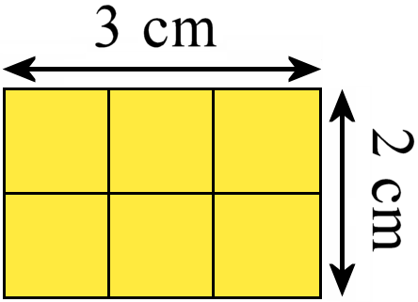
Remember to …
carefully studying what I do know already.
Use add and subtract to calculate what I do not know.
splitting the shape up.
using A = L x W.
Adding both your totals

