Slide 1
Imaginative Writing

Slide 2
On the next 3 slides, you will be shown three different pictures of a setting/story. I want you to choose the one that interests you the most and will help you to produce your best piece of writing (think description).
Once you have chosen your image, make a brainstorm in your book of adjectives and descriptive phrases that relate to your image. Try and think of a storyline that your image will take you on as you will need to include dialogue (speech) in your writing. For this reason, you may want to have two characters (or more/less).
Notes:
When your child has chosen their desired image, you may wish to discuss their initial ideas. Have they got good descriptive phrases? Can any be up-levelled? Have they thought about all of the features that they can see?

Slide 3
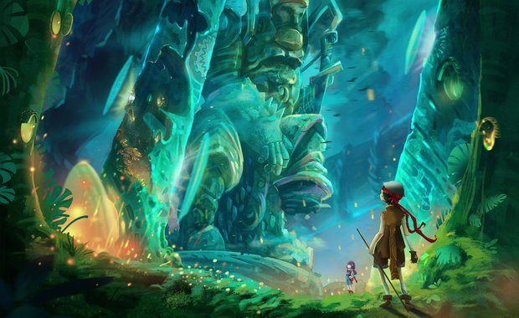

Slide 4
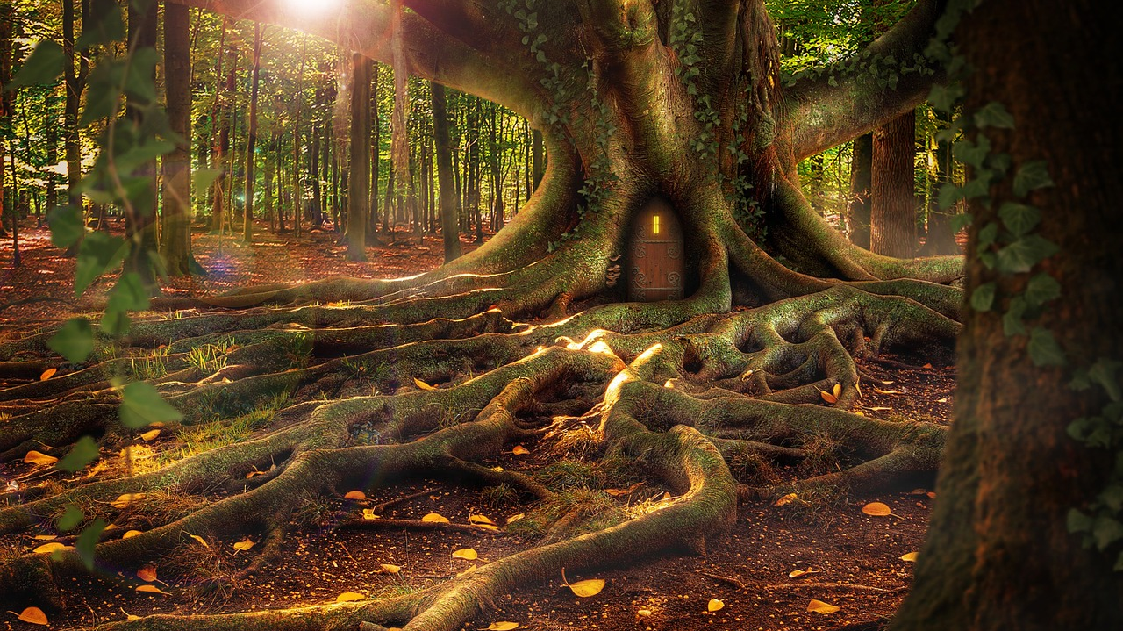

Slide 6
Your task today will be to write a story of a short adventure that takes place in your setting. Before you start writing, you need to produce a small plan to help jot down your initial ideas so you have a structure when writing.
On the following slide will be the guidelines you have to follow (you may wish to look at these first to help with your plan).
Your plan can be either notes, in the form of a story map or verbally to an adult or a sibling.
You will have to follow the DADWAV instructions as shown on the next page. This well help make your writing even more interesting.

Slide 7
DADWAV
DADWAV is a great way to improve our writing skills. We need to work our way down the list, starting each new sentence in the way described:
Description Action Dialogue (speech) Where Adverb Verb
Each of these are sentence starters so that our sentences become more interesting! I have included an example on the next page to show you but I know yours will be much better.

Slide 9
(Description) As he stumbled over the rocky floor, emerald green trees stood before him whilst glistening orange sparks filled the path in front of him. (Action) He stood back and observed the unknown statue which towered above him. (Dialogue) “Urm, Kayla. What is that and where are we?” Jackson quivered. (Where) Beneath him, the ground began to shake and Kayla edged closer to the statue to investigate further. (Adverb) Cautiously, Jackson checked his surroundings before advancing towards his sibling. They had to make it out alive. (Verb) Retrieving a mysterious book from her bag, Kayla scrambled through the pages hoping she would find exactly what was in front of her.

Slide 10
DADWAV instructions
Based on your initial ideas, you are going to write a short story opening based on DADWAV instructions.
You should:
Use DADWAV to help structure your sentence openers
Ensure you use high-level vocabulary where appropriate
Capture the reader’s interest
Write your story in your green book. You may want to draw lines or stick lined paper in to make sure that your writing is neat.
When you’ve finished, go back over your work and show where you have used the DADWAV examples.

Slide 11
Does it make sense?
When you’re happy with it, read your story to your family. Please share your stories with us!

