Slide 1
Imaginative Writing

Slide 2
On the next 3 slides, you will be shown three different pictures of a setting. I want you to choose the one that interests you the most and will help you to produce your best piece of writing (think description).
Once you have chosen your image, make a brainstorm in your book of adjectives and descriptive phrases that relate to your image. You may even note down figurative language (similes, metaphors and personification) that could also be used later.
Notes:
When your child has chosen their desired image, you may wish to discuss their initial ideas. Have they got good descriptive phrases? Can any be up-levelled? Have they thought about all of the features that they can see?

Slide 4
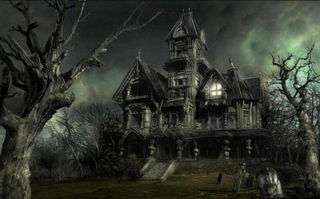

Slide 5
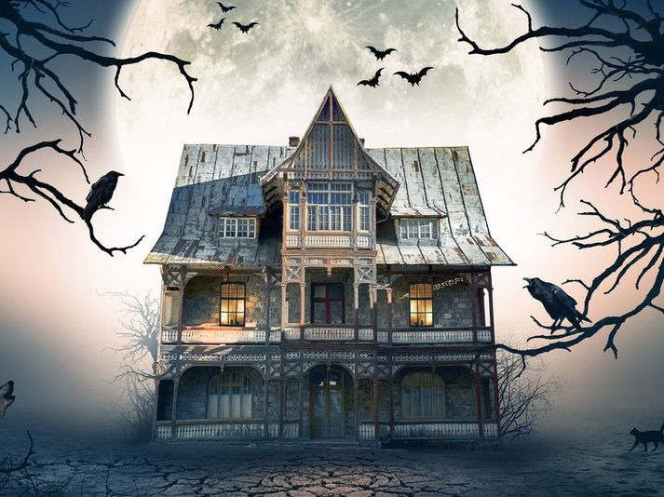

Slide 6
Your task today will be to write a story of a short adventure that takes place in your setting. Before you start writing, you need to produce a small plan to help jot down your initial ideas so you have a structure when writing.
On the following slide will be the guidelines you have to follow (you may wish to look at these first to help with your plan).
Your plan can be either notes, in the form of a story map or verbally to an adult or a sibling.

Slide 7
Slow Writing instructions
Based on your initial ideas, your story must follow the structure below. This is to encourage you to really think about each sentence (make sure they flow). Read your sentences throughout so you can edit your work as you go. 1. Your sentence must start with a verb. 2. Your sentence must contain an example of figurative language (simile, metaphor or personification). 3. Your sentence must use a relative clause. 4. Your sentence must be a complex sentence (your subordination can go at the beginning or in the middle). 5. Your sentence must contain an emotion. 6. Your sentence must use a modal verb. 7. Your sentence must be 3 words only.
Write your story in your green book. You may want to draw lines or stick lined paper in to make sure that your writing is neat.
Notes:
One way in which we have been trying to encourage children to become more conscious with what they are writing is through ‘slow writing’. This is where children are told what to include in that given sentence to ensure they have a range of writing techniques and become more familiar with using these throughout. The focus is on the quality of the writing rather than quantity. It encourages children to really think about that individual sentence and the effect it will have on the reader. Encourage children to read their work through before moving on to the next sentence to ensure it makes sense and flows.

Slide 8
Does it make sense?
When you’re happy with it, read your story to your family.

