Slide 1

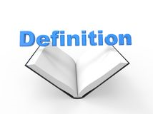
Year 5/6 word list
sacrifice
To give up something dear or valued for a cause that you believe in.

Slide 2
Year 5/6 word list
secretary
An administrative office worker.

Slide 3
Year 5/6 word list
shoulder
The upper joint of your arm.

Slide 4
Can you think of any words that have a silent letter in it?

Slide 5
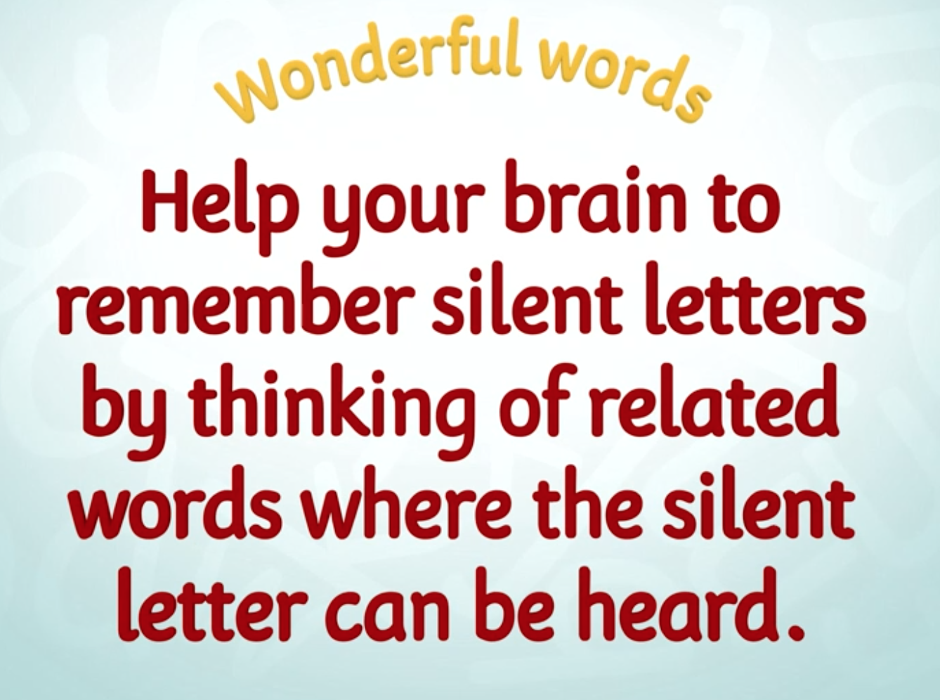
Notes:
https://www.bbc.co.uk/teach/class-clips-video/english-ks2-wonderful-words-silent-letters/zh4hf4j
Video clip to help children learn a range of techniques. These aren’t essential ways children have to learn them, but they may find one or two techniques are useful to them. I myself particularly remember breaking a word down as shown in the last section.

Slide 6
What Are Silent Letters?
Some letters in words do not make a sound, they are silent.
Silent letters are letters that you can't hear when you say the word,
but that are there when you write the word.
There are silent letters in some English words because over hundreds of years,
we have changed how we pronounce these words, but have kept the spelling.
The spelling tells us how the word used to be pronounced.
For example: knock. In the past, people used to say the word with the k sounded out at the beginning! That would sound very strange to us today!
Notes:
The next few slides will explain the focus of today’s new spelling pattern with examples.

Slide 7
How Can We Remember How to Spell Words with Silent Letters?
Sometimes we can forget to include letters when they
can’t be heard in words or if they are difficult to hear.
One way to remember the spelling of words with silent letters
is to stress the silent letter when you say the word to yourself.
Break the word up and decide how you say
it to yourself, to help you remember the spelling.
For example: Wednesday has a silent d.
You could remember how to spell it by saying Wed-nes-day.
Task: Choose some words with silent letters and try breaking them up in this way,
to help you remember how to spell the word correctly with the silent letter.

Slide 8
Can You Find the
Silent Letters in These Words?
knife
knife
wrapper
wrapper
wrong
wrong
write
write
gnome
gnome
wreck
wreck
crumb
crumb
lamb
lamb
knuckle
knuckle
know
know

Slide 9
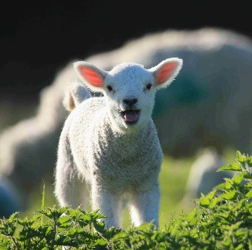


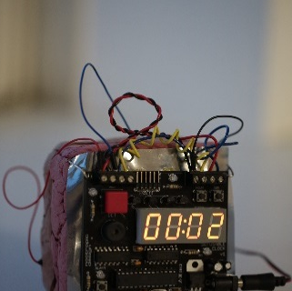
A silent b occurs after m, before t.
lamb
thumb
debt
bomb
What other words do you know with a silent b?
thumb
numb
climb
comb
tomb
lamb
dumb
doubt
debt
bomb
crumb
succumb
Photo courtesy of therealbadgerboy, .reid, SalFalko, adulau (@flickr.com) - granted under creative commons licence – attribution
Notes:
Slides 9-18 will take children through the different silent letters with MANY examples – please feel free to use as needed.

Slide 10
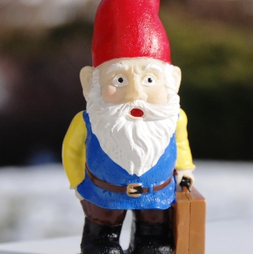
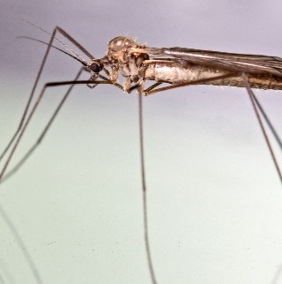
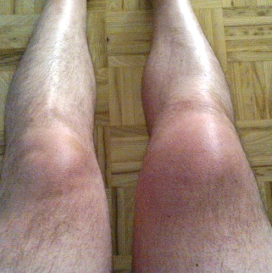
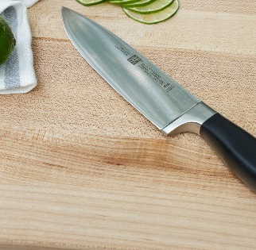
A silent k and a silent g are found before n.
gnome
gnat
knee
knife
What other words do you know with a silent k or g?
campaign
foreign
gnarl
sign
knowledge
knobbly
assign
reign
design
knit
knuckle
kneel
knew
knight
knead
knock
Photo courtesy of roosterfarm, m-a-r-t-i-n, tanty0, dinnerseries (@flickr.com) - granted under creative commons licence – attribution

Slide 11
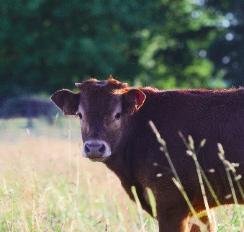
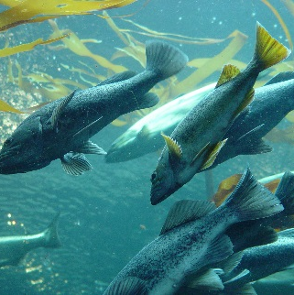

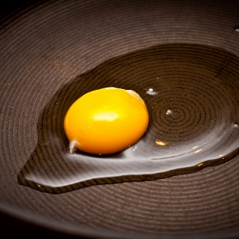
A silent l follows vowels a, o and u.
calf
salmon
chalk
yolk
What other words do you know with a silent l?
calf
yolk
folk
chalk
talk
walk
half
calm
palm
Photo courtesy of stanzebla, merelymel, polkadotcreations, shardayyy (@flickr.com) - granted under creative commons licence – attribution

Slide 12
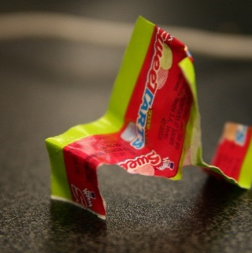
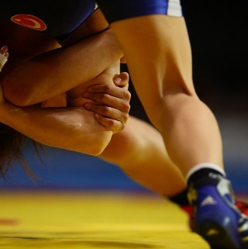
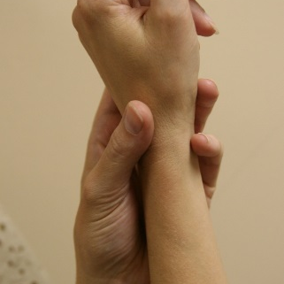

A silent w often goes before r.
wrapper
wrestle
wrist
wreck
What other words do you know with a silent w?
wrong
wrinkle
wriggle
wrote
write
Photo courtesy of quinnanya, gowestphoto, stevendepolo, slobirdr (@flickr.com) - granted under creative commons licence – attribution

Slide 13
What words do you know with a silent h?
rhubarb
ghost
monarch
chrome
whisky
rhyme
orchid
archaeology
Sikh
vehicle
hour
spaghetti
echo
white
technology
whisk
stomach
chaos
ache
chemist
exhausting
honest

Slide 14
What words do you know with a silent t?
castle
listen
soften
thistle
fasten
moisten
wrestle
often
ballet
depot
watch
whistle
asthma
gourmet
rapport

Slide 15
What words do you know with a silent u?
baguette
built
silhouette
guitar
guest
circuit
guilty
buoy
guess
guinea pig
disguise
dialogue
colleague
tongue

Slide 16
What words do you know with a silent n?
autumn
column
condemn
hymn
solemn

Slide 17
What words do you know with a silent c?
conscious
resuscitate
scenario
fascinate
miscellaneous
scissors
scene
scent
science
acquire
descend
scenic
disciple
obscene

Slide 18
What words do you know with a silent l?
should
could
would
half
Lincoln
halve
alms
Falkland
caulk
salmon
palm
calm
chalk
Stockholm
yolk
Suffolk
Norfolk
colonel

Slide 19
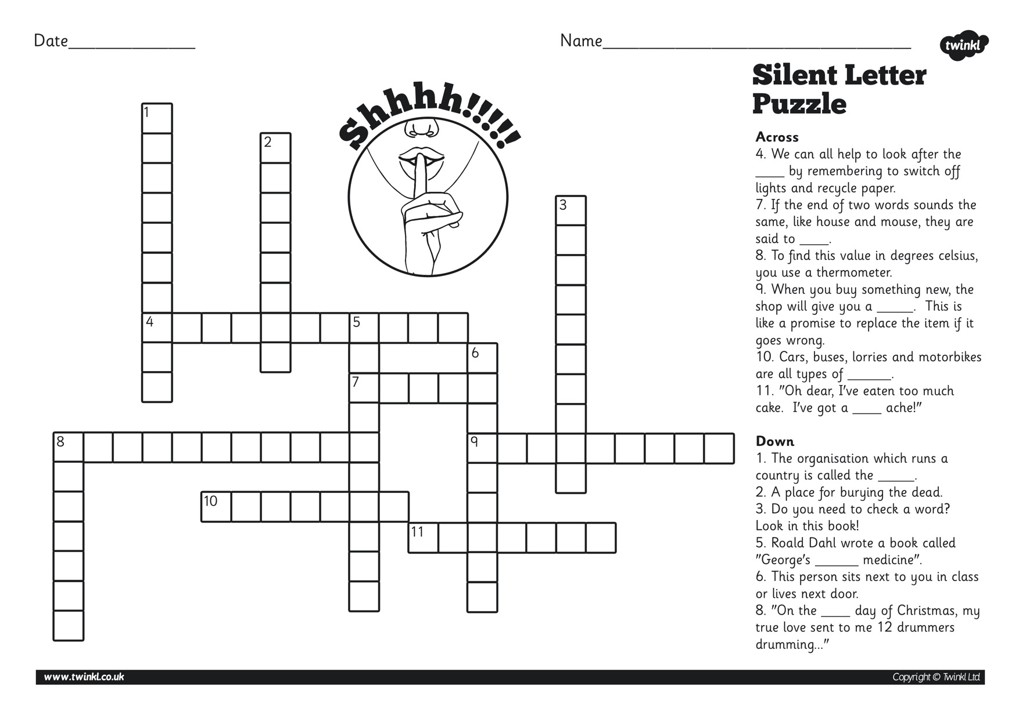
Notes:
Optional crossword to test knowledge of silent letters (some they might not have covered today but will be aware of them).

Slide 20
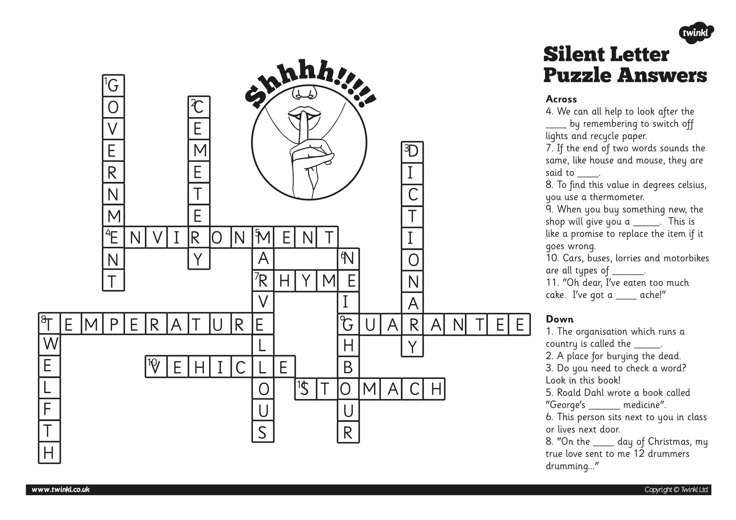
Notes:
Answers ☺

Slide 21
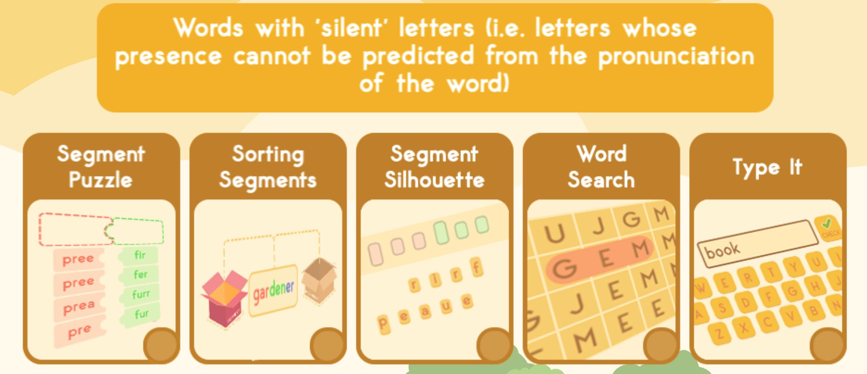
Notes:
https://spellingframe.co.uk/spelling-rule/40/47-Words-with-silent-letters-i.e.-letters-whose-presence-cannot-be-predicted-from-the-pronunciation-of-the-word
Optional online interactive games for children to consolidate knowledge.

