Slide 1

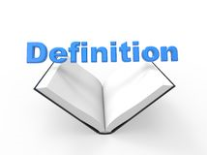
Year 5/6 word list
symbol
A thing that represents or stands for something else.
+ x @

Slide 2
Year 5/6 word list
system
A set of rules or connected things/devices that operate together.

Slide 3
Can you think of any words that have end with ‘ant’?
Notes:
We have explored this spelling pattern earlier in the year (autumn) but children need to become more confident using this spelling pattern correctly in their writing.

Slide 4
Spellings that end in –ant
triumphant(ly) _____________________________________________________________________________________________
significant(ly) ______________________________________________________________________________________________
elegant(ly) ________________________________________________________________________________________________
extravagant(ly) ____________________________________________________________________________________________
hesitant(ly) _______________________________________________________________________________________________
vibrant(ly) ________________________________________________________________________________________________
reluctant(ly) _______________________________________________________________________________________________
vacant ___________________________________________________________________________________________________
contestant ________________________________________________________________________________________________
relevant / irrelevant _________________________________________________________________________________________
accountant ________________________________________________________________________________________________
enchanted ________________________________________________________________________________________________
inhabitant ________________________________________________________________________________________________
pendant _________________________________________________________________________________________________
deodorant ________________________________________________________________________________________________
Notes:
A lot of these words can be adverbs (explain how a verb is carried out). Give children chance to familiarise and start own definitions / synonyms.

Slide 5
Spellings that end in –ant
My word means:
colourful
bright
eye-catching
triumphant(ly)
significant(ly)
elegant(ly)
extravagant(ly)
hesitant(ly)
vibrant(ly)
reluctant(ly)
vacant
contestant
relevant / irrelevant
accountant
enchanted
inhabitant
pendant
deodorant
My word is: vibrant

Slide 6
Spellings that end in –ant
My word means:
empty
unfilled
void
triumphant(ly)
significant(ly)
elegant(ly)
extravagant(ly)
hesitant(ly)
vibrant(ly)
reluctant(ly)
vacant
contestant
relevant / irrelevant
accountant
enchanted
inhabitant
pendant
deodorant
My word is: vacant

Slide 7
Spellings that end in –ant
My word means:
player
competitor
participant
triumphant(ly)
significant(ly)
elegant(ly)
extravagant(ly)
hesitant(ly)
vibrant(ly)
reluctant(ly)
vacant
contestant
relevant / irrelevant
accountant
enchanted
inhabitant
pendant
deodorant
My word is: contestant

Slide 8
Your turn!
triumphant(ly)
significant(ly)
elegant(ly)
extravagant(ly)
hesitant(ly)
vibrant(ly)
reluctant(ly)
vacant
contestant
relevant / irrelevant
accountant
enchanted
inhabitant
pendant
deodorant
Notes:
Children choose their own word and write down three synonyms of that word. Get another member of family to guess. Repeat.

Slide 9
Anagrams
yteeganll
elegantly
Notes:
Children to unscramble the letters to spell one of their new words.

Slide 10
Anagrams
aattiinnbh
inhabitant
Notes:
Children to unscramble the letters to spell one of their new words.

Slide 11
Anagrams
ylluettncar
reluctantly
Notes:
Children to unscramble the letters to spell one of their new words.

Slide 13
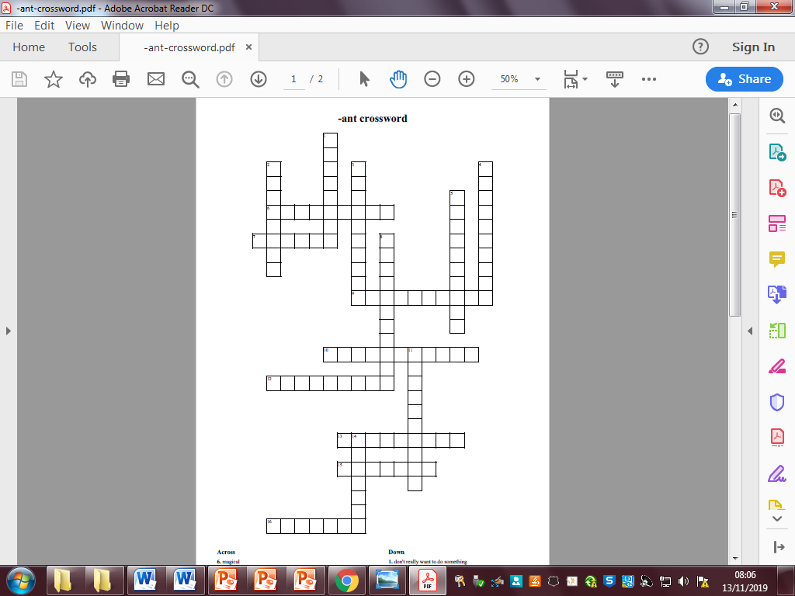
Notes:
Word document attached with clues/numbers.

