Slide 2
What is a homophone?
A homophone is a word that is pronounced the same as another word but differs in meaning.
A homophone may also differ in spelling.
E.g. their, there, they’re

Slide 3
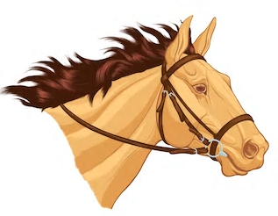
Homophones
bridal
bridle
Notes:
We have learnt all the year 5 homophones for the year so will spend the next few weeks recapping them.
Children should know the difference between both homophones & the spelling and be able to choose the correct one to complete a given sentence.
Bridle = The head gear used to control a horse!

Slide 4
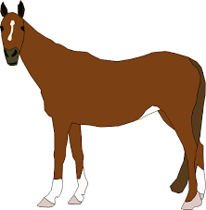
Homophones
A boy went to horse riding school on Saturday. “Hello,” he said. “Am I _____________ to ride that horse there?”
“Certainly,” replied the trainer. “Make sure the _____________ is nice and tight and follow the _____________ of cones.”
The boy smiled and began to ride.
“Please don’t _____________ the reins on the horse’s neck,” the trainer added as the boy ran off.
Notes:
Testing knowledge from last week too.
allowed / bridle / aisle / alter

Slide 5
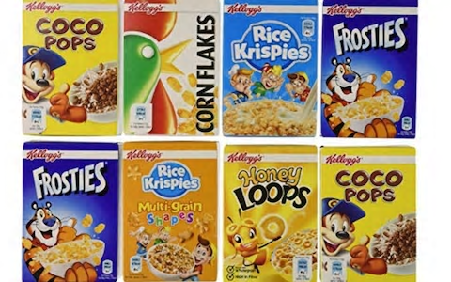
Homophones
cereal
serial
Notes:
Serial – repeatedly doing the same thing again and again. Can also be a programme on TV.

Slide 6
Homophones – cereal or serial?
Anthony watched the ______________ drama that was on TV.
Mr. Douglas bought his favourite ______________ from the shop.
Mr. Douglas called Gabi a ______________ chatterbox!
Notes:
Serial
Cereal
Serial

Slide 7
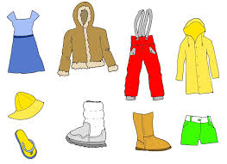
Homophones
compliment – to say something nice about a person.
complement – things that go well together.

Slide 8
“I like your new hairstyle,” Mr. Douglas said to Miss. Whitehouse.
“Thanks for the complement / compliment,” Miss. Whitehouse replied.

Slide 9
“I like your new hairstyle,” Mr. Douglas said to Miss. Whitehouse.
“Thanks for the compliment,” Miss. Whitehouse replied.

Slide 10
Mrs. Blair gave me a complement / compliment.

Slide 11
Mrs. Blair gave me a compliment.

Slide 12
What is needed for correctly written direct speech?
Notes:
We have explored and used direct speech several times throughout the year (they have looked at it in previous years too). Children can mostly write direct speech correctly but often forget to use closing punctuation (,.!) before the closing inverted comma.

Slide 13
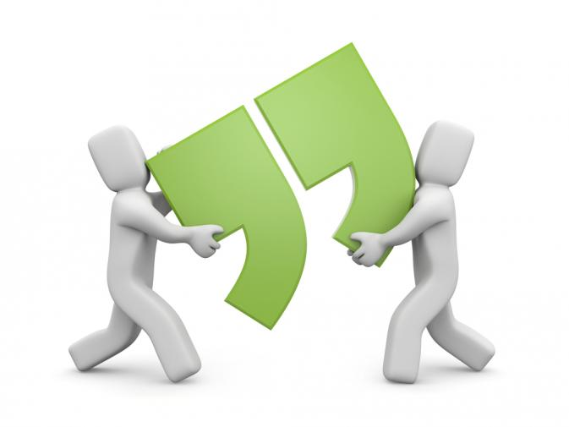
Inverted commas aka speech marks
“ ”

Slide 14
Notes:
We always encourage children to use a synonym for said. They must choose one which is appropriate to the context. E.g. They can’t use thundered if it was not meant in a loud or aggressive tone.

Slide 15
Examples
"You'll never guess what I've just seen!" screeched Sam, excitedly. "What's that?" asked Louise. "Our teacher has a broomstick and a black pointy hat in the back of her car. Maybe she's a witch!" "No, silly! They're for the school play!" replied Louise, sighing.
Remember we can make our speech more interesting and add detail by including adverbs or information about what the character is doing.

Slide 16
Inverted commas checklist
“
ABC
sentence
closing punctuation , ! ?
”
said + who said
__________________________________________________________________________________________________________________________________________________________
Notes:
Children to have a go at independently writing their own speech using the checklist to help.
Inverted comma
Capital letter
The speech itself
.,! Whichever is most appropriate
Inverted comma
Who said it and synonym for said

Slide 17
Inverted commas checklist
“
ABC
sentence
closing punctuation , ! ?
”
said + who said
__________________________________________________________________________________________________________________________________________________________

Slide 18
Inverted commas checklist
Option 1
“
ABC
sentence
closing punctuation , ! ?
”
said + who said
Option 2
Who said it
“
ABC
sentence
closing punctuation . ! ?
”
________________________________________________________________________________________________________________________________________________________________________________________________________________________________________________________________________
Notes:
Try to encourage children to vary the way in which they write speech so it does not always appear the same throughout.
Introduce the idea that when a new person speaks, you start a new line. I use the rhyme 66, 99, new speaker, new line.

Slide 19
Spot my mistakes and correct them!
“How much for a shoe shine” asked the traveller.
Notes:
First, identify the mistake. Encourage children to explain why.
Then, fix the mistake.
Missing closing punctuation. Should be a question mark.

Slide 20
Spot my mistakes and correct them!
“a shoe shine costs one penny,” replied Alfie. “I will have one please,” said the man.
Notes:
Remember to remind children 66, 99, new speaker, new line.
2 mistakes - firstly, new speaker, new line.
A should be a capital letter

Slide 21
Spot my mistakes and correct them!
Alfie said “All done sir.”
“Thank you.” Said the customer.
Notes:
Doesn’t need to be a capital ‘s’ for said.
Try to replace said for something more relevant and interesting

Slide 22
Your Task
Imagine you are out on a walk with your friend or parent and you see an unknown creature trying to capture someone on a bike (image to the left).
I would like you to write a least 5 pieces of effective dialogue remembering new speaker, new line.
You must have a range of synonyms for said and include appropriate adverbs and actions of the characters.

Slide 23
Notes:
On the following slides will be SATS questions based on what they have just learnt.

Slide 24
Where should the inverted commas go?
Notes:
Boxes 1 and 2

Slide 25
Bet you can do this SATs question!
Notes:
2

Slide 26
The SPaG tests are easy when you know how…
Notes:
Maya whispered, “I can see a baby hedgehog! Keep quiet so we don’t scare it.”

Slide 27
Hmm... Remember what we’ve learnt
Notes:
3

Slide 28
You can do this ☺
Notes:
4

