Slide 1
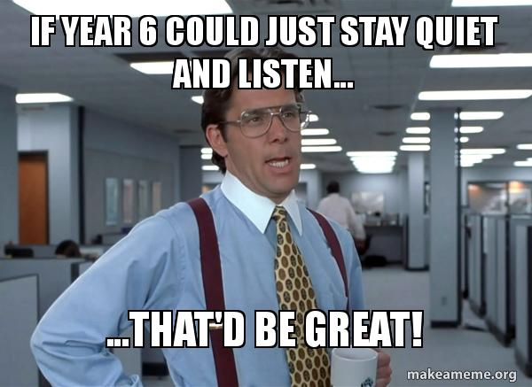
YEAR SIX TACHER TAKE
OVER!

Slide 2
Hello Year Five,
Today the Year Six teachers have taken over!
Very soon you will be doing this.
We are HOPING that we can see you guys before the six weeks holiday!
BUT…for now…we really want to start to get to know you all!

Slide 3
Today you will be writing your own character profile about yourself!
Take a look at Mr Silvester’s
example on the next slide for
ideas…

Slide 4
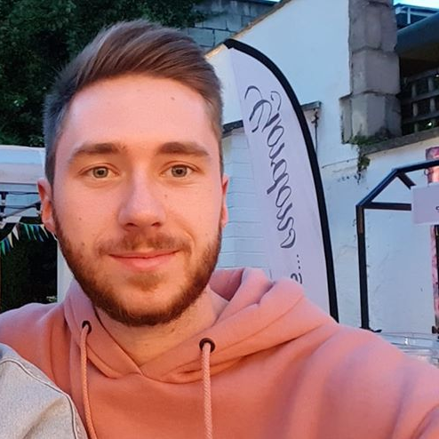
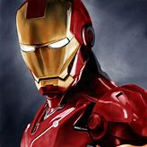
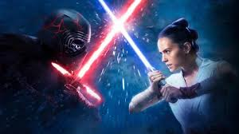
Mr Silvester
Arsenal
Holidays
Music
Hi! My name is Mr Silvester (my real name is John-Paul but do not ever call me that – you have been warned). I am 27 years old and have been teaching at Featherstone for about 5 years. I am the leader of Computing in school; I love using technology in the classroom so get used to it.
In Year Six this year I would like to ensure that all the children have a successful year, do well in their SATs and ultimately, have fun!
A few things that I like to do when I’m not in school are:
Socialise with friends
Go on holiday to cool places
My mother’s name is Emma and I have an older sister named Danielle; they both work for the NHS. I don’t live in Erdington but I am from Birmingham.
I’m not worried too much about next year but I do hope that It is successful and the new Year Six children learn a lot of new things. I’m really excited to potentially go on a residential at the end of the year too!

Slide 5
Home screen
Must be a ‘selfie’ and it must look like you!
It must have your name on it (big and bold)
It must be coloured in
You can personalise your phone case
Apps
1) You must have at least 3 apps at the top of your screen that describe you best.
2) You must have a piece of writing on this page that talks about:
Who you are
What you want to achieve in Year Six (and later on in life)
A minimum of 2 things you love to do/read/watch/play
Something about your family and where you come from
A message to me about what you are looking forward to and any worries you might have.
A template is provided on the next slide.

Slide 7
REMEMBER TO MAKE THIS AS COLOURFUL, CREATIVE AND AS AWESOME AS YOU CAN! ☺
We will look forward to receiving your character profiles on Twitter.
If not, please do bring them in when you next come in to school!
With your parent/carer permission. Get them to take a photo of your writing and then share it with us @FeathrstoeYR6.

Slide 8
TIME TO WRITE!
Remember to continuously proof read your work to ensure:
It makes sense.
It has impact.
It is persuasive.
You have used higher-level vocabulary.
You have used Year Six grammar and punctuation.
With your parent/carer permission. Get them to take a photo of your design and writing and then share it with us @FeathrstoeYR6.

