Slide 1
Year 5 Measure Length
Week 3 Lesson 2 – problem solving

Slide 2
In today’s lesson
We are going to apply everything you have learnt over that last few lesson on measurement. These problem solving questions will put what you have learnt into real everyday scenario’s. You need to be aware what method you are using to get to the answer.

Slide 3
Timmy the dog is 1.24m long. Bella the cat is 17cm shorter than Timmy. How long is Bella in meters?
What measurements are used?
To answer this question you need to be aware of the. Measurements used. As you can see from the question, we have M and CM.
What does the question want us to find out?
The question is comparing the two animals. How long the dog is compared to the cat. This means we are subtracting one away from the other.
What do we need to do first?
Currently, the measurements are both different units. This means it is hard to subtract them. What we need to do is make them both the same unit of measurement.
Continued on next slide

Slide 4
Timmy the dog is 1.24m long. Bella the cat is 17cm shorter than Timmy. How long is Bella in meters?
I am going to convert both measurements so that they are Metres.
Timmy is 1.24m so is already using the right unit of measurement.
Bella is 17 cm shorter. So she is being measured by centre
metres.
We need to convert from CM to M.
17cm ÷ 100 = 0.17m
CM | to | M | ÷ 100
M | to | CM | X 100
100CM = 1M 1M = 100CM
1
7
0
1
7
Place holder needed in the ones column remember.

Slide 5
Timmy the dog is 1.24m long. Bella the cat is 17cm shorter than Timmy. How long is Bella in meters?
Timmy 1.24m
Bella is 0.17m shorter
Now we have the same unit of measurement. We cam subtract Timmy’s length by the difference between him and Bella.
1.24m – 0.17m = 1.07m
Remember
Biggest number at the top
Decimal lined up directly underneath each other.
Add place holders to any missing columns
1
1
 |  | 1 | . | 2 | 4
 | - | 0 | . | 1 | 7
 |  | 1 | . | 0 | 7

Slide 6
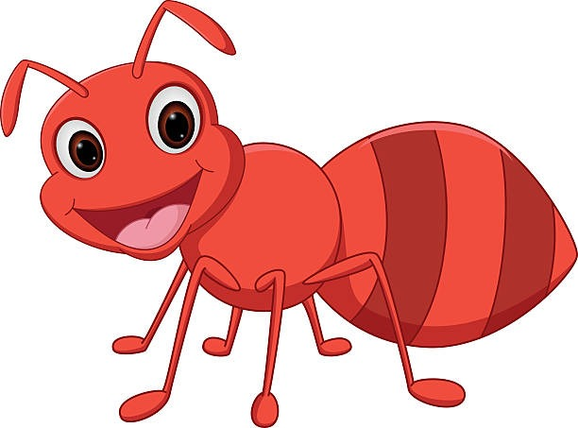
Two ants are helping to build their ant hive. One ant puts some mud down that is 17mm and the other puts some mud down that is 1.4cm.
In cm, how much mud do they have?
17mm needs to converted to cm
MM to CM = ÷ 10
 | 1 | . | 7
+ | 1 | . | 4
 | 3 | . | 1
Now that we have them both as centre meters we can add them together.
1.7cm + 1.4cm=
Altogether they have 3.1cm
1
MM | to | CM | ÷ 10
CM | to | MM | X 10
This is because 1CM = 10MM AKA 10MM = 1CM!
1
7
1
7

Slide 7
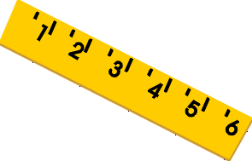
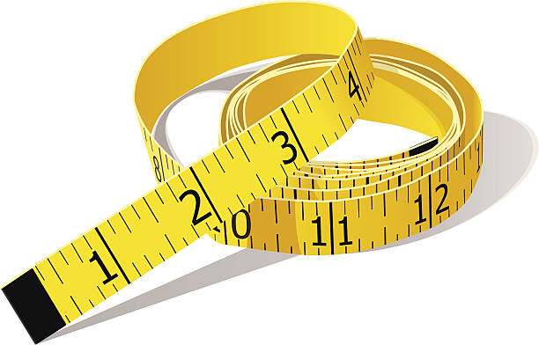
Important notes for today.
converting between mm, cm, m and km (on the next slide is the table used from each of the previous lessons to help you).
knowing when to add or subtract (read the question carefully).
using column method (biggest number always at the top and make sure your decimals stays in the same column).

Slide 8
MM | to | CM | ÷ 10
CM | to | MM | X 10
This is because 1CM = 10MM AKA 10MM = 1CM!
CM | to | M | ÷ 100
M | to | CM | X 100
100CM = 1M 1M = 100CM
M | to | KM | ÷ 1,000
KM | to | M | X 1,000
1,000M = 1KM 1kM = 1,000CM

Slide 9
Notes:
Print back2back for the chn to use if needed.

Slide 10
Notes:
Print back2back for the chn to use if needed.

