Slide 2
Spot the year 5 error!
The boy who was in trouble ran away.
Notes:
The boy, who was in trouble, ran away.
Commas to separate relative clause.

Slide 3
Spot the year 5 error!
“where are you going?” Sally questioned.
Notes:
“Where are you going?” Sally questioned.
Speech to begin with a capital letter.

Slide 4
Spot the year 5 error!
As she was walking in the park 5 dogs ran past.
Notes:
As she was walking in the park, 5 dogs ran past.
Comma needed after ‘park’ as it is a subordinate clause (used at the start of a sentence).

Slide 5
Commas are not new learning in Year 5 SPaG!
What have we used commas for in the past?
Notes:
Children would have learnt commas over the last couple of years and have been recapped each year.
This year, children have learnt how to use commas to clarify meaning/avoid ambiguity.
This is something children are still working on and need more practice with as it is not consistent in their writing.
Some slides may be familiar with children but they are good discussion points.

Slide 6
Let’s revise a few uses of the good ol’ comma!
Commas in a list
Relative clause
Complex sentence
Notes:
Discuss each type and children write one example of each.

Slide 7
Commas are so useful
Sometimes, commas can make what we are trying to write or say really clear (they clarify meaning).
In other words, if we were to miss the comma out, they would make our writing unclear (ambiguous).

Slide 8
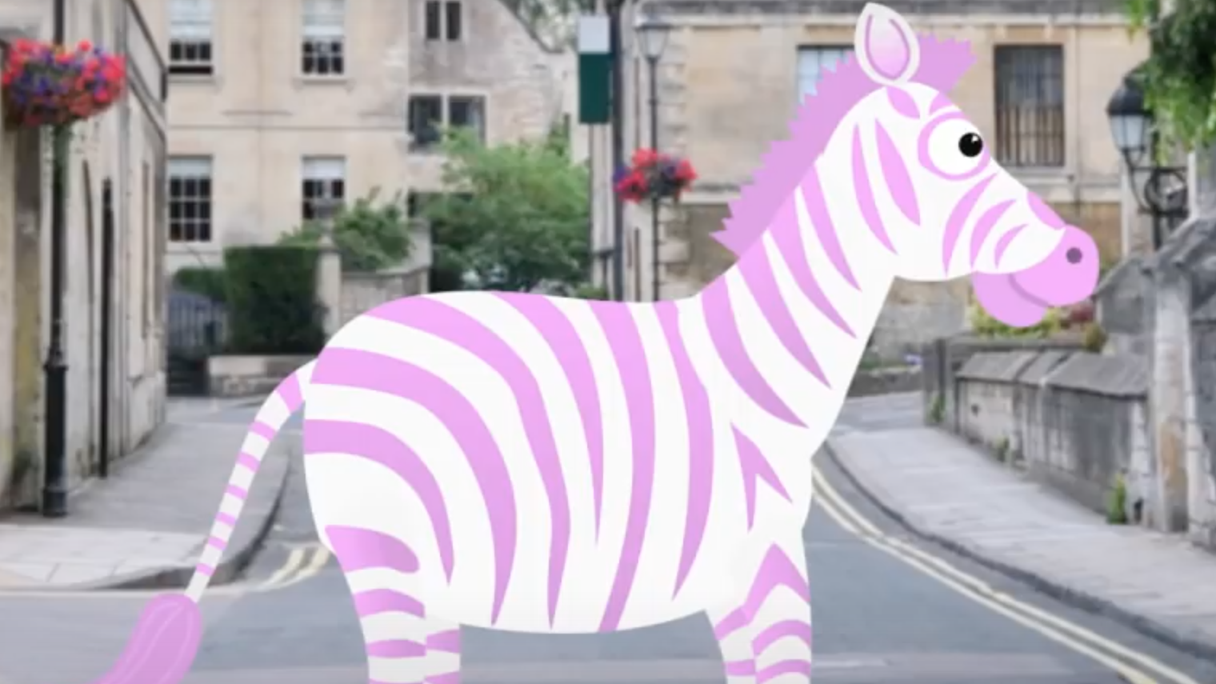
Notes:
https://www.youtube.com/watch?v=mjv5Vp7tHsU
Short video clip which goes through and explains examples then gives children a chance to consolidate their learning (maybe with adult support too if needed).

Slide 9
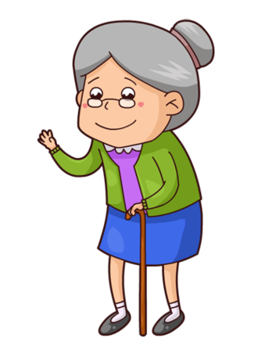
Commas to clarify meaning
Let’s eat Grandma!
Notes:
Show chn that this sentence is very unclear (ambiguous) because it seems as if the writer/speaker is telling everyone to eat Grandma!
Model/explain how by placing a comma after eat, it slows the sentence down and then instructs Grandma to eat.
This is very similar to the ‘lets eat Dad’ example shown in the video clip.

Slide 10
Commas to clarify meaning
Help a burglar!
Notes:
Show chn that this sentence is very unclear (ambiguous) because it seems as if the writer/speaker is telling everyone to help the burglar.
Model/explain how to put the comma after help, which slows down the reader meaning that the person is now calling for help.

Slide 11
Commas to clarify meaning
Karen the sports coach is leaving.
Karen, the sports coach is leaving.
Notes:
This one was also shown in the video but did not have the explanation to support.
Children to verbally explain what is the difference between sentence 1 and sentence 2 and how the comma means that Karen is NOT the sports coach.

Slide 12
Commas to clarify meaning
Most of the time travellers take the bus.
Most of the time, travellers take the bus.
Notes:
Sentence 1 makes it sound like it’s time travellers!

Slide 13
Commas to clarify meaning
Edward tickled the boy with a bunch of carrots.
Edward tickled the boy, with a bunch of carrots.
Notes:
Sentence 1 is showing that the boy had a bunch of carrots.
Sentence 2 shows that Edward is tickling the boy by using a bunch of carrots.

Slide 14
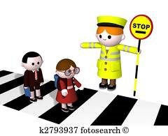
Commas to clarify meaning
Slow children crossing.
Slow, children crossing.
Notes:
Sentence 1 suggests the children are slow.
Sentence 2 means that cars need to be slow as there are children crossing.

Slide 15
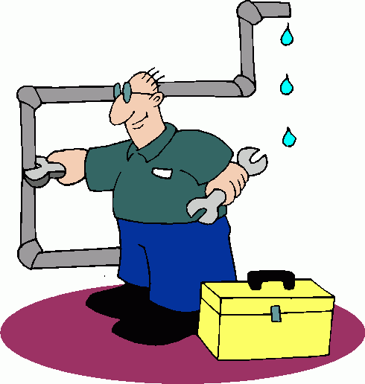
Commas to clarify meaning
Now blow up the pipe!
Now blow, up the pipe!
Notes:
Sentence 1 suggests the pipe will explode.
Sentence 2 means someone needs to blow in the pipe to remove something.

Slide 16
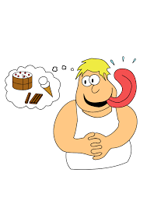
Commas to clarify meaning
Put in one comma in sentence two to change the meaning.
We ate chocolate cake and raspberries.
We ate chocolate cake and raspberries.
Notes:
This is children’s chance to show they know how to alter the meaning themselves
E.g. We ate chocolate, cake and raspberries.

Slide 17
Commas to clarify meaning
How have the commas changed the meaning?
The old lady collected all sorts of things: silver, paper hats, felt flowers and buttons.
The old lady collected all sorts of things: silver, paper, hats, felt, flowers and buttons.
Notes:
Sentence 1 shows she collects hats made from paper and flowers made from felt.
Sentence 2 shows she collects paper, hats, felt and flowers.
Sentence 1 = 4 items
Sentence 2 = 6 items

Slide 18
Notes:
On the following slides will be SATS questions based on what they have just learnt.

Slide 19
Reckon you can do this?
Notes:
Ana’s favourite things are camping, holidays, cycling and swimming.
Note what happens if you miss the comma out after camping → she enjoys taking a break/going to a campsite as a holiday.

Slide 20
Let’s put it to the test with two examples
Notes:
After they left Jon, Sally and Bob went to the cinema.
After they left, Jon, Sally and Bob went to the cinema.

Slide 21
Apply your learning…
Notes:
The commas in the first sentence mean that all mangoes taste delicious/all mangoes are grown in hot countries. There are no commas in the second sentence, so it means that only mangoes grown in hot countries taste delicious.

Slide 22
Your task
To consolidate your knowledge of commas (in a variety of ways), complete the activity sheet attached. Think back to the different ways we can use a comma. There will be a key focus on commas for clarity.
Refer back to the PowerPoint and video clip if you need to ☺
Notes:
I would advise children to complete the sheet independently and if they need support, then to ask to go through it.
Answer sheet will also be attached.

