Slide 1
Year 5 Measure Area and perimeter
Week 6 Lesson 4 - revision

Slide 2
Over the last two weeks, you have done a lot of learning on measurement.
Today you are going to have a quick recap to everything that you have learnt.
I have put together some revision slides to re -jog your memory.

Slide 3
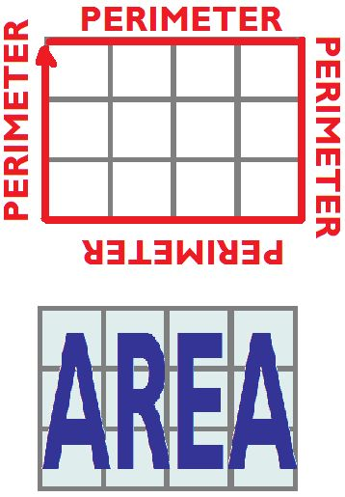
Perimeter – Key message
When we measure all the way around the outside of a straight-sided shape.

Slide 4
Remember - Area
When we measure all of the inside space in a shape.
A = L x W

Slide 5
Finding the perimeter of known shapes
6cm
6cm
6cm
6cm
6cm
6cm
6cm
6cm

Slide 6
Inverse operation for finding sides
This is a regular octagon with a perimeter of 88cm.
When you all ready know the perimeter and the sides are equal length, you can divide the perimeter by the amount of sides.
88 divide by 8 = 11 cm per side
??cm
Notes:
Model how to get the given perimeter and divide by the number of sides that there are. 88÷8 = each side is 11cm.

Slide 7
Finding perimeter
(7 + 5) x 2 = 24 cm
5cm
7cm
use the formula P = (L + W) x 2
Not to scale

Slide 8
Missing sides - perimeter
Not to scale
Unfortunately, we can’t work out the perimeter just yet as we have two missing sides. But are we able to work out what these sides are based on what we already know?
4cm
3cm
6cm
7cm

Slide 9
Missing sides - perimeter
From the information we have on this shape, we can work out its perimeter if we find the missing sides. As you can see by the blue arrows, we have two sides missing. Lets concentrate on the larger line (A). Using the orange arrows we can work out what this side is because they’re opposite to the side we want to work out. Just because they aren't one side, doesn’t mean we cannot work it out. Both oranges added together would be the same as A.
4 + 6 = 10cm
A = 10cm
4cm
3cm
6cm
7cm
B
A

Slide 10
Missing sides - perimeter
Now we have found A, we need to find out what B is. Again, using the two sides that are opposite. The two sides that are opposite and are vertical are shown by the orange arrows. As you can see, the arrow on the left measuring 7cm is the largest. This is the total length of the shape. B is smaller.
B = 7cm – 3cm
B = 4 cm
4cm
3cm
6cm
7cm
B
A = 10cm

Slide 11
Finding area
(Not to scale)
8cm
4cm
A = L x W AREA = 8 X 4

Slide 12
Finding area - inverse
OK, so the area is done for you, as is one side. So, how do you calculate the missing side?
10cm
Area = 50cm²
??cm
By using the information that we have, it is possible to find out the missing side. Rather than multiply to find the area, we are going to do the inverse to find the missing side.
So
50 divided by 10 = missing side (5 cm)
A = L x W

Slide 13
Finding area of a compound shape
First step is to find a suitable place to split your shape in half. This will then make two different rectangles. This makes it a similar process to yesterday.
However, one thing to be careful of is when you split your shape some of the measurements may change. Use your knowledge from last week to help you.
4cm
3cm
Width of A = 4 cm
Length of A = 7cm
4 x 7 = 28cm²
Width of B = 6cm
Length of B = 4cm
6 x 4 = 24 cm²
However, we want the total area of both shapes. We need to then add both totals up.
28 + 24 = 52cm²
6cm
A
7cm
B
4cm
10cm
Not to scale

