Slide 1
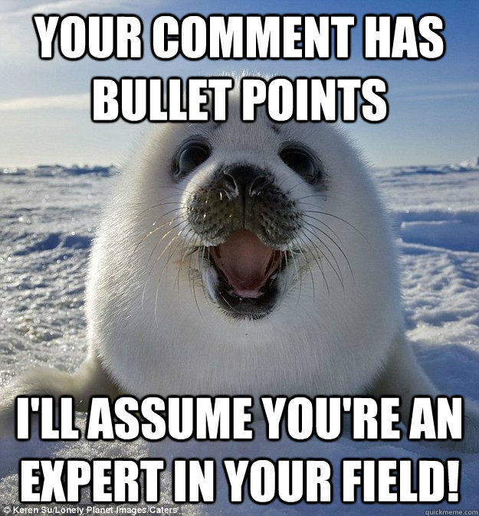
Home Learning: English
Grammar
Bullet points

Slide 2
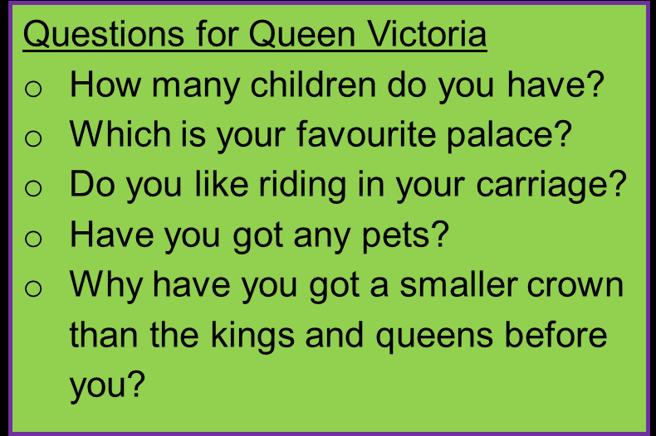
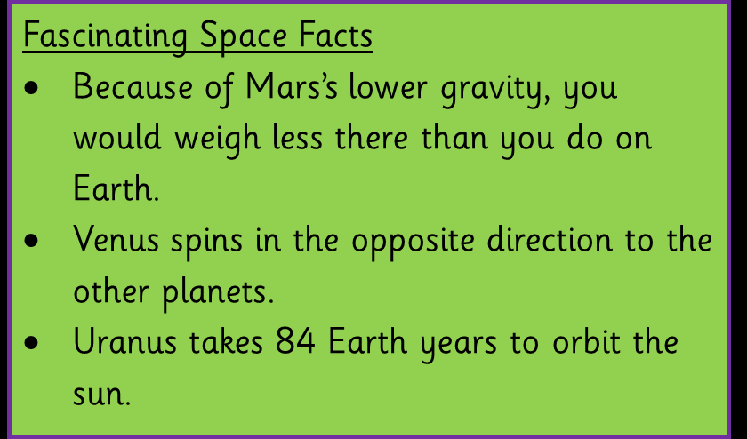
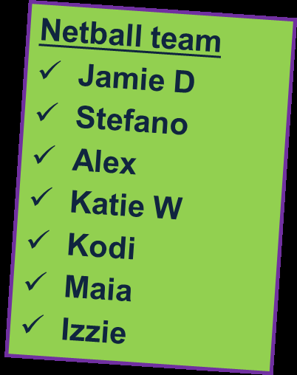
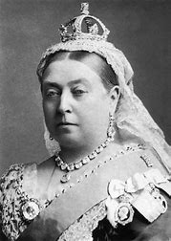
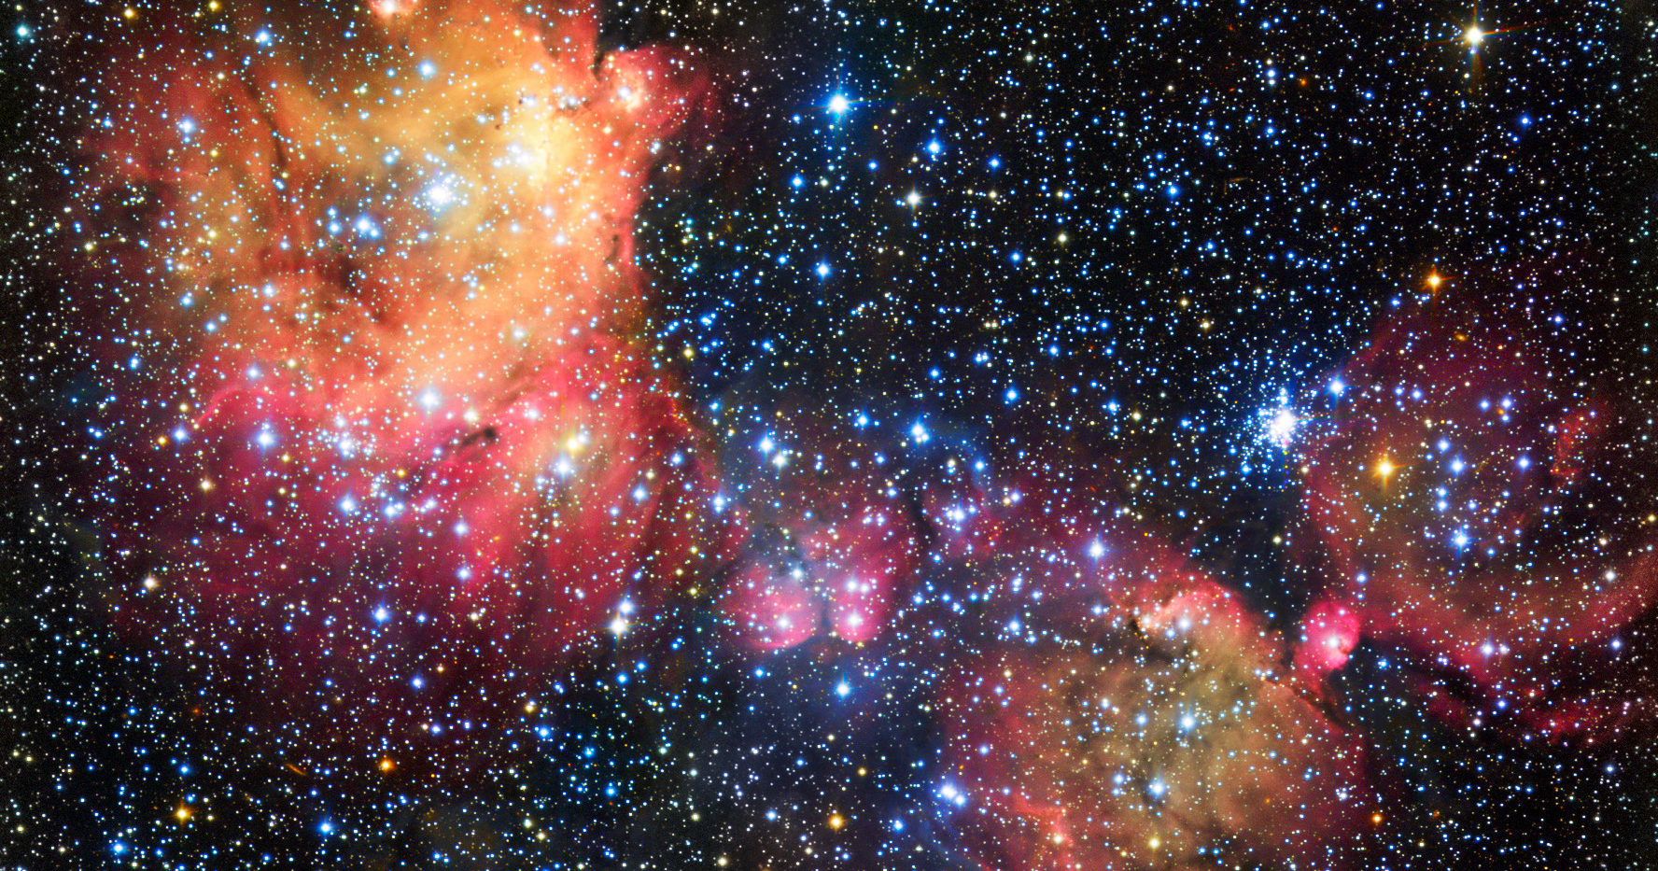
Why do we use them and where do we find them?

Slide 3
We use bullet points to separate items in a list. We use bullet points instead of numbers when the items do not go in a particular order.
Six largest countries in the world:
Russia;
Canda;
USA;
China;
Brazil;
Australia.
Questions for Mr Silvester
How old are you?
Do you have a dog?
What football team do you support?
Listing questions
Listing facts
Listing notes
Listing proper nouns
Fascinating Space Facts
Because of Mars’ lower gravity, you would weigh less there than you do on Earth.
Venus spins in the opposite direction to other planets.
Elephants
Biggest land mammals
Weigh more than car
Trunk = nose
Tusks = v long teeth

Slide 4
What’s the same? What’s different?
Six largest countries in the world:
Russia;
Canda;
USA;
China;
Brazil;
Australia.
Fascinating Space Facts
Because of Mars’ lower gravity, you would weigh less there than you do on Earth.
Venus spins in the opposite direction to other planets.
Same
Both have something at the start to explain what the list is about.
Both have punctuation.
Different
One uses a colon and the other is underlined.
The bullet points are different
One uses semi-colons and the other just full stops.

Slide 5
How do I do it?
Six largest countries in the world:
Russia;
Canda;
USA;
China;
Brazil;
Australia.
This is called a stem. If you have a list that expands/explains the stem, use a colon.
Be consistent with your bullet points. If you use a circle, use it for the whole list. Do not change from a circle to a star. This will look unprofessional.
Capital letters
If it is a proper noun, like Russia, use a capital letter as normal. If it is not a proper noun, you can choose whether to use a capital or not. However, be consistent.

Slide 6
How do I do it?
Six largest countries in the world:
Russia;
Canda;
USA;
China;
Brazil;
Australia.
Punctuation. After each item, you can use either a semi-colon, a full stop or nothing. However, be consistent. Usually, if it is a complete sentence, you will need a full stop.
At the end of the list, if you have used semi-colons throughout, make sure the last one is a full stop.
CONSIETNCY IS KEY! WHEN YOU HAVE USED A STYLE, STICK TO IT!

Slide 7
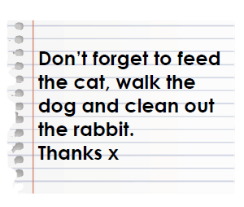
Check my example – what do you think?
The stem is fine.
Don’t forget to:
Feed the cat;
walk the dog.
Clean out the rabbit.
Thanks.
“Thanks” is not part of the list.
The punctuation at the end of each item is not consistent.
Can you try to fix this bullet point list?
There is no capital letter consistency.
Notes:
There are many words to successfully do this list. An example:
Don’t forget to:
. Feed the cat;
. Walk the dog;
. Clean out the rabbit.

Slide 8
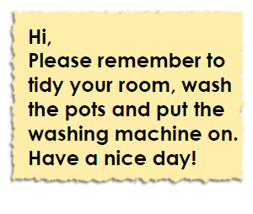
Can you turn these examples into a successful bullet point list?
Notes:
Again, this can be completed many ways. Check for consistency.
Example
Please remember to:
. Tidy your room.
. Wash the pots.
. Put the washing machine on.

Slide 9

Can you turn these examples into a successful bullet point list?
Notes:
Again, this can be completed many ways. Check for consistency.
Example
Changes in spring
. Trees blossom
. Birds feeding
. Bulbs flowering
. Baby animals being born

Slide 10

Can you turn these examples into a successful bullet point list?
Notes:
Again, this can be completed many ways. Check for consistency.
Example
Family jobs to share:
. Clean bathroom;
. Tidy bedrooms;
. Dust;
. Vacuum;
. Wash the cars;
. Fill and empty dishwasher.

Slide 11



Today’s task
Write three bullet point lists with the following subjects:
2) Things that you have done whilst being away from school.
3) What you are looking forward to when you come back to school.
1) What you are looking forward to for Year Six.

Slide 12
ANSWERS!
Remember- your answers can vary. Just be consistent!
Things I am looking forward to in year Six:
Going on school trips;
Maybe taking part in a residential;
Learning loads of cool new topics;
Preparing for Secondary School.
During lockdown, I have been:
Completing my home learning.
Helping out with the chores.
Spending time with my family.
What am I looking forward to?
Seeing my mates
Seeing my teachers
Doing fun science experiments

