Slide 1
The focus for reading this week is retrieval.
This is where we will find the information directly in the text.
Reggie ‘fishes’ for the answers and pulls it out.
Read the pages from the text attached. Then, carefully answer the questions. Remember to check your answers by scanning back through the text.

Slide 2
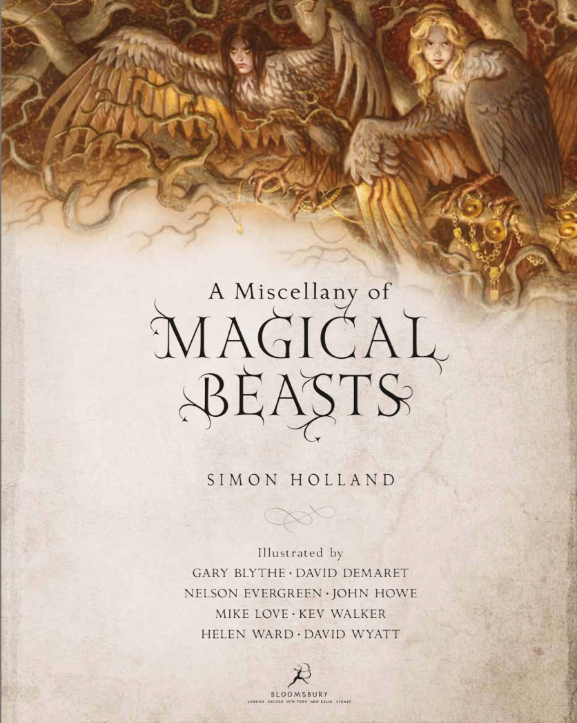
You will need to Ctrl + click the
Picture to download the text for today’s activity.
Notes:
https://www.worldbookday.com/resource/miscellany-magical-beasts/

Slide 3
A Miscellany of Magical Beasts
Look at ‘A World of Magical Beasts’. What two adjectives are used to describe the beasts in the opening sentence?
What is a centaur?
Look at the page ’The Phoenix’. What is Heliopolis?
The phoenix differs in appearance according to ancient Egyptian mythology and ancient Greek & Roman legends. Identify one animal it is compared to in Egyptian mythology and one animal it is compared to in Greek legends.
Look at the page ‘Giants’. What are the Asilky also known as? Circle one answer. Frost giants Russian giants Irish giants Scottish giants
According to the text, what causes the ground to shake?
Look at the page ‘Fearsome Giants’. Who causes Finn to shake with fear?
How does the Windigo travel without being seen?
Notes:
Normally the children would have the text printed in front of them or able to scan with their fingers directly. I would encourage the children to identify the key words in the question and understand what the question is asking them to do. Then, go back to the text and scan for those key words (sometimes synonyms could be used to test children’s knowledge).
E.g. The first question – We know it must be two words only with the first sentence so we only need to look at that sentence. What is an adjective? A describing word. What is this describing? The beasts. Therefore, it must be _____ and _____.
The answers can be found in the text or will be uploaded on Friday

