Slide 1
Year 5 Revision Negative Numbers
Week 7 Lesson 3 – Roman numerals recap

Slide 2
From this point ….
We have gone through each of the mathematics objectives in Year 5. It is important from this point that we make sure we consolidate what we have already learnt. So, from today’s lesson, we will be going back through all the lessons we have done this school year that we need to look back over.

Slide 3
Negative numbers

Slide 4
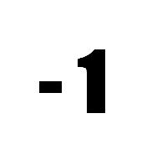
When might we need to use negative numbers?
Money
Temperature
Sea level

Slide 5
4 – 7 =
Question we have here is a subtraction. The first number is smaller than the second number this means that we are going to have an answer which is negative.
A number line is a great way to visually see how to answer the question.
-7
-3
0
4
From the number line you can see I have started on four and made 7 jumps backwards on the number line. You will notice I passed 0. Some children find it helpful with negative numbers to count back to 0 (in this case 4-4) then taking the additional amount (the other 3).

Slide 6
-4 – 6 =
You will notice that this sum already starts with a negative number (-4). Because we are subtracting, this means we will not be passing 0. When using a number line, we still use the same method.
- 6
-10
-4
We start by putting -4 on the number line. Then, we count back 6 times to reach -10.

Slide 7
Remember to
put the first number on the number
line.
count backwards until I reach the number that I am subtracting.
know that the difference is the gap between them.

