Slide 1
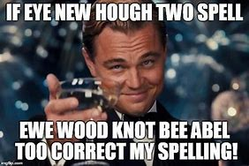
Home Learning: English
Thursday: Spelling

Slide 2
Today’s spelling focus is…
-cious and –tious
Can you think of any words with these endings?

Slide 3

Spacious
In this picture we can a lot of space in
the attic. We could describe the attic as
very spacious.
Space (noun) >>>>> Spacious (adjective)

Slide 4
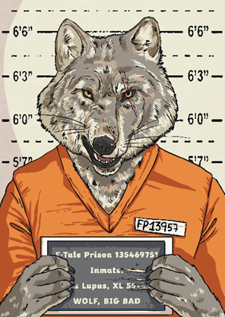
Malicious
The character we see in this picture has a lot of malice.
malice (noun) >>> malicious (adjective)

Slide 5
Malicious/Spacious
When the root word ends in -ce, we
need to remove these letters and add
the suffix -cious. It will change it from
a noun into an adjective.

Slide 6

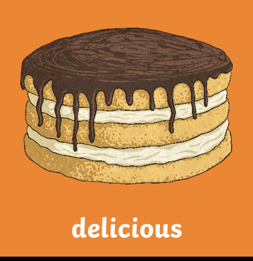

HOWEVER, sometimes adjectives end in the suffix -cious which don't follow the rule.
Price >>> Precious
Delight >>> Delicious
Fierce >>> Ferocious

Slide 7
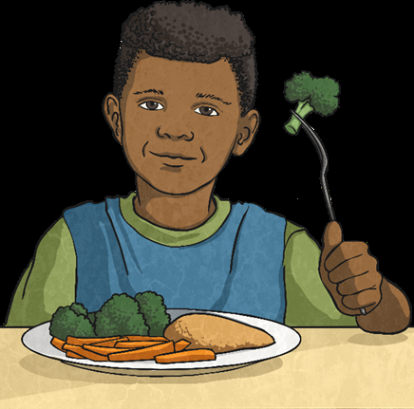
The suffix -tious
acts in a similar
way to -cious.
The food here is full of nutrition. We could describe it as very nutritious.
Nutrition (noun) >>>>> Nutritious (adjective)

Slide 8
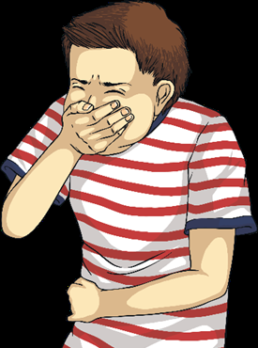
If the root word ends in -tion, remove
-tion and replace it with -tious.
Ambition >>>> Ambition >>>> Ambitious
The person here has got an infection. As the root word ends in -tion, we need to remove it and add -tious.
Infection >>>>>>>>>>>> Infectious

Slide 9
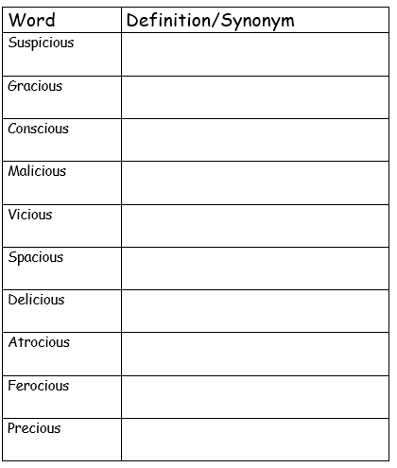
Create your own table and find a definition and a synonym for each of these –cious words.

Slide 10
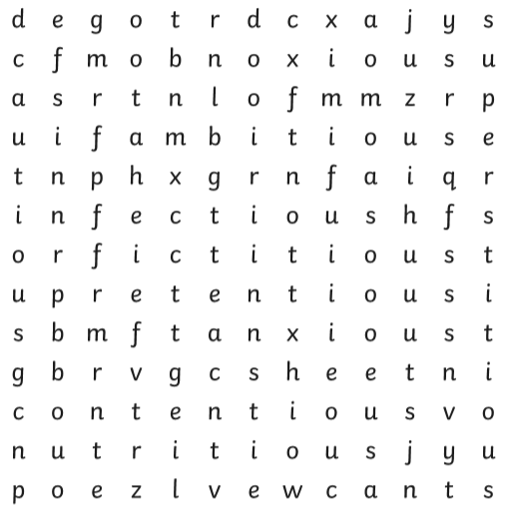
How many of the words with
–cious and -tious can you find?
Finished? Have a go at this game.
https://www.bbc.co.uk/bitesize/topics/zt62mnb/articles/zp7dk7h

Slide 11
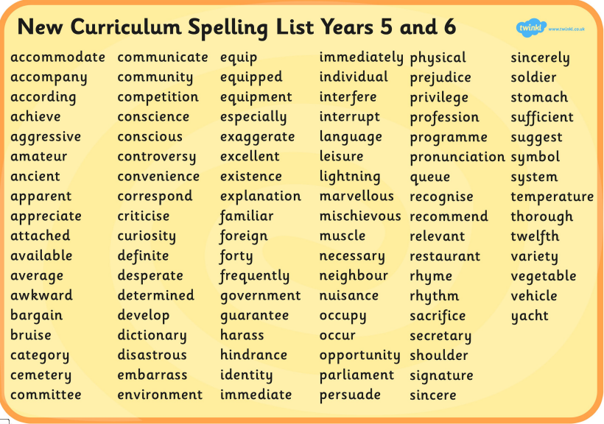
Don’t forget about your Year 5 and 6 Spellings.
Take 5 and make a mnemonic for each.
See my example below.
Silly
Yellow
Mangoes
Belong
On
Lemons

