Slide 1
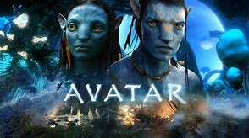
Home Learning: English
Wednesday: Writing

Slide 2
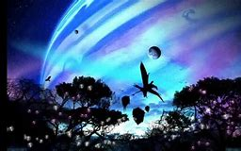
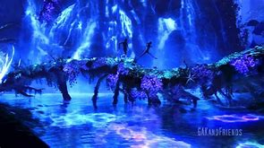
Today we will be writing our own non-chronological report on YOUR OWN PLANET.
Watch the clip from Avatar which discusses the planet that the film is set on: Pandora.

Slide 3
https://www.youtube.com/watch?v=GBGDmin_38E

Slide 4
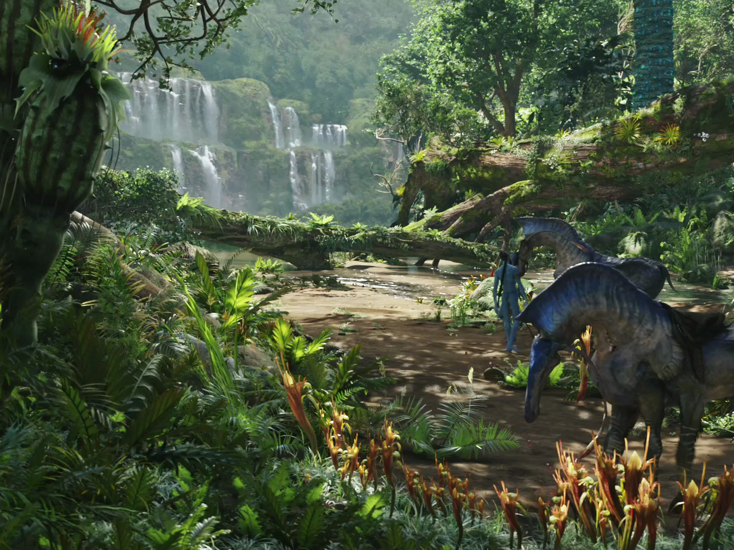
The World of Pandora
Re-watch the video and create a mind map for each of these sections:
That Mr Silvester loves a good mind map...
Location
Appearance
Day and Night
Animals
Human presence
... Especially if it’s done with sub-headings.

Slide 5
Location
Appearance
Pandora
Animals
Day and night
Human presence

Slide 6
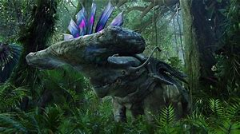
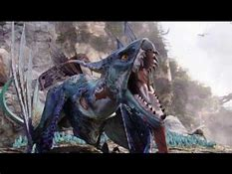
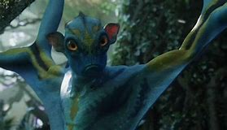
Some of the key animals mentioned
Polyphemus
Alpha Centauri
Na’vi
Mountain Banshee
Direhorse
Thanator
The Great Leanoptrex – King of the Sky
Thickskinned Hammerhead Tythanasaurs
You can find out loads more information about Pandora using the following link:
https://james-camerons-avatar.fandom.com/wiki/Pandora

Slide 7
Optional step: create your own mind map on YOUR OWN MADE UP PLANET.
You can use this to write your report or you can use your mind map on Pandora.
Location
Appearance
Animals
Day and night
Human presence

Slide 8
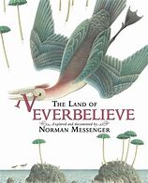
So…how do we write a non-chronological report?
Example
Having read The Land of Neverbelieve, pupils created models of their own fantastical landscapes. They acted out a journey through their imaginary land and then used their ideas to write an information text.

Slide 9
Read it on your own first.
Is it interesting?
How is it set out?
What grammar/vocabulary techniques are used?
Sentence structures and vocabulary?
Most importantly: is it fit for purpose?

Slide 10
The pupil can write effectively for a range of purposes and audiences, selecting language that shows good awareness of the reader.
The information text takes the reader on a journey through an imaginary land. Noun phrases are strong and vocabulary choices show a good awareness of the reader.
Select vocabulary and grammar to reflect what the writing needs.
There is some variation of sentence structure (although they are usually subject led). Subordinate clauses help to clarify points. There are some examples of multi clause sentences.
Vocabulary supports the purpose of the writing. Sometimes this is unambitious (big fan, very large snake, big body, big creatures).

Slide 11
Use a range of devices to build cohesion.
Cohesion is used mostly through pronouns , determiners and synonyms.
Range of punctuation.
Commas for fronted adverbials and clauses.
Brackets for parenthesis.
Colons in a list.
Hyphens to avoid ambiguity.

Slide 12
Use your mind map as a guide to help you write.
As well as these points, try to fit in some relative clauses from yesterday’s lesson so long as they are
impactful.

Slide 13
An example introduction for Pandora
Pandora is a mysterious world of wonder and beauty. It is filled with mythical things from day and night, no matter which way you look at it, it is gorgeous. Pandora is one of the many moons orbiting the planet Polyphemus. If you take one breath from the toxic atmosphere in Pandora, it can suffocate you in seconds. There is beauty in everything, even the most frightening things. In this report, you will discover many of the strange, bewitching things about Pandora, including the animals that inhabit it, its landscape, day and night on Pandora and finally the human presence.
Next, I would use my mind map to create sub-headings for each section: location, animals etc.

Slide 14
Title
Introduction
Sub-heading and paragraph 1
Pictures and Year Six grammar throughout, including:
Bullet point lists, sub-headings, subject-specific words, relative clauses, semi-colons etc.
Sub-heading and paragraph 3
Sub-heading and paragraph 2

