Slide 1
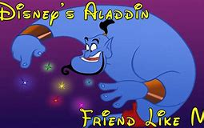
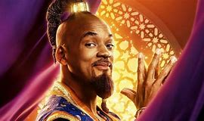
Home Learning: English
Monday: Reading

Slide 2
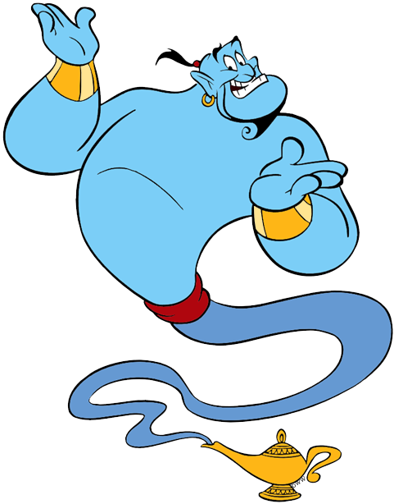
Background Information
"Friend Like Me" is a song from the 1992 Disney film Aladdin. It was performed by Robin
Williams in his role as the Genie. The song was nominated for the Academy Award for Best
Original Song at the 65th Academy Awards and the Golden Globe Award for Best Original
Song at the 50th Golden Globe Awards in 1993.
After Aladdin releases the Genie from his lamp and the Genie explains that he can give
Aladdin almost anything within a limit of three wishes, the Genie proves his
nigh-omnipotent power to the sceptical thief with an impressive musical number, stressing
that he is a friend unlike any other.

Slide 3
https://www.youtube.com/watch?v=R8rnMc22AG8
https://www.youtube.com/watch?v=1at7kKzBYxI
This is the Will Smith version – lyrics differ slightly

Slide 4
Aladdin - Friend Like Me
Well, Ali Baba had them forty thieves
Sheherezade had a thousand tales
But, master, you’re in luck 'cause up your sleeves
You got a brand of magic never fails
You got some power in your corner now
Some heavy ammunition in your camp
You got some punch, pizazz, yahoo and how
All you gotta do is rub that lamp
And I'll say Mister Aladdin, sir
What will your pleasure be?
Let me take your order
Jot it down
You ain't never had a friend like me
No no no
Life is your restaurant
And I'm your maître d'
C'mon whisper what it is you want
You ain't never had a friend like me
Yes sir, we pride ourselves on service
You're the boss, the king, the shah
Say what you wish, it's yours!
True dish, how about a little more baklava?
Have some of column A

Slide 5
Try all of column B
I'm in the mood to help you dude!
You ain't never had a friend like me
Can your friends do this?
Can your friends do that?
Can your friends pull this out their little
hat?
Can you friends go, poof!
Can your friends go "Abracadabra," let 'er
rip
And then make the sucker disappear
So don't ya sit there slack-jawed,
buggy-eyed
I'm here to answer all your midday prayers
You got me bona fide and certified
You got a genie for your charge d'affaires
I got a powerful urge to help you out
So whatcha wish? I really wanna know
You got a list that's three miles long, no
doubt
Well, all you gotta do is rub like so oh oh
Mister Aladdin, sir, have a wish or two or
three
I'm on the job, you big nabob
You ain't never had a friend, never had a
friend
You ain't never had a friend, never had a
friend

Slide 6
Why does the genie talk about magic being up your sleeves?
What do you think this “power” the genie talks about is?
What does the genie mean by “in your corner”?
What is the genie trying to prove to Aladdin in this verse?

Slide 7
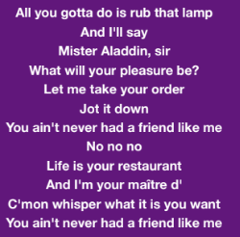
5) How do you know that Aladdin is the Genie’s master?
6) The genie uses the metaphor of life being like a restaurant. What does he mean by this?

Slide 8
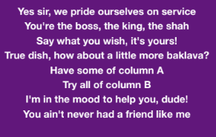
7) Why does the genie use the pronoun “ourselves”?
8) Which word most closely matches “shah”?
Leader
Servant
Referee
Human

Slide 9
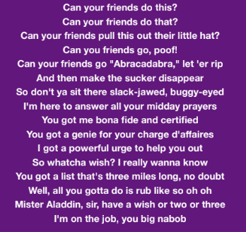
9) What emotion would you be feeling if you were “slack-jawed” and “buggy-eyed”?
Surprised
Sad
Scared
Happy
What does “bona fide” mean?
11) Why does the genie think Aladdin will have a long list?

Slide 10
ANSWERS
Why does the genie talk about magic being up your sleeves?
This means that you have a secret plan or idea. It is called an idiom.
2) What do you think this “power” the genie talks about is?
The power is the wishes that the genie can provide.
3) What does the genie mean by “in your corner”?
In boxing, each boxer has their own team in a corner. It means that he is going to provide support for him or coach him.
4) What is the genie trying to prove to Aladdin in this verse?
The genie is trying to prove how valuable he can be to Aladdin.

Slide 11
ANSWERS
5) How do you know that Aladdin is the Genie’s master?
He calls him sir and acts like a waiter.
6) The genie uses the metaphor of life being like a restaurant. What does he mean by this?
When you go to a restaurant, you are given a menu that you can choose from. The genie is trying to say that Aladdin can have anything he wants.
7) Why does the genie use the pronoun “ourselves”?
He is referring to himself and the magic carpet.
8) Which word most closely matches “shah”?
Leader – “shah” is a title given to the emperors, kings, princes and lords of Iran.

Slide 12
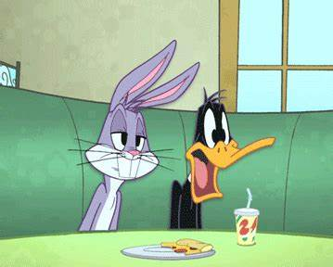
ANSWERS
9) What emotion would you be feeling if you were “slack-jawed” and “buggy-eyed”?
Surprised – like when a character drops their jaw
and stares with their eyes wide open.
What does “bona fide” mean?
It means genuine and real.
11) Why does the genie think Aladdin will have a long list?
Maybe because all of his masters did and they were greedy. Also, he can tell that Aladdin doesn’t have much at the moment.

